Slide 1
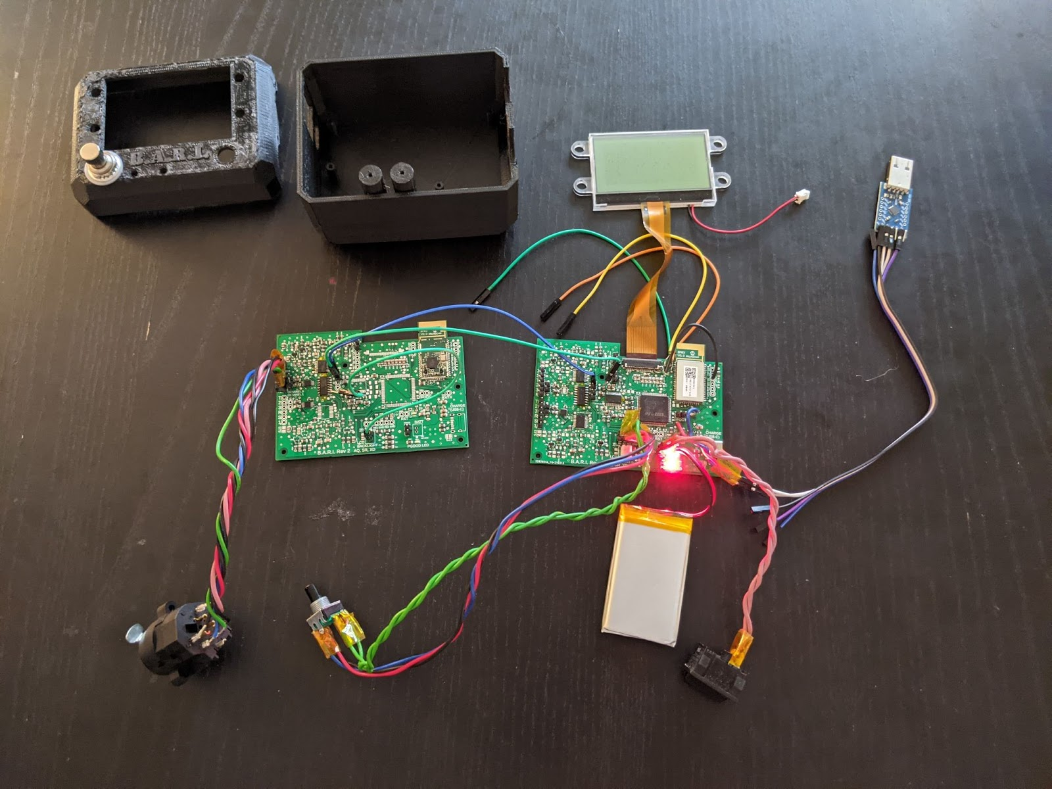
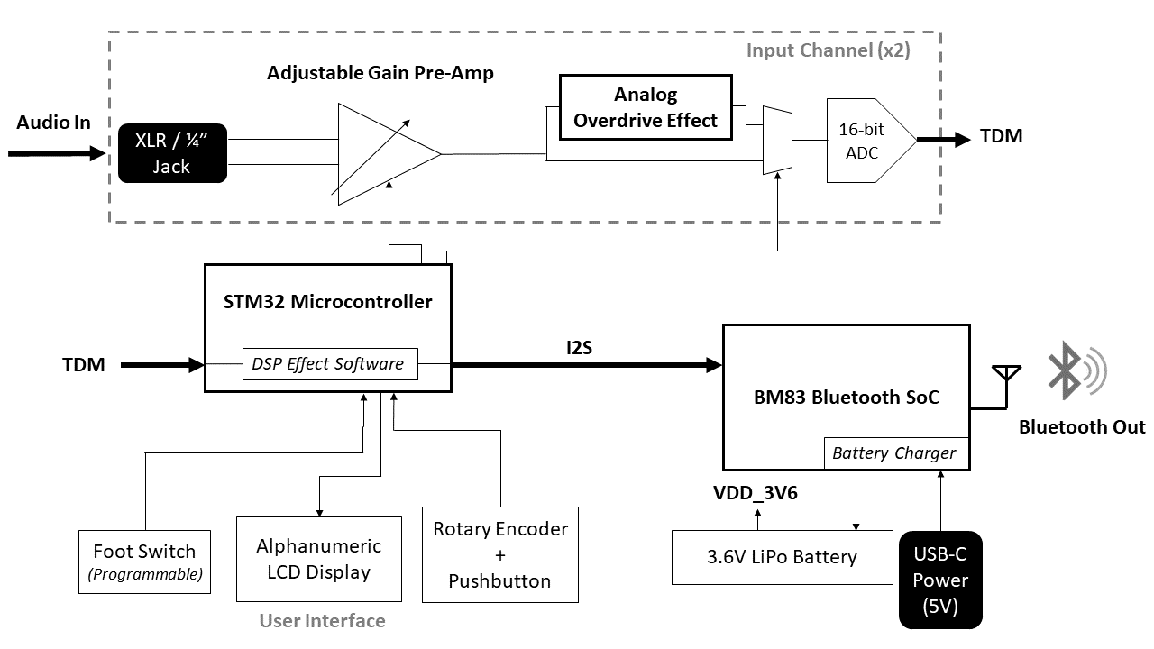
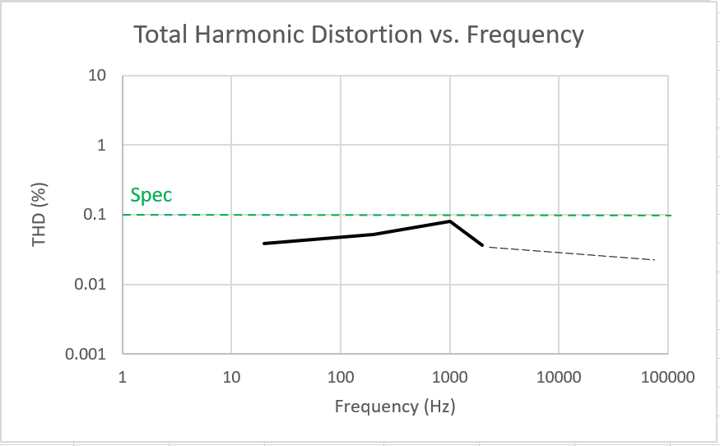
The Bluetooth Audio Rejiggering Instrument (B.A.R.I.)
Team D0: Adam Quinn, Xingran Du, Sam Rainey
Product Pitch
System Description
B.A.R.I. is a Bluetooth-enabled audio effects pedal, the first of its kind. With a low price point (< $100 at volume), small form factor, and the ability to connect to any standard Bluetooth speaker, B.A.R.I. enables casual musicians to easily jam with their friends or practice anywhere, without having to buy (and lug around!) bulky audio equipment.
Despite its accessible price point, B.A.R.I. is the only effects unit to offer Bluetooth compatibility, and is highly capable, featuring not only both true-analog and digital audio effects but also dual input channels. B.A.R.I. accepts input from either microphone (XLR) or instrument (1/4”) cables to the same audio channel, enabling a wide range of use cases.
B.A.R.I - Product Photo
B.A.R.I - Components View
LCD Display
LCD Display
USB Connector
to Bluetooth Module
XLR/1/4”
Inputs
Bluetooth
Module
System Architecture
System Block Diagram
Footswitch
Rotary Encoder w/ Button
Pre-amplifier Circuit
(*prototype version only)
Battery
Main Board
Power Switch
System Evaluation
Key Specifications
Preamplifier Distortion
Metric | Result | Pass | Subsystem
Response Latency | ~50ms | ✓ | UI
State Update Time | ~200ms | ✓ | UI
Processing Latency | 1.3ms | ✓ | Microcontroller
Bluetooth Range | 6m | ✓ | RF Module
Effects Implemented | Overdrive, Delay, EQ | ✓ | Analog and Digital Effects
Max Current Draw | 150 mA | ✓ | Power
Est. Battery Life | 10 hrs | ✓ | Power
(not to exceed)

