Slide 1
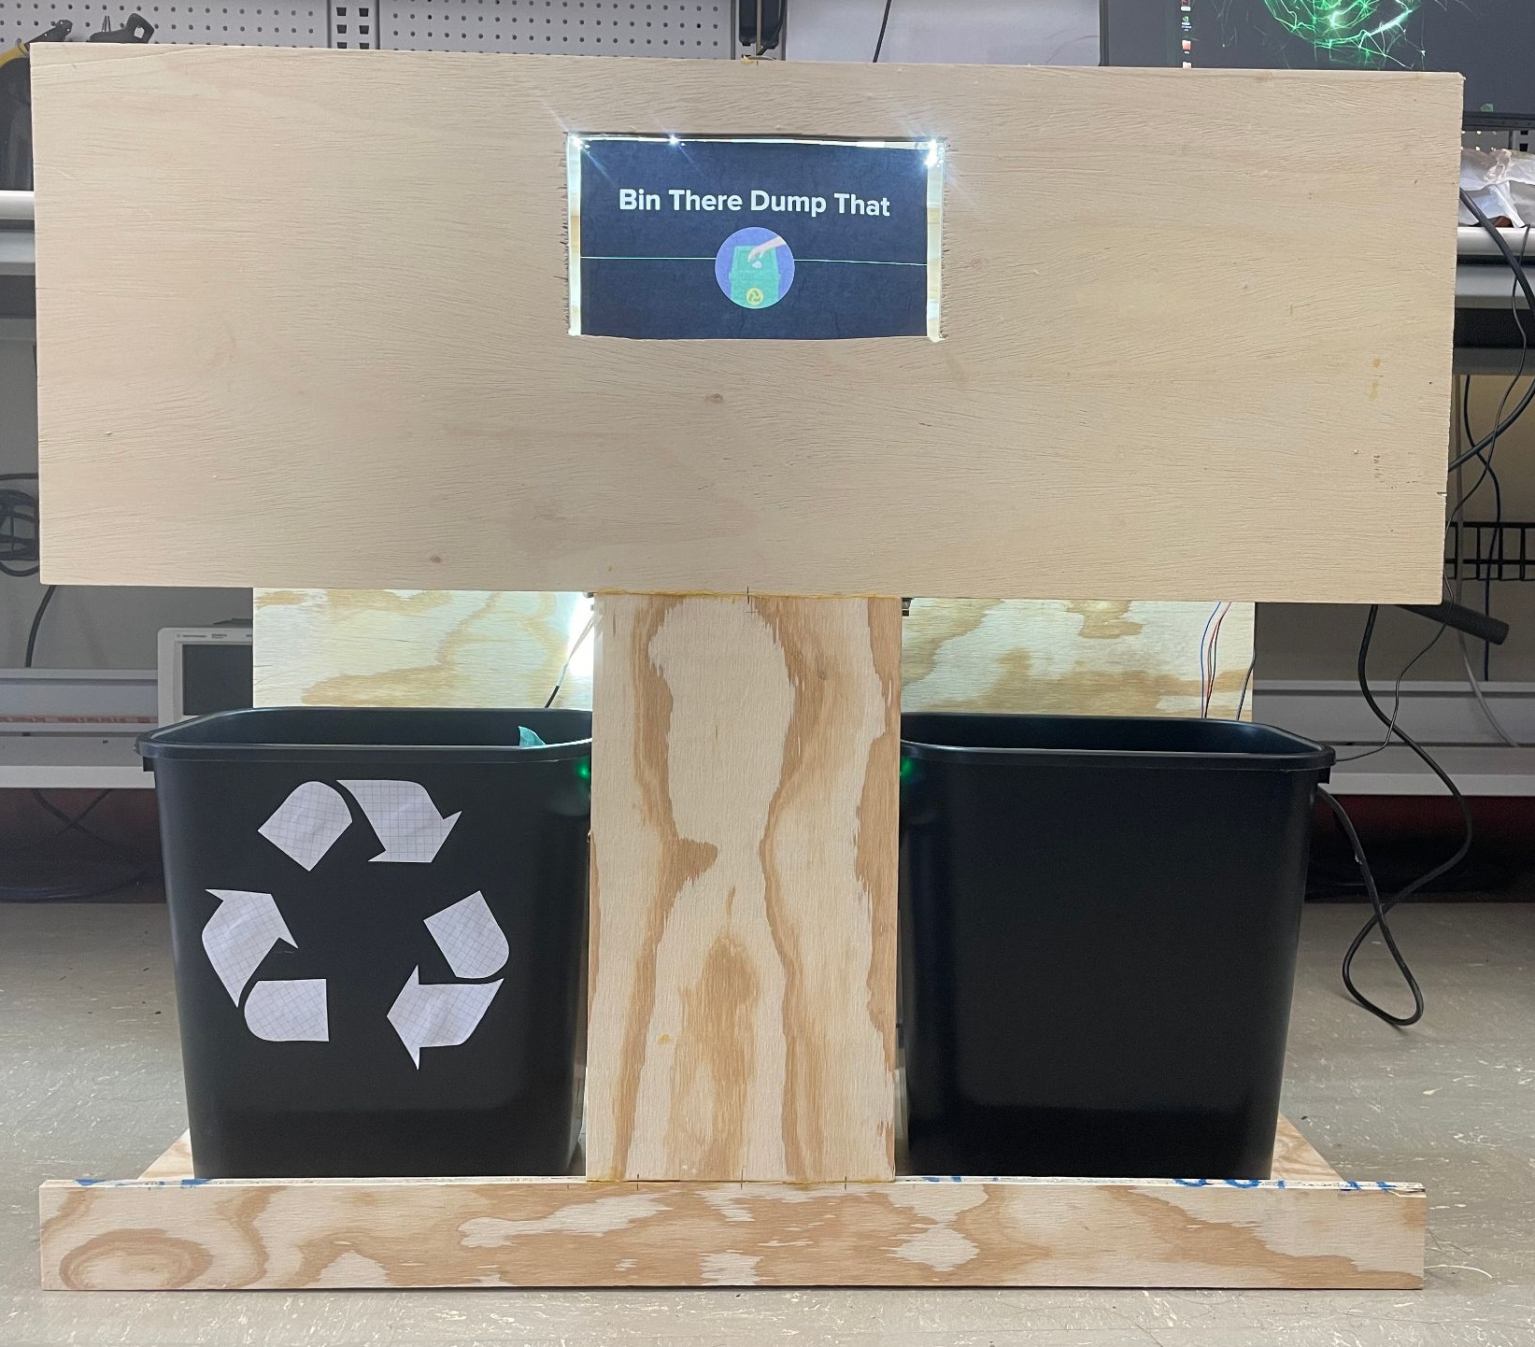
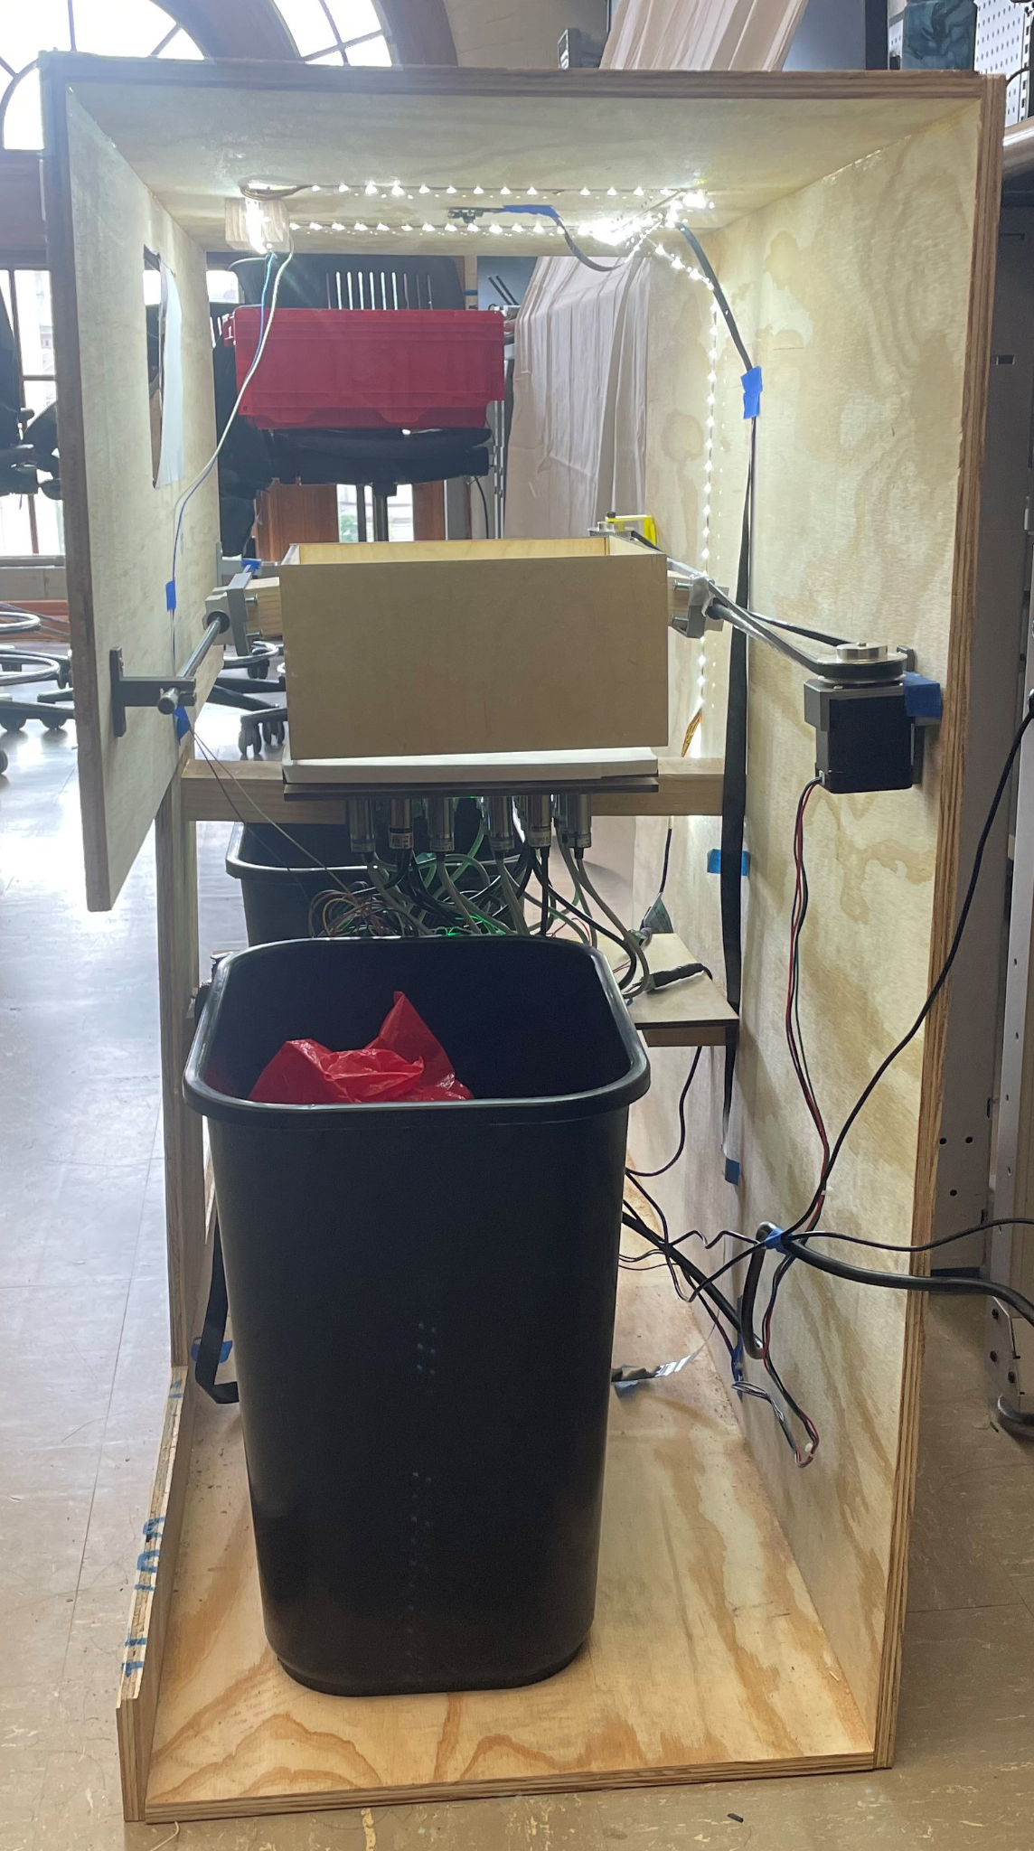
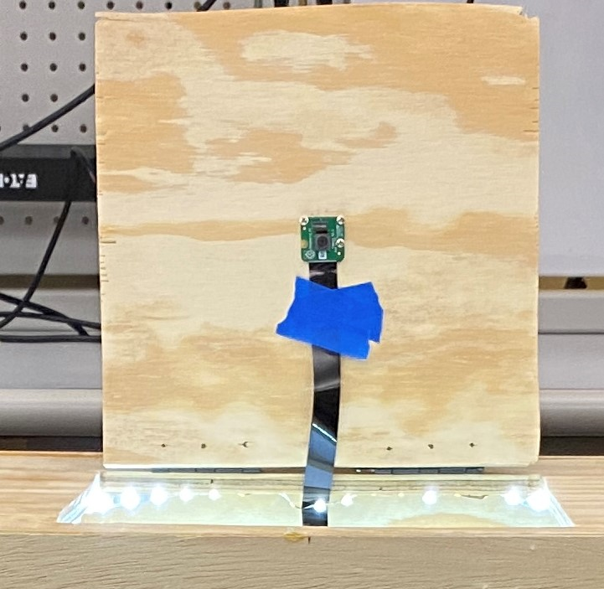
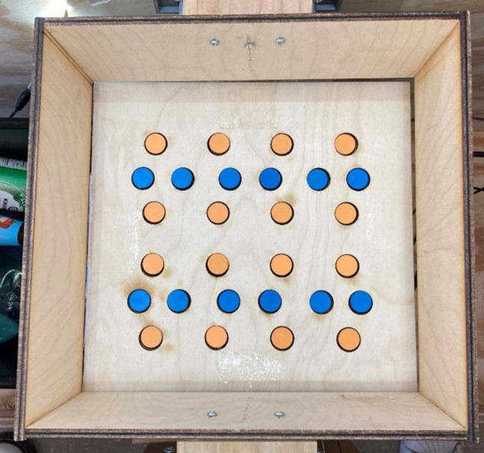
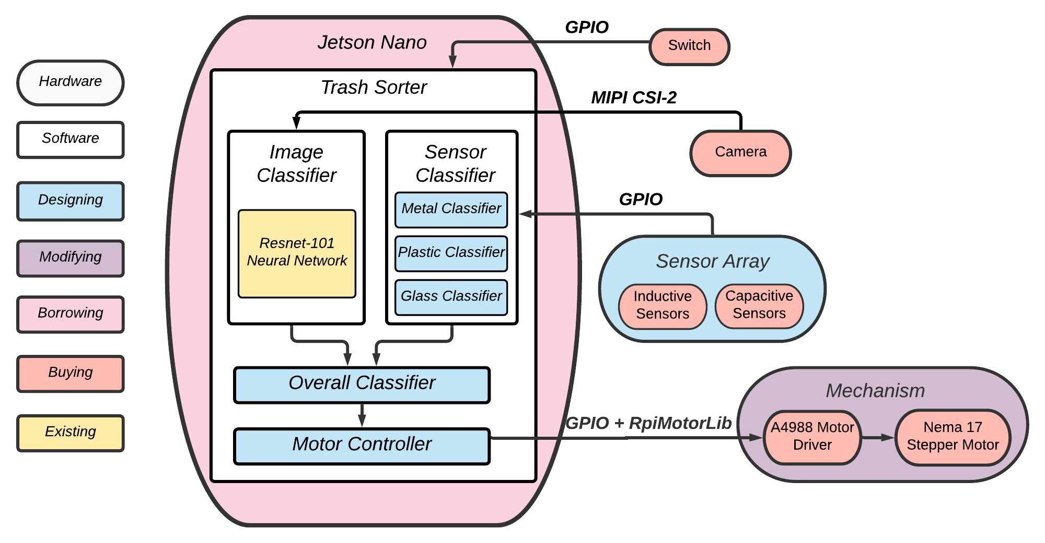
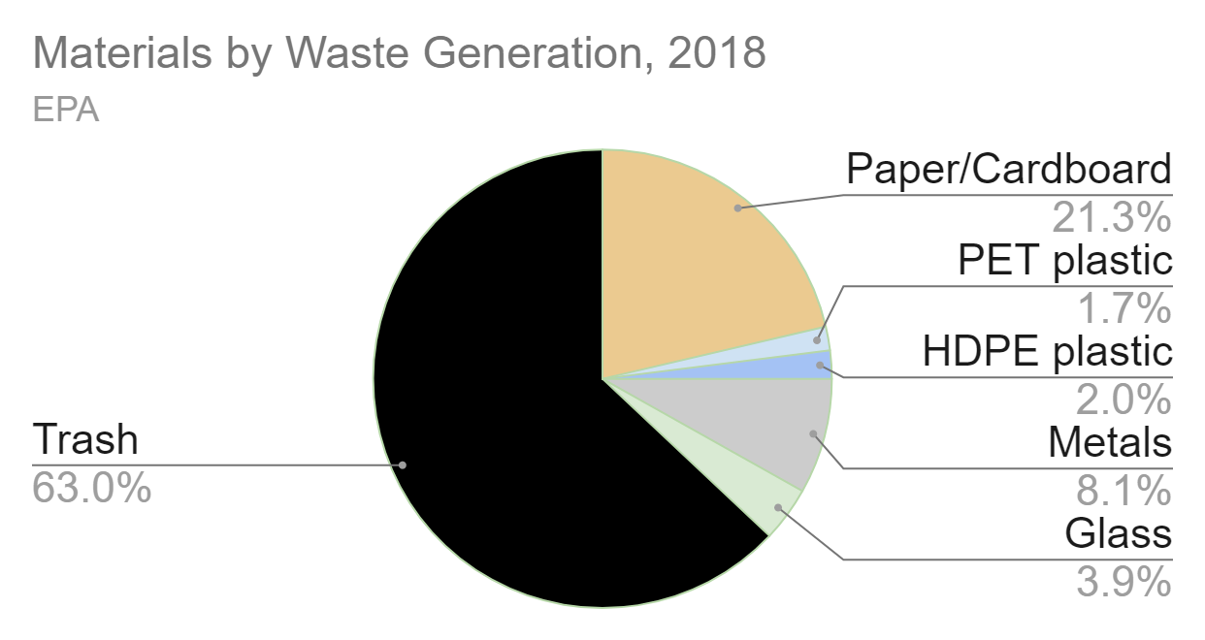
Bin There Dump That
Team C6: Jessica Lew, Lauren Tan, Tate Arevalo
Product Pitch
System Description
Our automatic trash sorter will be able to put items into one of two categories: recyclables and non-recyclables. Users won’t have to think about how to sort their trash; our sorter will do it for them! Users will be able to insert items one-by-one into our sorting platform and can watch it automatically move items into the correct bin. We aim to improve recycling accuracy rates and decrease recycling contamination rates on CMU’s campus. We used a camera and 28 sensors to distinguish between different types of recyclables and trash. Our goals included 90% accuracy in sorting objects, each under a second, and we ultimately achieved 90.6% accuracy in sorting objects, each under 3 seconds.
Camera
Mechanism
Sensor Array
System Architecture
Inductive
Sensor
System Block Diagram
Capacitive
Sensor
System Evaluation
Classifier Accuracies by Material
Goals
Material | Sensor | Image | Overall
Plastic | 79.6 | 42.7 | 89.8
Metal | 96 | 82 | 98
Glass | 76 | 90 | 96
Paper/Cardboard | 52.2 | 84.8 | 91.6
Recyclables | 67.1 | 80.6 | 93.4
Trash | 92 | 96 | 89
Overall | 67.1 | 80.6 | 90.6
 | Metric | Results
Mechanism Accuracy | 99% | 100%
Classifier Accuracy | 90% | 90.6%
Latency | < 1 s | < 2.78 s Classifiers: 0.117 s Mechanism: 2.66 s
50 trials/material for sensor, image classifiers
100 trials/material for overall classifier

