Slide 1
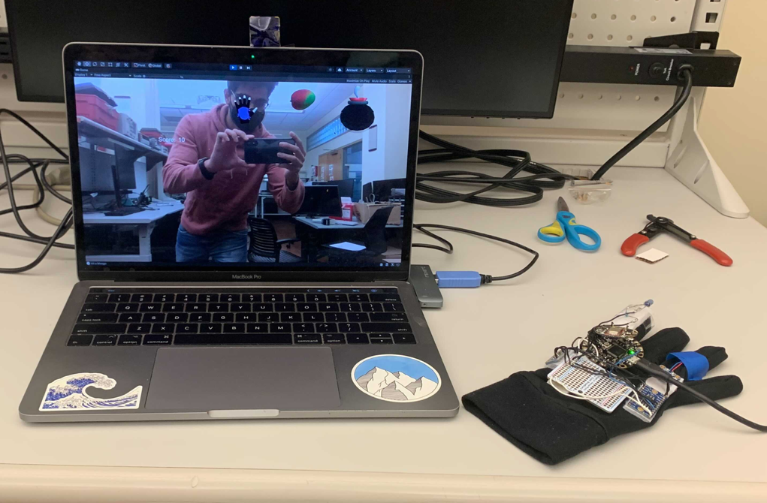
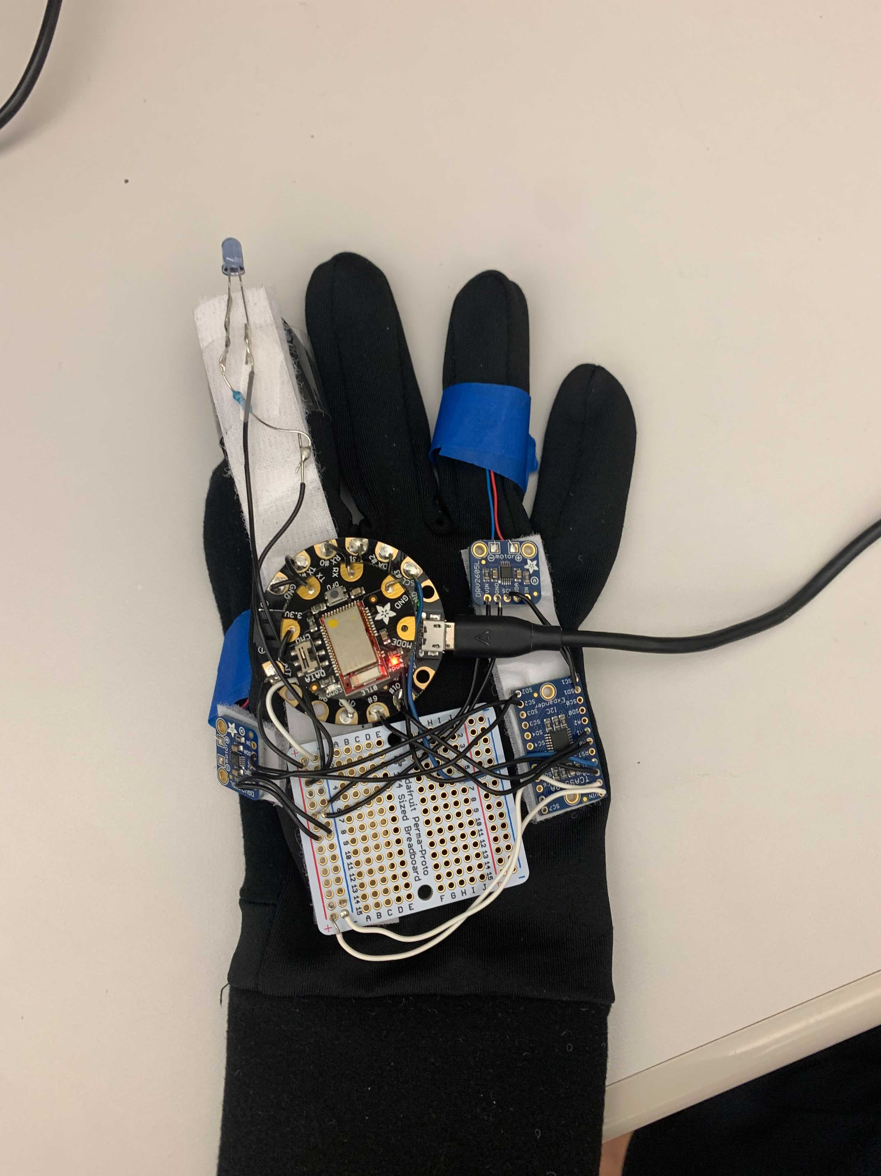
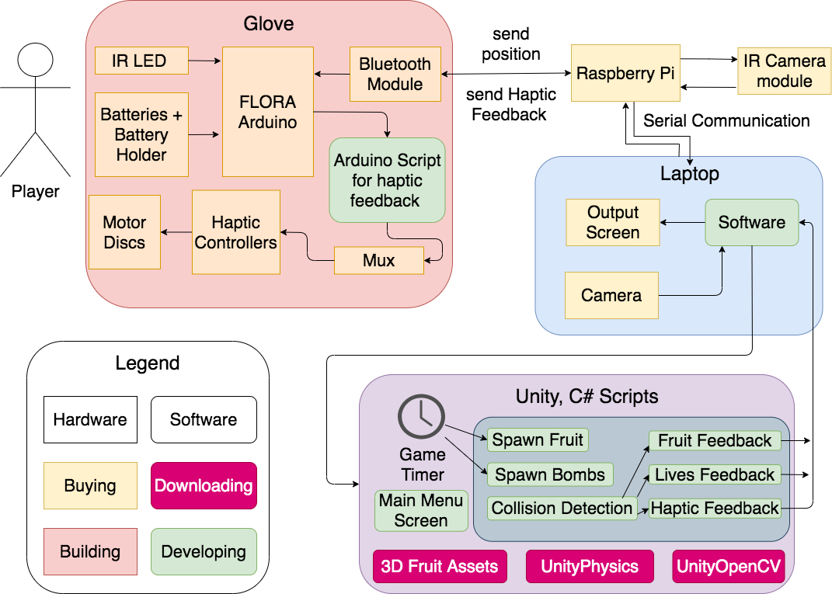
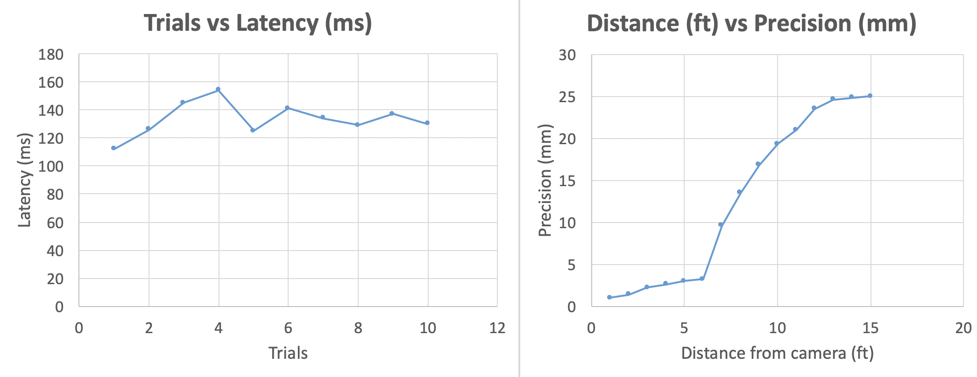
FruitNinjaAR
Team C5: Arthur Micha, Ishaan Jaffer, Logan Snow
Product Pitch
System Description
The use of Augmented Reality(AR) systems has become exponentially popular in recent years. The human- environment interaction methods have become increasingly expensive and existing controllers are clunky objects that need to be held. FruitNinjaAR is a wearable glove and AR Game environment with haptic feedback. Our design consists of Infrared LEDs, image processing, a RaspberryPi, a wearable Arduino, infrared Camera and Unity Game environment. Our system has an average glove-environment latency of 133ms and minimum precision of 25mm when played from distances up to 15 feet away.
Overall System
Zoomed-in subsystem: Glove
IR camera
RaspberryPi (behind laptop)
IR LED
FLORA
Arduino
System Architecture
Haptic
Feedback
FruitNinjaAR Block Diagram
Unity game
Glove
System Evaluation
Latency averaged 133ms across 10 trials. Precision was 5mm – 25mm in our optimal system interaction area.

