Slide 1
Magic Mice
Bradley, Jenny, Jade

Slide 2
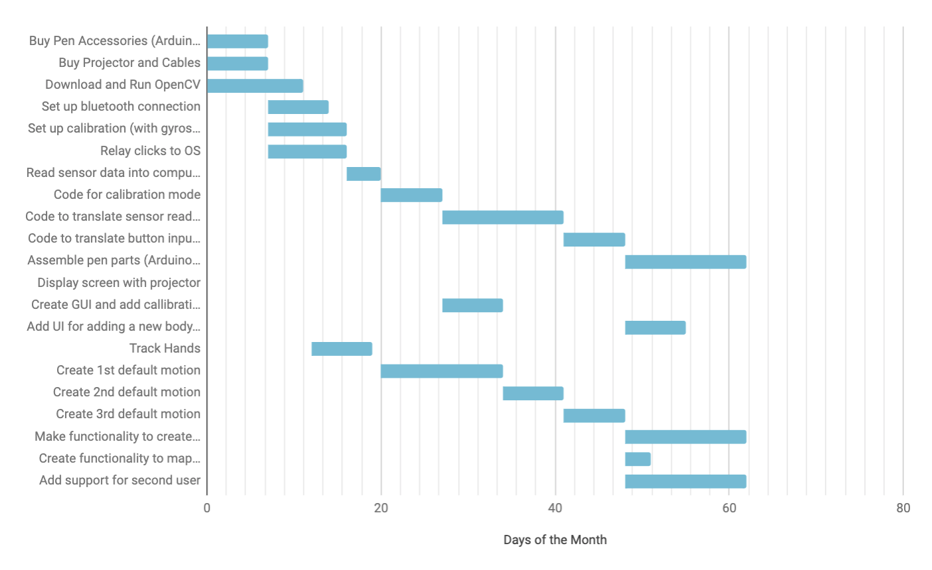
Project Management: Schedule

Slide 3
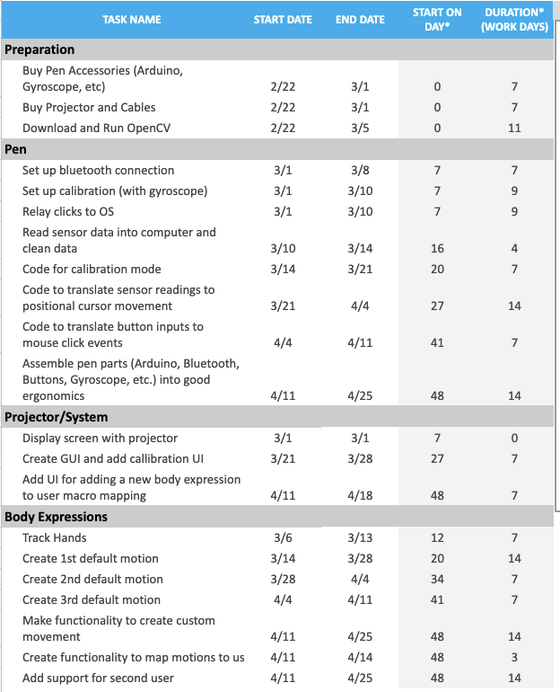

Slide 4
What we have done
Pen Tracking
Tried a few IMUs
Linked to mouse movement on computer
Added Kalman Filter + calibration + calculated distance by integration
Gesture Recognition
Isolated hand in frame
Trained model
Tracks 4 default gestures: Open, Fist, Thumbs-Up, Thumbs-Down
Gestures linked to user macros
Open: Command + t
Fist: Command + w
Thumbs-Up: Command + →
Thumbs-Down: Command + ←
Add custom gestures

Slide 7
Demo: Hand Gesture Recognition

Slide 8
Demo: New Hand Gesture

Slide 9
Demo: Pen Tracking

Slide 10
Next Steps
Pen Tracking
Increase accuracy of pen tracking (add openCV component with laser or object tracking)
Relay clicks to computer
New IMU
Pen Clicks
Gesture Recognition
Automate adding new gestures
Projector
Finish GUI (Tkinter)
Calibration page
Update Gestures

Slide 11
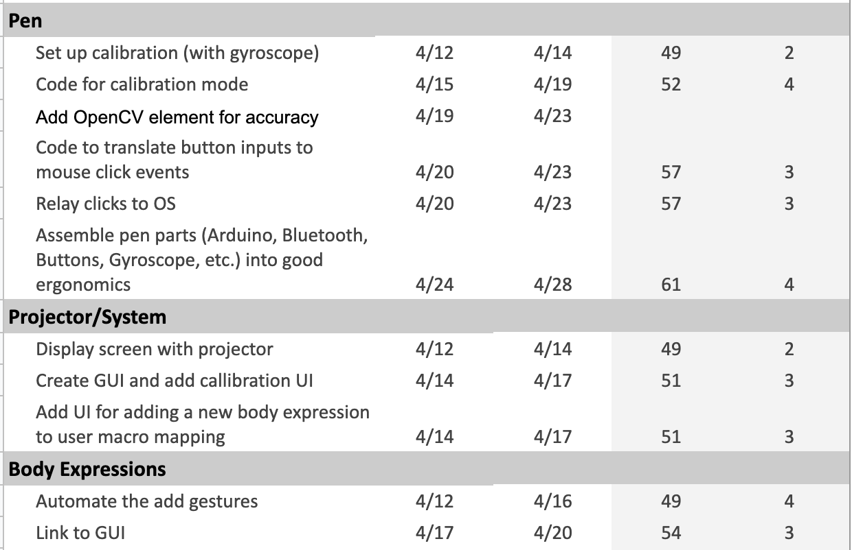

Slide 12
