Slide 1
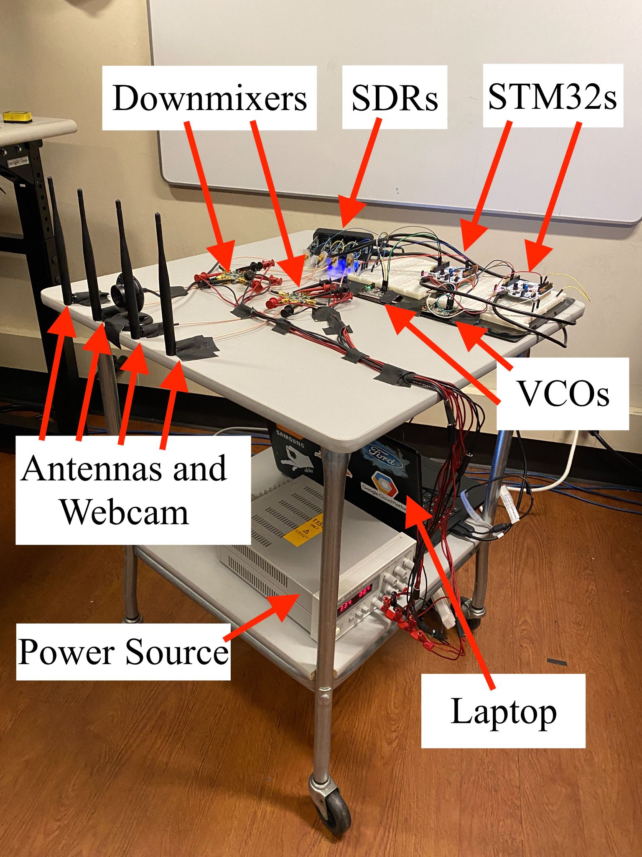
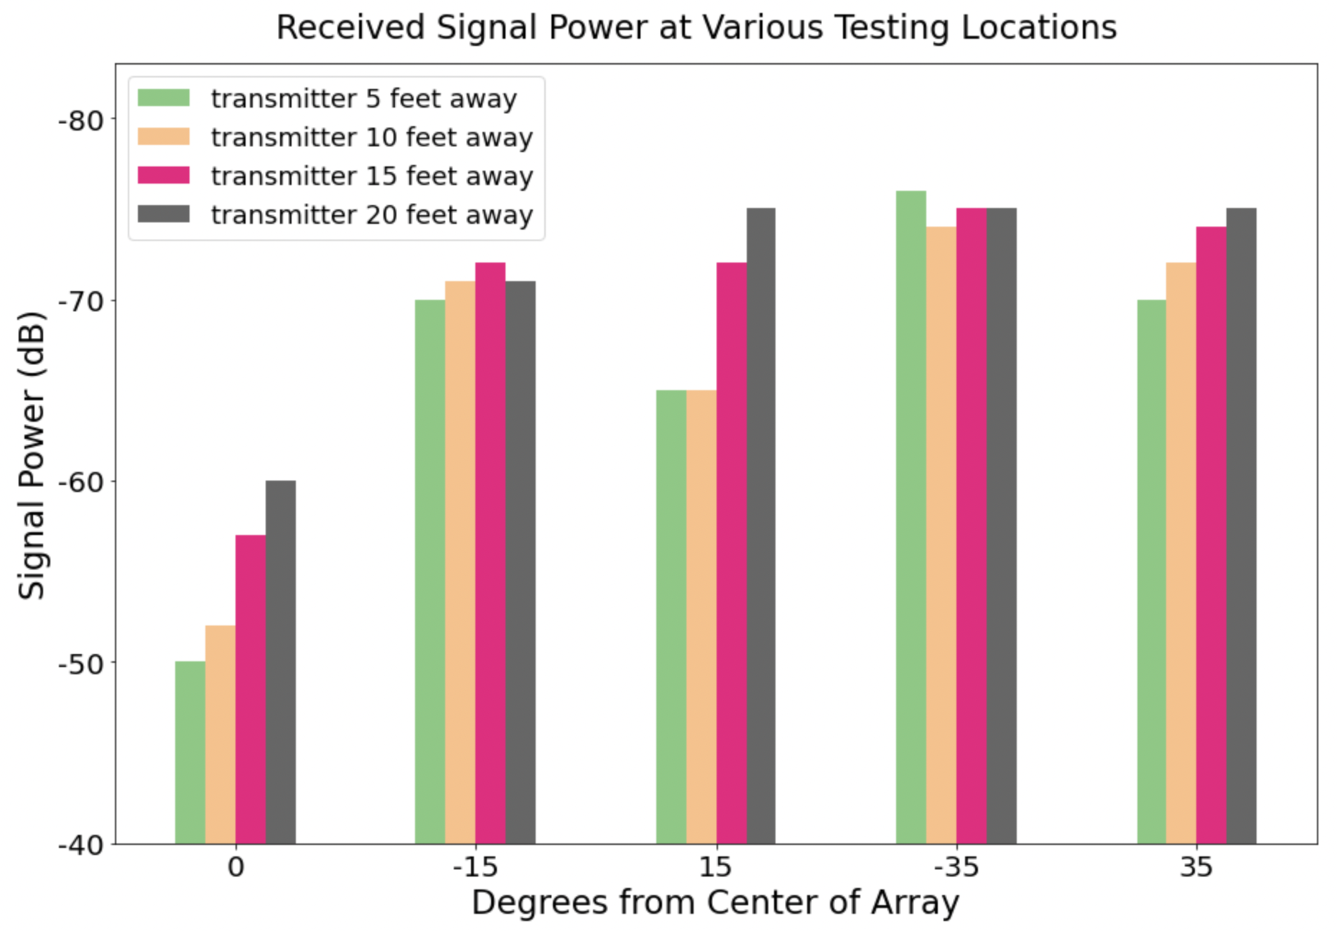
WiFi Localization
Team C2: Txanton Bejos, Vrishab Commuri, Enock Maburi
Product Pitch
System Description
In many situations it is pertinent to be able to identify the locations of devices that may be transmitting data over WiFi. This need can be seen in areas of security when sweeping a room such as locating devices that should not be connected to a network. In order for our product to be viable it has to have good detection from a room sized distance. As such we decided that approximately 15-20 feet would be a realistic distance for us to go for. We also need to be able to detect devices within a reasonable field of view of the camera, in order to have good directionality we chose antennas with a lobe width of 30 degrees. Overall, our system was able to measure signal strength with an accuracy of about 80% between the expected and measured values.
For our overall system we built it on top of a moving cart, this allowed us to quickly make our system mobile without needing to prototype and manufacture an enclosure. Unfortunately due to time constraints we were limited to using a bench power supply meaning our range of motion was still limited by the length of the cable, however we feel this was a good proof of concept.
Our system made use of many evaluation boards, this was to keep the prototyping time down, however added additional cost that limited the overall effectiveness of our system. If we revisited this project we think it would be more effective to spend ample time designing custom PCBs with all the necessary components as this would significantly reduce the cost of the overall system. This would allow us to make use of more antennas and spend the savings on better software defined radios.
System Architecture
Here is a block diagram outlining our final system. It is made up of antennas that connect to a downconverting mixer. As a reference frequency for the mixer we have a voltage controlled oscillator that is configured using an STM32. The intermittent frequencies are then fed from the mixer into a software defined radio that is connected to a laptop over USB to process the data.
Figure 2: Picture of our final system
System Evaluation
Plot 1: signal power in decibels averaged over 50 trials at each location. Lower is better.
Each trial 15 seconds duration (sampled at 2 * 10^6 samples/sec)
System is roughly 80% accurate
0° is in the middle of the main lobe, so power is high
15° is right at the edge of the main lobe, so power fluctuates
35° is outside the main lobe, so power is low
Figure 1: Block Diagram
Figure 3: Test Results

