Slide 1
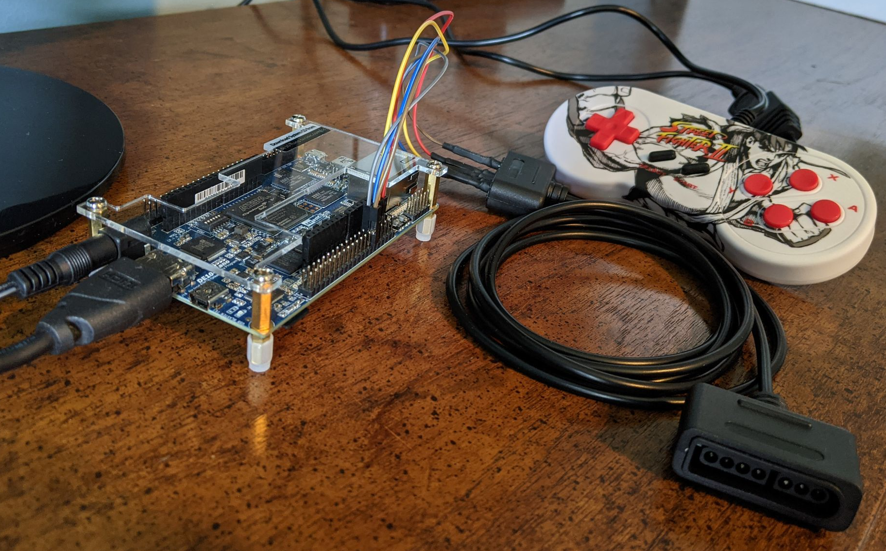
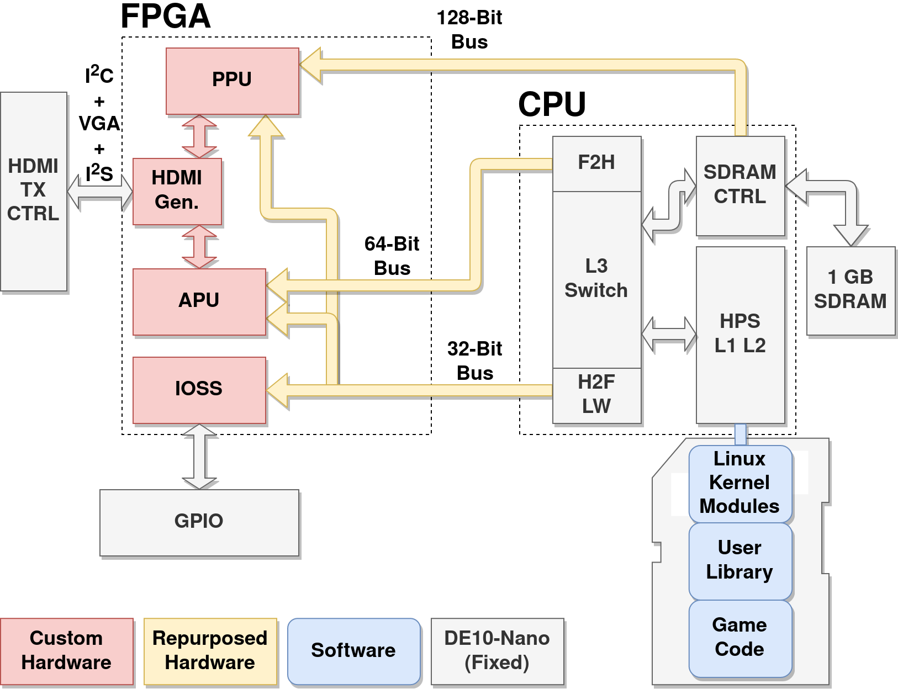
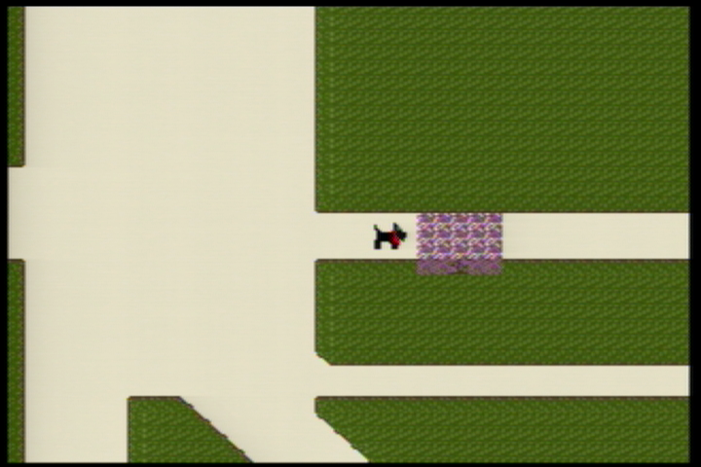
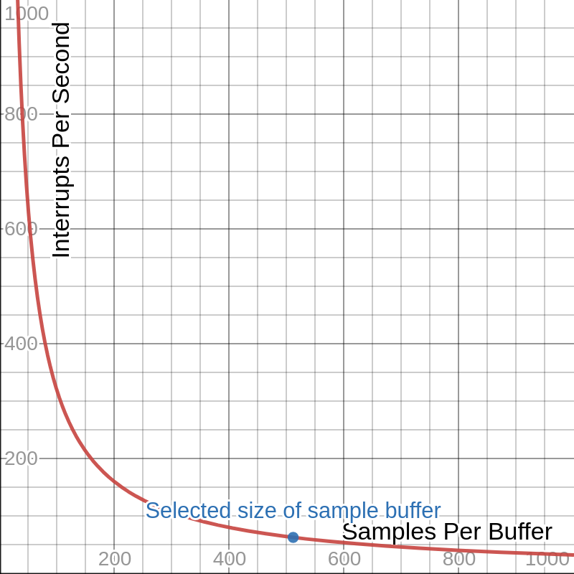
FP-GAme
Team C1: Andrew Spaulding, Joseph Yankel
Product Pitch
System Description
FP-GAme is a retro video game console and development kit for hobbyists and learners.
Low cost (< $200) compared to traditional development kits (~ $2000).
Offers features similar to the NES and GBA.
More accessible development experience compared to traditional retro consoles.
Open source: https://github.com/FP-GAme
Includes detailed instructions for the entire development process.
Convenient user libraries allow hobbyists to focus on developing their games, rather than on obscure hardware details or Assembly programming.
FP-GAme utilizes the DE10-Nano board, equipped with an Cyclone V SoC, HDMI output, and GPIO.
Cyclone V SoC:
FPGA contains our Pixel Processing Unit (PPU), Audio Processing Unit (APU), I/O Subsystem (IOSS).
APU supports 8-bit signed PCM at 32 KHz.
PPU contains 2 tile layers with independent scrolling and a sprite layer.
Game code calls user library, which communicates with kernel mode drivers for our custom hardware.
FP-GAme Hardware
System Architecture
HDMI
DE10-Nano
SNES Controller Port
System Evaluation
Tech Demo (System Test)
APU Design Tradeoffs
A smaller buffer size is disruptive for the CPU, as it generates a large amount of interrupts.
Too large of a buffer introduces a delay.
We selected a size of 512 samples with 60 interrupts per second to balance these factors.
Background Tile
Sprite
Foreground Tile
Foreground, background, and sprite layers functionally correct, outputs at 60Hz 640x480

