Slide 1
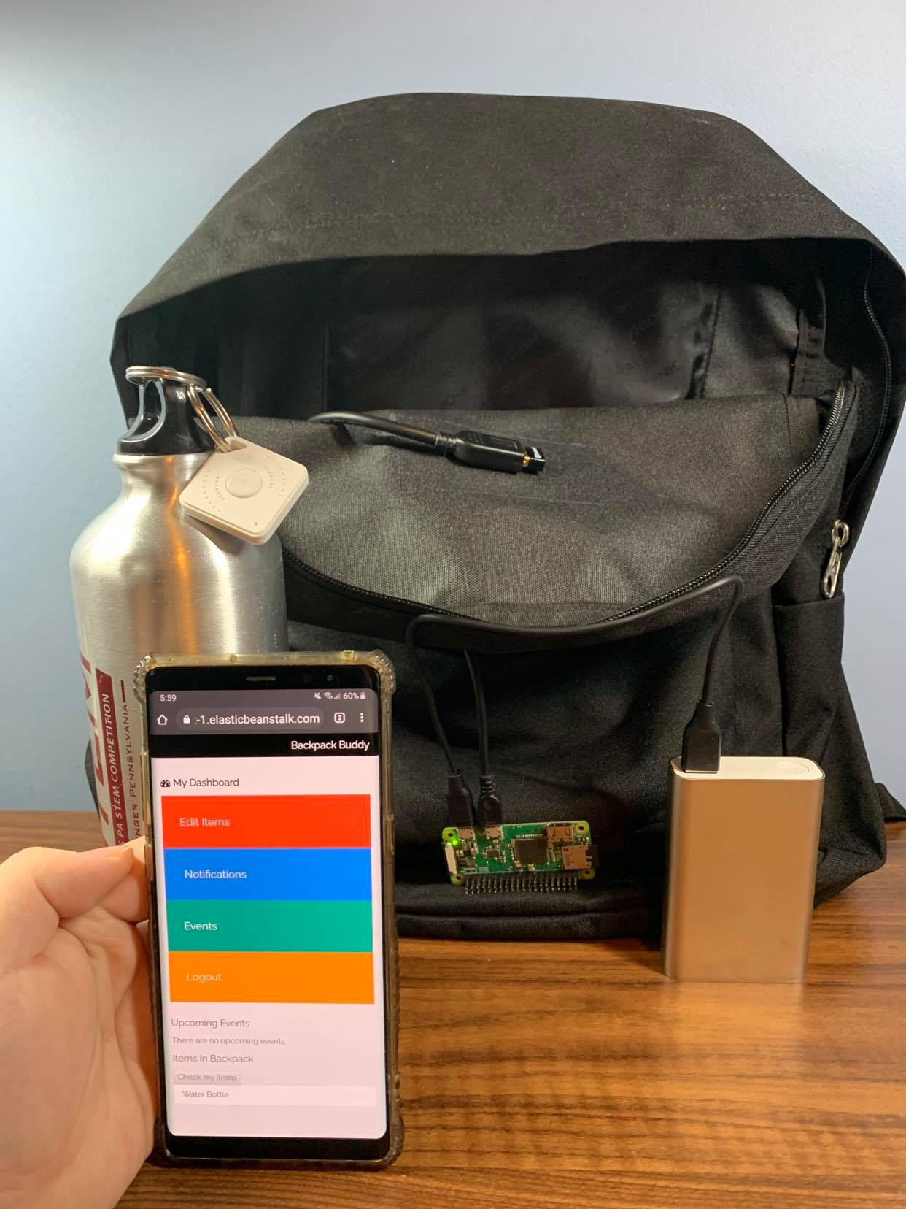
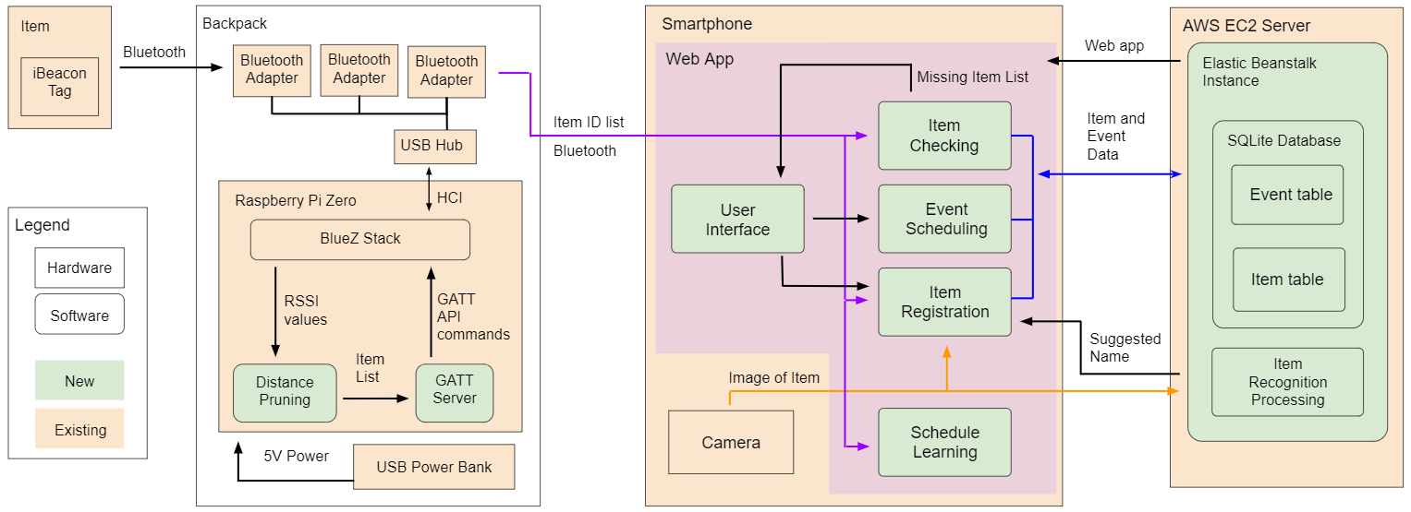
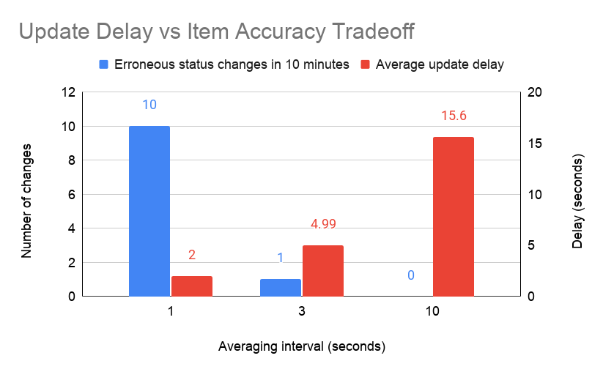
Backpack Buddy
Team C0: Joon Cha, Aaron Li, Janet Li
Product Pitch
System Description
Our project aims to tackle a common problem shared by every student: keeping track of their items between all the classes, meetings, or sports practices they have. However, existing asset-tracking technologies such as Tile or the newly-released Apple AirTags focus only on locating individual items, while Backpack Buddy allows users to manage collections of their items as they relate to their calendar events.
Users of Backpack Buddy will add tags to items to communicate to our backpack-mounted device, which updates our interactive web application, allowing for event creation, item registration, and an interface of items currently inside the backpack. Our app also handles notifications for upcoming events, missing items, and lost items. Finally, our app includes an image recognition portion used for identifying images of items for automatic registration.
Our use-case requirements are to detect what tagged items are in the backpack, display the item list to the user, and notify of missing items. Our system meets and exceeds our use-case requirements, with our backpack device lasting 18+ hours without recharge, detection of 10 tagged items within a 0.5-meter range ± 0.1m with 100% accuracy, 88% image recognition accuracy on items, and notifications for both missing and lost items.
Complete System Components
USB Bluetooth Adapter
Item with attached BLE tag
Asus USB Power Bank
Web application (w/ image recognition module)
Backpack Device
(Raspberry Pi Zero)
System Architecture
Overall System Diagram
System Evaluation
Longer averaging interval = increased item accuracy but also increased update delay

