Slide 1
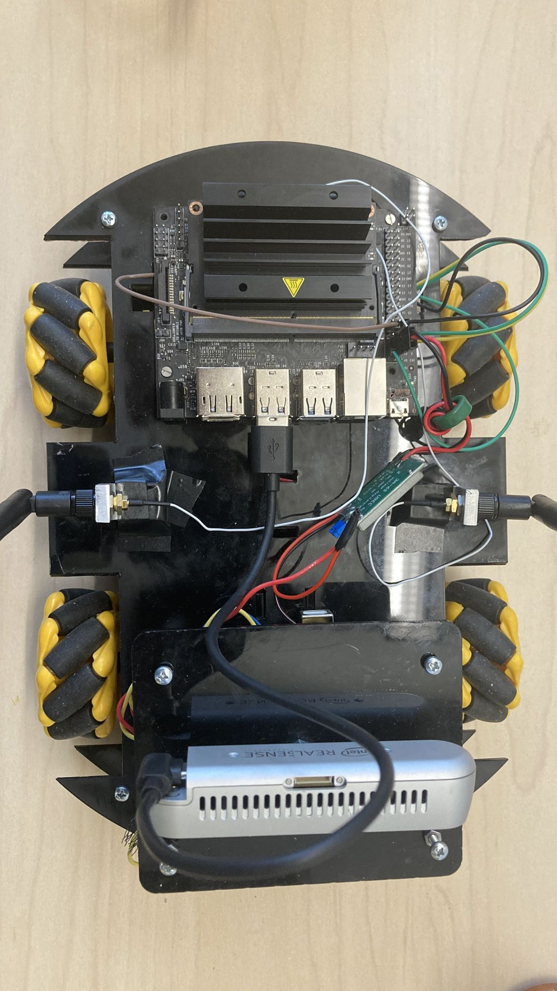
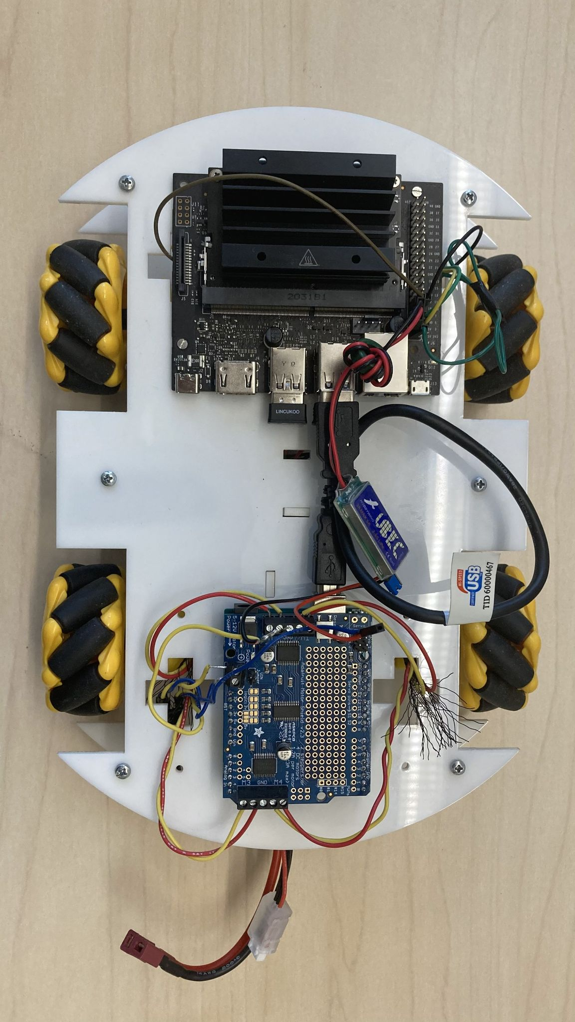
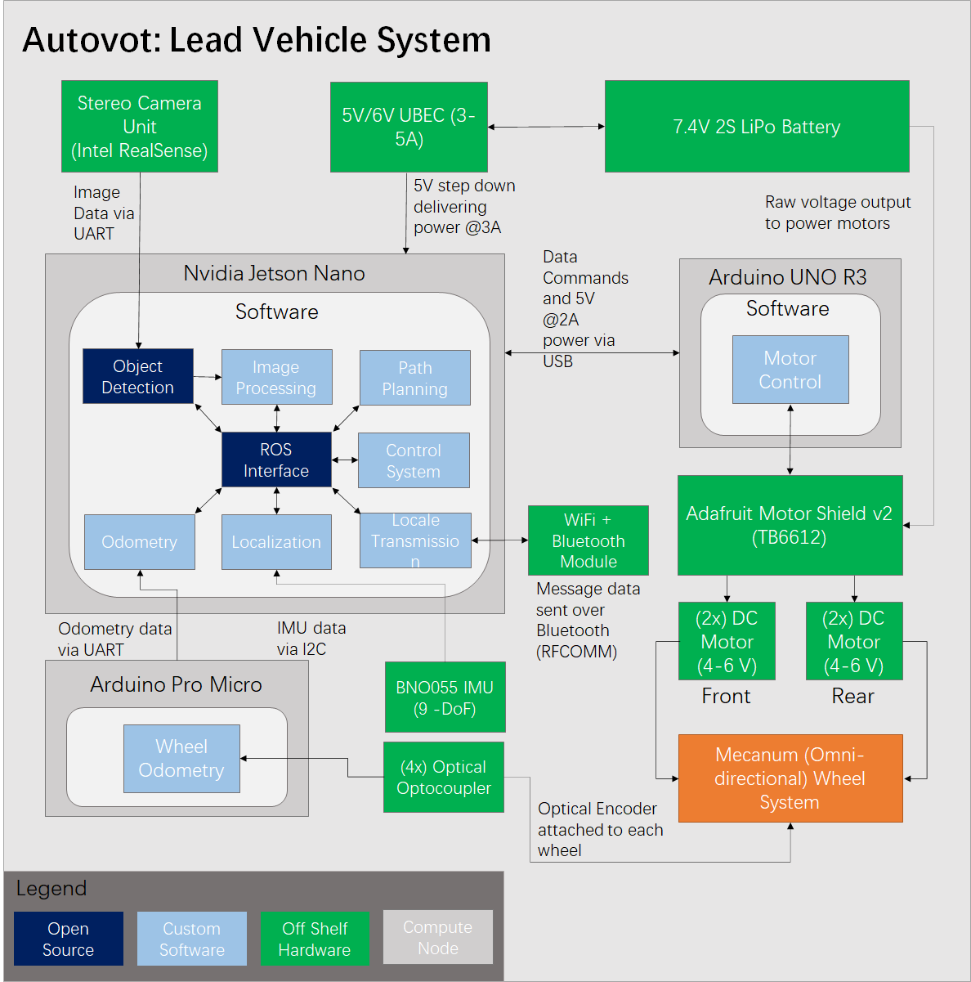
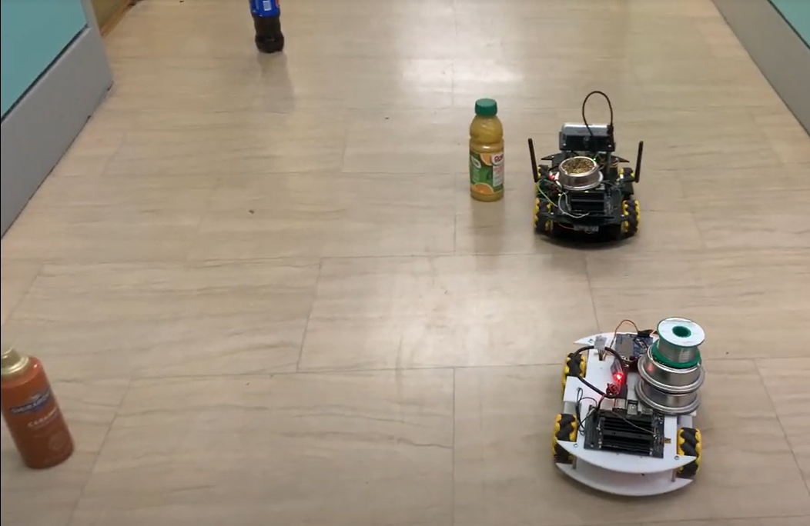
AutoVot: An Autonomous RC Vehicle Convoy
Team B6: Joel Anyanti, Jeffrey Tsaw, Fausto Leyva
Product Pitch
System Description
The goal with this project was to demonstrate the usefulness of Vehicle to Vehicle communication in autonomous vehicles. As a result, we developed AutoVot, an autonomous vehicle convoy that leverages Vehicle to Vehicle Communication to navigate a course with obstacles. The lead car uses a depth camera to detect obstacles along the course to generate a path to navigate to the goal, all while communicating instructions to the following vehicle via Bluetooth. This allows both vehicles to safely navigate the course without collisions, even though the following car has no perception capabilities.
RealSense
Lead (left) and Trailing (right) AutoVots
The lead vehicle relies on Intel RealSense Depth camera to provide RGB-D images to the system. Obstacle bounding boxes, when encountered, are extracted from the RGB image using MobileNet v1 SSD. Using the depth information, obstacle (x, y) locations are determined, and A* path path planning algorithm is used to dynamically update the path. Obstacle locations are sent to the following vehicle via bluetooth, which updates its own map and runs A* to determine what path to follow.
Mecanum Wheels
Adafruit Motor Shield
System Architecture
Jetson Nano
WiFi + Bluetooth Adapters
System Evaluation
Table 1: Required and Achieved Metrics
Metric | Required | Achieved
Vehicle Speed | 1m/s | 0.5m/s
Object Detection Latency | 100ms | ~30ms
Path Planning Latency | 10ms | ~100ms
Communication Latency (64 bytes) | 100±40ms | ~80ms
Detection recall @ (r= 0.4m, sample of 50 images) | 95% | 98%
Detection precision @ (r = 0.4m, sample of 50 images) | 90% | 92%
Course Length | 30m | 10m
Obstacle type and number | 15, 2 classes | 5, 1 class
Shown above: Evaluating our system on a 5m x 1.5m course with 5 obstacles to verify if navigation occurs without collisions.

