Slide 1
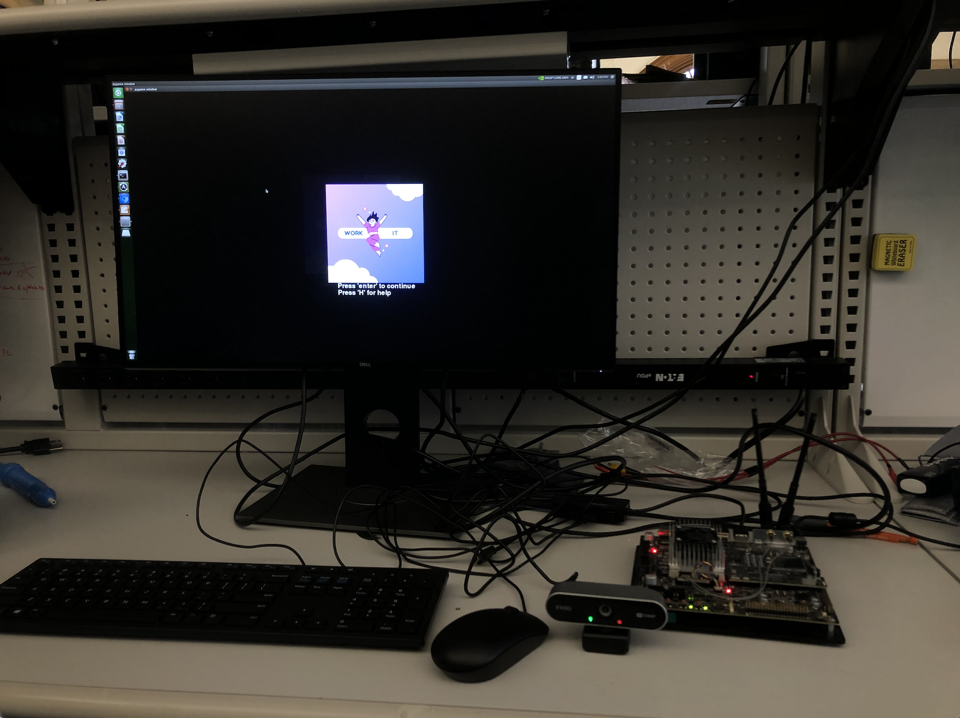
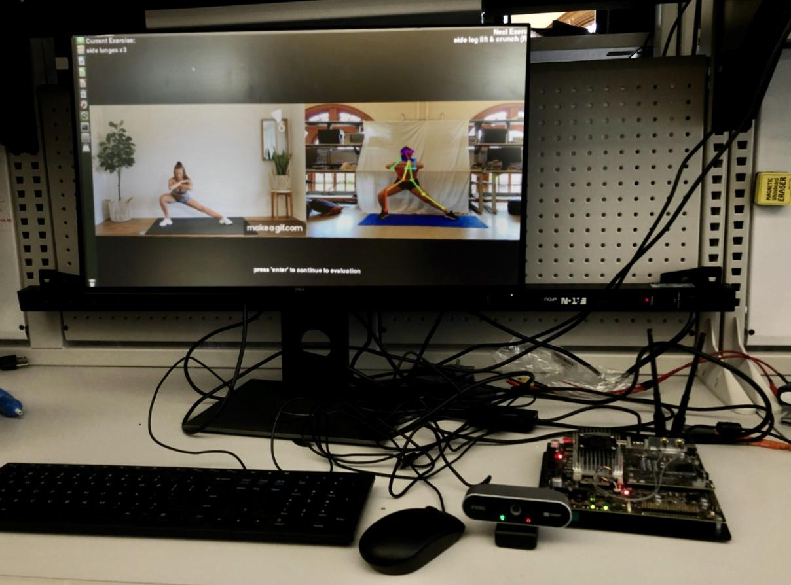
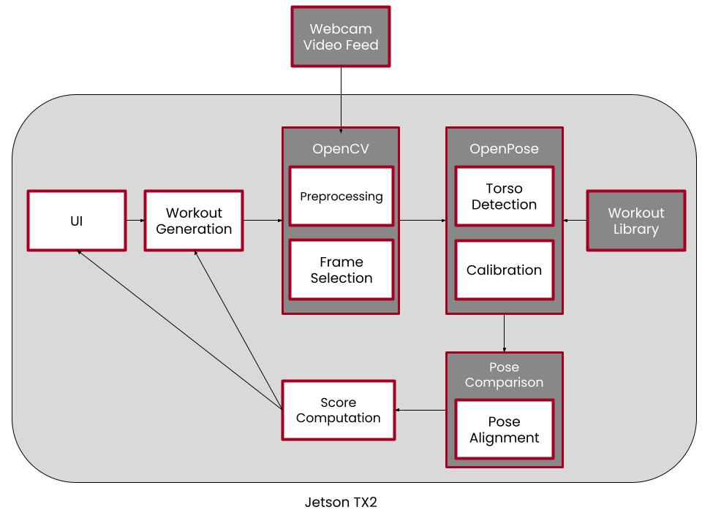
Work It
TEAM B5: Madeline Mianzo, Sarah Tan, Zixuan Zou
Product Pitch
System Description
With the spread of COVID-19, many people have transitioned to working out from home instead of at the gym. But it’s hard to find the motivation for at-home exercising, especially when workouts lack variety.
To solve this issue, we decided to create an exercise game—Work It—designed to engage the user and respond directly to their fitness level. Work It has three different workout types: arms, legs, and core. It initially evaluates the user’s fitness level for each of those categories with a standard set of exercises to provide an appropriate full-body workout. Over time, the user will be re-evaluated and Work It will modify the user's workouts to match their progress.
Product setup
Monitor
In the pictures you include for your system, you MUST include labels that point to the critical subsystems.
(In general, it is highly recommended to include a picture of your product in this section!)
Xavier TX2 board
System Architecture
USB camera
Block diagram of system components
System Evaluation
Goal and Actual System Performance Metrics
Requirements | Metrics | Actual
Hardware Performance | < 1 min time limit | < 3 seconds
OpenPose Detection | 90% accuracy | 86% accuracy - CMU Tensorflow OpenPose model
Pose Alignment | 90% accuracy | 90% of poses detected correctly at 432x368 frame size
Pose Comparison | 90% accuracy | arm exercises - 91.67% accuracy core exercises - 85.71% accuracy leg exercises - 94.12% accuracy average accuracy - 90.5%
Score Computation | Score should reflect user’s completion and accuracy | Score changes based on form and repetitions
Notes:
18-500: ECE Design Experience Project Poster
We will be using the ARENA system for the virtual public demo on May 13, 2021. The ARENA (https://arena.conix.io/) is being developed in the CONIX Research Center and led by Prof. Anthony Rowe. Your project poster is intended to welcome the Final Demo audience to come and talk to you about your project. Remember that your audience will not be familiar with your project, so you need to include a product pitch, describe the system you designed with block diagrams and pictures, and describe your test results. Most importantly everything must tie together with your test results showing that your product meets the requirements that were identified as being important to the application area. Note below that you must prioritize content on the poster to meet the intent above while also meeting the minimum sizing detailed below to be easily visible at a reasonable distance.
Mechanics:
Post your poster (in both PowerPoint and PDF format) to your Wordpress blog as its own entry.
Upload your poster PDF to Canvas.
Export the poster as a JPEG and provide a link to the poster in the Final Demo Google form. Content:
Your poster should be 30 in wide by 18 in tall as in the template provided.
It should be saved as a 2160 x 1296 JPEG file.
The smallest font you can use is 18 point. All labels, all blocks in any block diagram etc should respect this minimum font size. If you insert a block diagram as an image and rescale it, it may appear blurry, and you may violate the min font size guideline, so please do not rescale.
Imagine your audience is some random Carnegie Mellon student or faculty member or one of the sponsoring engineers from Apple who wandered into your demonstration. You cannot expect your audience to understand technical terms or concepts, so you should populate your poster with labeled and annotated images that allow you to do a good job of explaining them at the demo.
You should include four items in your poster as indicated in the template:
Due: May 10, 2021 at 11:59pm
o A product pitch: what is the application area / use case driving your product, and how well does your product meet the application area / use case requirements. This is a text only block. Use bold font to highlight how well you met the use case requirements.
o A system block diagram: Use the latest block diagram to describe your final system. You can use a separate hardware and software block diagram if you prefer. You may also consider a state diagram or flow chart for software if that is more descriptive than a block diagram.
o One or more pictures of your final product where each picture has a title and/or short caption and (lots of) appropriate labels. Note that you can include solid models directly in the ARENA environment, so including those in a poster would be redundant. You can speak to your audience in the VR environment but cannot point to locations on the picture so make sure all the critical items you will want to present have labels. Zoom ins or alternate views to highlight hidden areas of your product may also be critical for some teams.
o One or more graphs or tables that summarize the test results; each graph or table should have a title and/or short caption (one line preferred, two lines sparingly). It is critical to show that you can tie your poster story with the product pitch in this section. Graphs are especially useful to highlight trade-offs you have in your system and highlight the engineering challenges you faced this semester.

