Slide 1
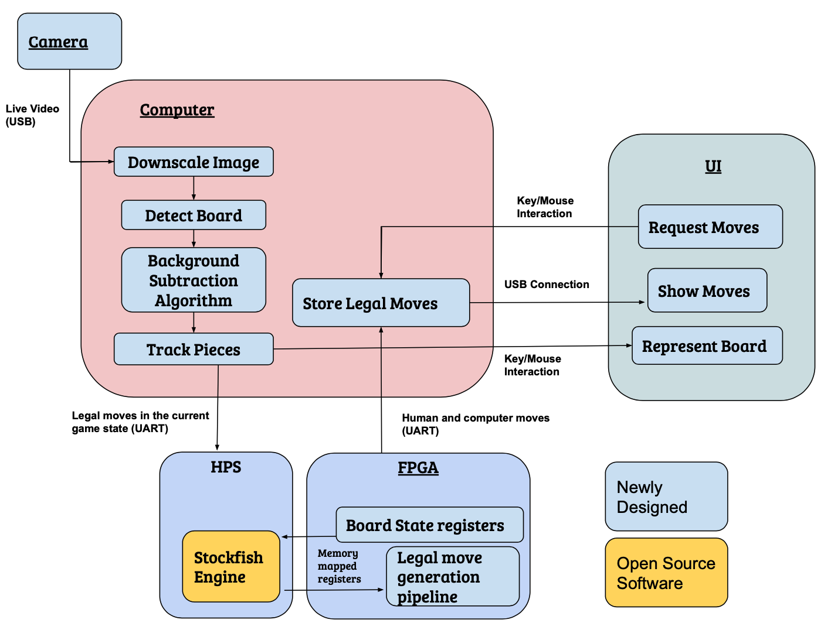
Chess Teacher
Team B4: Michael Cai, Joseph Chang, Jee Woong Choi
Product Pitch
System Description
Chess Teacher is a system capable of teaching people how to play chess using artificial intelligence. What differentiates our product from the others is that it creates a more realistic environment by having physical pieces rather than playing on a computer. Our system can play chess against a human being on a real chessboard and also recommend moves to help them improve their performance. In this way, it allows for social distancing and a more economical approach than in-person chess tutoring. The system is built on a real chessboard with a camera to detect chess moves, and the computing is done using a computer and FPGA.
FPGA/HPS subsystem
Chess board: (Camera fixed above)
Computer
System Architecture
Chess Teacher Block Diagram
Figure 2: Entire system setup
System Evaluation
Correctness Metrics
Requirement | Testing Strategy | Metrics | Actual Output
Move detection | Software + Visual confirmation => 20 unique moves | 99% accuracy in move detection & < 400 ms processing time | 20/20 Moves correctly detected
FPGA legal move generation | Hardware testbench (ensure correct legal moves generated) => 10 unique board states | 100% Correct | 10/10 Board states correctly analyzed
Communication between Computer and FPGA | Hardware testbench (analyze packets are sent correctly) => 15 unique packets | Latency of < 1s & 100% data accuracy | 15/15 unique packets from PC to FPGA to PC
UI | Visual confirmation of representing the board correctly => 20 unique moves | 100% accuracy in representation of the board | 20/20 Moves correctly represented
Figure 1: Block System Diagram

