Slide 1
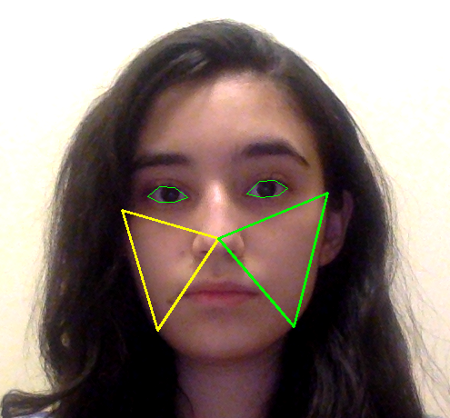
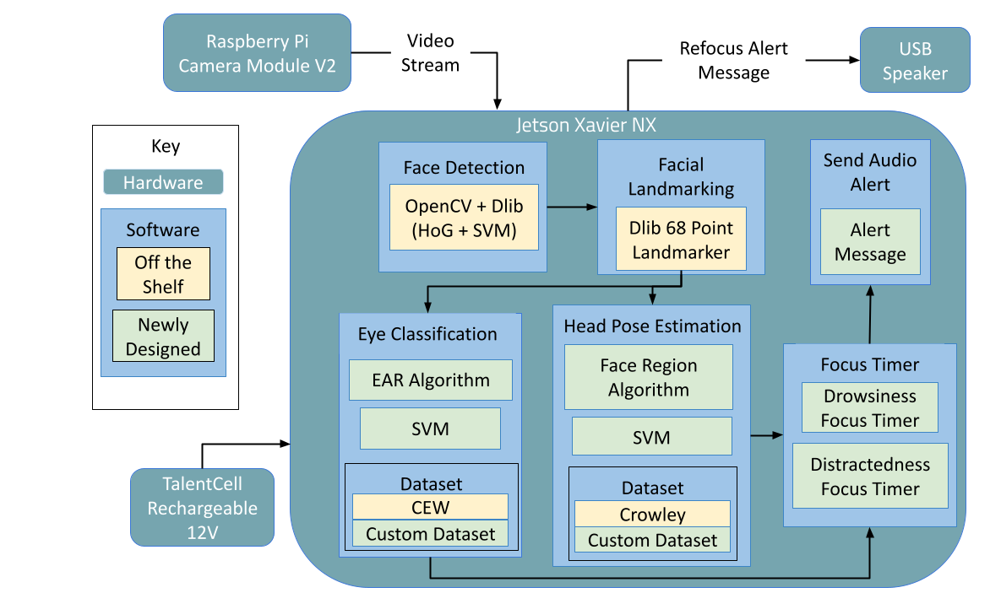
FocusEd
Team B1: Heidi Batres, Danielle Kakish, Vaheeshta Mehrshahi
Product Pitch
System Description
Our project is FocusEd, a distracted and drowsy driving prevention system. Our mission is to make our roads a safer place, and what better way to start than with the driver? FocusEd serves as a way for drivers to curb their distracted day driving while simultaneously improving road safety and their own driver education.
Our system was built with the quality attributes of usability and safety at the forefront of our design. FocusEd uses eye classification and head pose estimation to determine if the driver is either drowsy or distracted. Our system’s accuracy of distinguishing normal from distracted or drowsy behaviors is 87% from 100 trials.
Upon startup, the user is welcomed with an audio message explaining FocusEd. They are then stepped through a <1 min calibration process to train an SVM used to detect drowsiness. Then, with every frame, the system continuously performs head pose estimation and eye classification. An audio alert is sounded if the driver is drowsy or distracted. We continue with this loop until the driver has finished driving and turns off our system.
Vehicle Set Up
USB Speaker
Distracted (Right)
Jetson Xavier NX
System Architecture
RPi Camera Module
Overall System Block Diagram
Eye regions used for eye classification
Face regions used for head pose estimation
Drowsy
Not Drowsy or Distracted
System Evaluation
One of our trade-offs was to use a power bank rather than plugging our system into an outlet. With our power bank, our system runs 2 FPS slower than if our system were to be plugged into an outlet. Since we wanted our system to be portable, we are trading off slightly slower latency. Additionally, we chose to use a pre-trained head pose estimation model instead of asking the user to calibrate their poses to save time on the user end.
Requirement | Test | Metric | Testing Result
Face Detection | Detect faces in various daytime light | Face is detected >=90% of the time in all light conditions | 94% accuracy (5 datasets, 4355 photos)
Eye Classification | Compare open/ closed classification to truth | Classification & truth match >=90% of the time | 91% accuracy (4 datasets, 3403 photos)
Head Pose Estimation | Compare direction of head to estimation | Estimation & truth match >=85% of the time | 93% accuracy (2 datasets, 1451 photos)
Focus Timer | Distracted vs normal based on 1s drowsy or 2s not focused | Distinguishes distracted vs normal >=90% of the time | 87% accuracy (100 trials)

