Slide 1
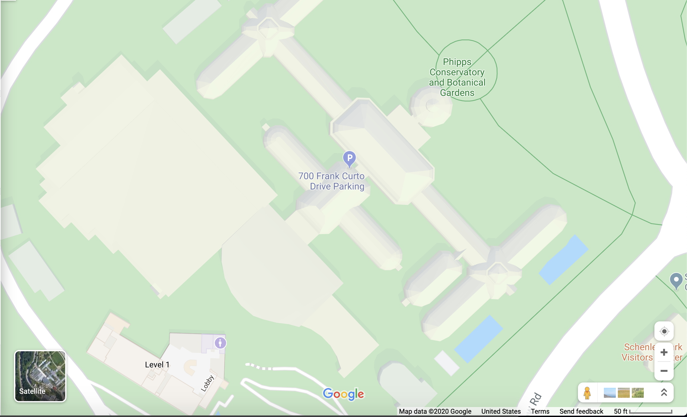
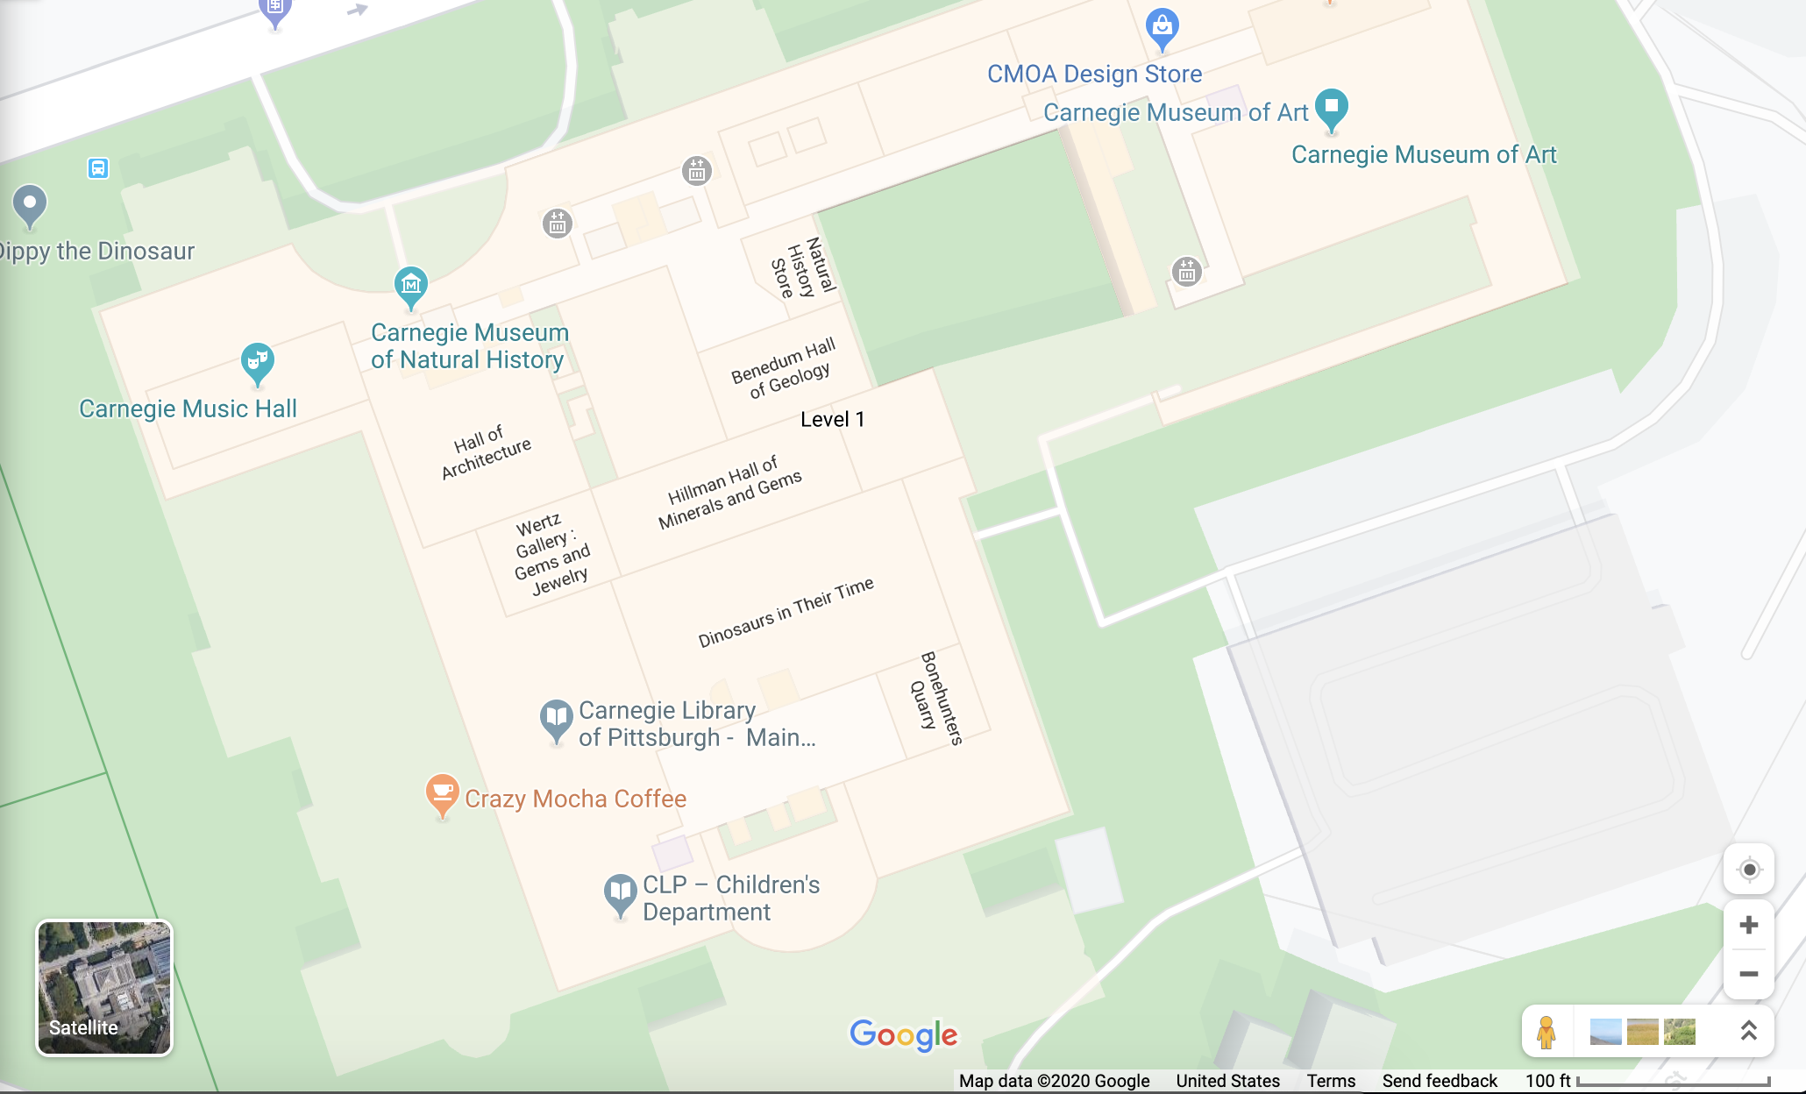
“The Great Indoors!”
Google Maps lacks accurate and comprehensive indoor positioning information.
Unlabeled Indoor Positioning
Labeled Indoor Positioning
Notes:
Problem: Google Maps has allowed man to explore Alaska, Antarctica, and even the moon. But there is one place that cartographers have yet to map. “The Great Indoors!”
Real world example of the problem
Current indoor situation - unlabeled unless manually upload floor plan

Slide 2
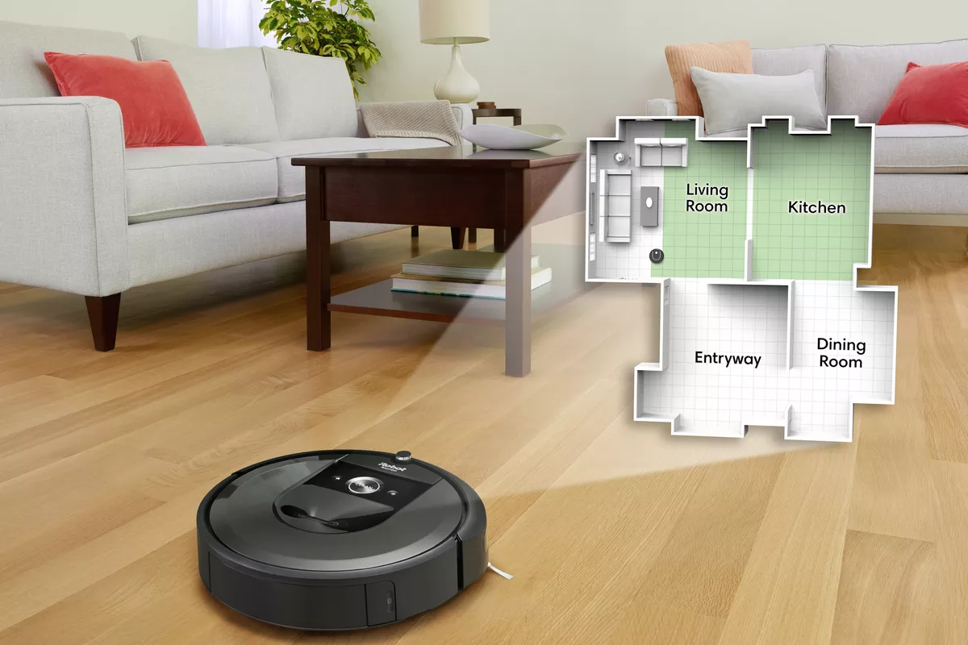
RIP: Robotic Indoor Plotting
Autonomous robot that generates an indoor floor plan, with room dimensions and labels.
Focus on :
Computer vision
Text recognition
Navigation (SLAM)
Web App
ECE Areas:
Signals (CV, text and object recognition)
Software (robot programming, Web App)
Notes:
Solution: RIP
Describe how to use it
Set it down and let it explore
What would it give back to the user and how could the user use it?

Slide 3
Requirements
Mapping Speed | Generate map faster than 7 sqft/min
Floorplan Accuracy (distance and depth) | Within 5% of true value
Text Labeling Accuracy | 80% correct of identified text
Obstacle Avoidance | 0 collisions with active or passive obstacles
Power | Operational time up to 60 mins per charge
Out of Scope:
Vacuuming
Entering and mapping behind closed doors
Notes:
Mapping Speed - Rooma speed
Floorplan Accuracy (distance and depth) - Realsense specs (1%), with variance for pathing to save time
Text Labeling and Accuracy - Existing OCR standards, with variance for camera resolution/angle
Obstacle Avoidance - based on roomba built-in sensors
Power

Slide 4
Components
Robot Base
Sensors
Computer Vision: text/door labeling
Navigation
Web application
Notes:
This is how we’ve decided to split up our project

Slide 5
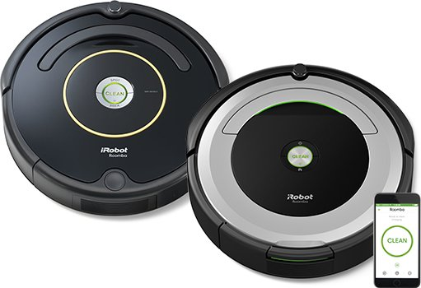
Robot Base
Control movement
Roomba - iRobot create 2 ($200)
Raspberry Pi
4GB RAM, USB 3 ports
Webcam mounted on platform
Roomba can supply power
Notes:
Why we chose Roomba:
Affordable, programmable, supported
Good size for camera tower
Includes sensors (directional ultrasound, cliff)
Pi: Affordable, strong, supported

Slide 6
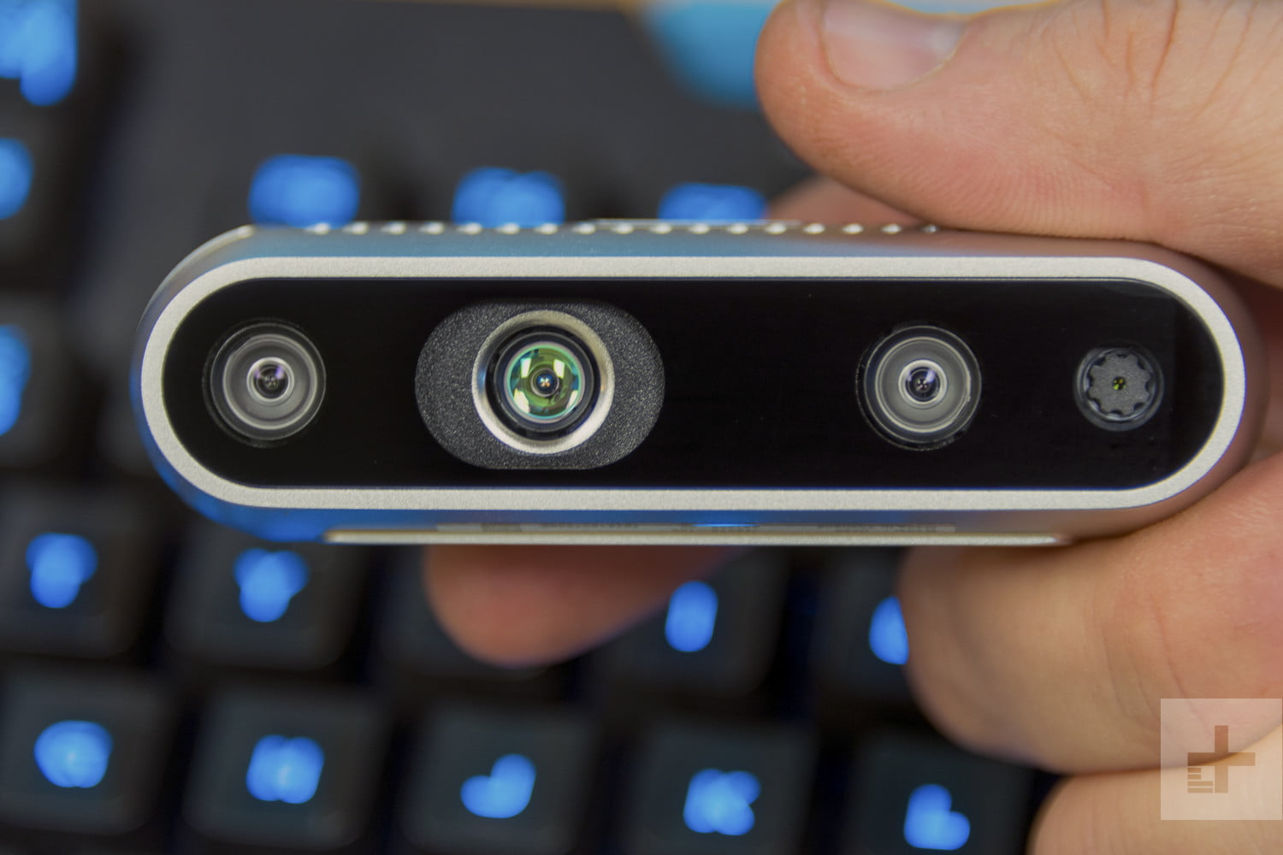
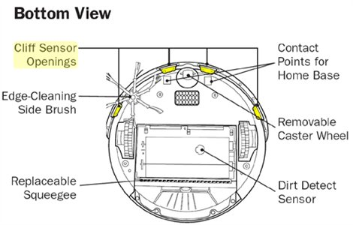
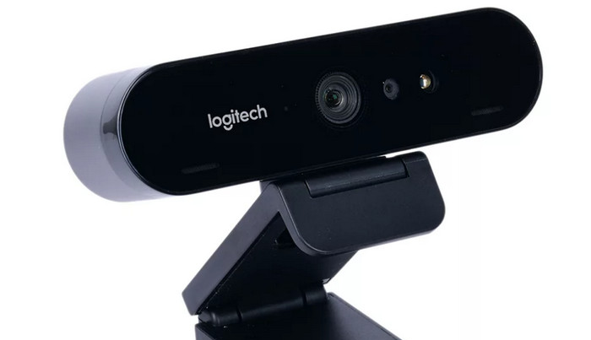
Sensors
Intel® RealSense™ Depth Camera D415 ($150)
Range: 0.16m to 10m
1280 x 720 active stereo depth resolution, upto 90 fps
Measure room dimensions
Recognize doors and active obstacles
Roomba has sensors
Cliff detectors
Light detectors (for obstacles)
Webcam mounted and angled upwards
Text recognition around doors
Notes:
Realsense for depth detection - multi-camera CV depth
Roomba built-in sensors for obstacle detection
Webcam for CV text recognition and door recognition

Slide 7
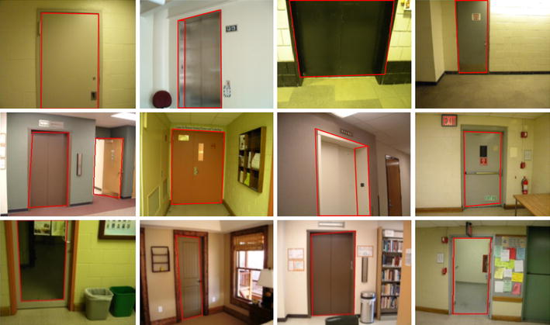
Computer Vision
Door Recognition
SURF algorithm for a guiding robot
Text Recognition
When door is detected, find and read label around perimeter of door
Leverage existing OCR (Optical Character Recognition) tools
Detect obstacles
Active (People walking)
Non-active (add to map)
Recognize walls, find dimensions
Notes:
SURF (SPEEDED UP ROBUST FEATURES)
Feature detection algorithm, faster than SIFT
Can offload text recognition to server
Non active treated as walls
Active possible path prediction and avoidance???

Slide 8
Navigation
 | Complexity | Accuracy | Mapping Speed | Notes
Perimeter Tracking | Simple | Very Accurate | Slow | Follow wall on right side to close loop, brute force to generate map
LSLAM (Lidar Simultaneous Localization and Mapping) | Very complex | Accurate | Fast | Explore and map while keeping track of current location Expensive processing power
OrthoSLAM | Medium | Inaccurate | Medium | Assume orthogonal features for lightweight real-time
Notes:
Perimeter tracking: Follow wall on right side to close loop, then generate mapping pattern
Lidar SLAM: Exploration and mapping while keeping track of where you are
OrthoSLAM: SLAM variation with assumptions of orthogonal features (walls), designed for use in real-time embedded systems

Slide 9
Web Application
Database backend: PostgreSQL
Filetype: Text encoding of geometric data
Server Hosting: AWS
Floorplan transmission: FTP
Basic UI
Notes:
File: save as coordinates of line, can customize for other geometric shapes
FTP to move file, one-way for now
UI MVP is a drop-down to select floorplan, and one image to display
Stretch goals:
Label building names
Fix misread text???
Integrate different floors by specifying stairwells/elevators
Integrate different sections of same floor by specifying connected doorways???
Integration with google maps API???
Normal Google Maps usage, but can click into a building to view our floorplan

Slide 10
Key Challenges
Accuracy of text recognition and labeling
Training
Processing power of SLAM and CV
Offload processing to server where possible, OrthoSLAM
Power supply
custom transformer, external power supply
Mapping Speed
Different navigation algorithms
Integration
Plan ahead!
Notes:
Possible user correction in webapp
Can sacrifice accuracy for speed

Slide 11
Test Plan
Rectangular room (empty and furnished)
Door labeling (glass, solid color, elevators, closet doors)
Text labeling (variety of size, color font)
Irregular shaped room (empty and furnished)
Rooms with active objects (moving people)
Proposed Test Cases
Wean 5th floor (big, standardized building)
Tepper Quad (cluttered area with furniture)

Slide 12
