Slide 1
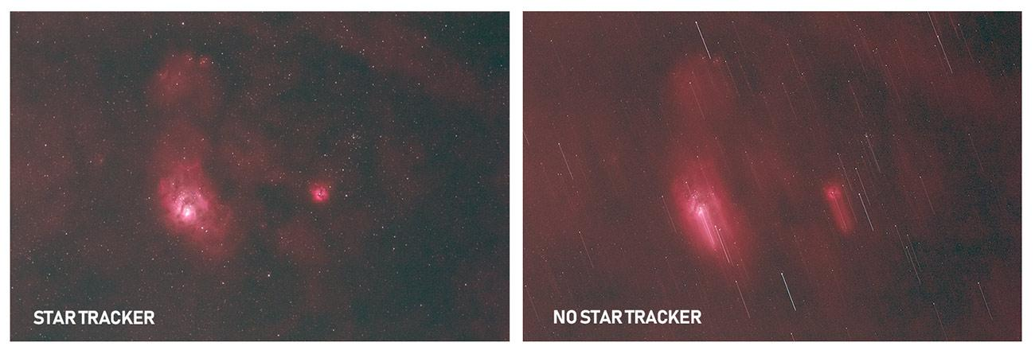
Asterism Final Presentation
Objective: Develop a motorized camera mount capable of compensating for the movement of astronomical objects (both with, and relative to the starscape)
Key Points:
Improved Polar Alignment Procedure
CV-based object tracking

Slide 2
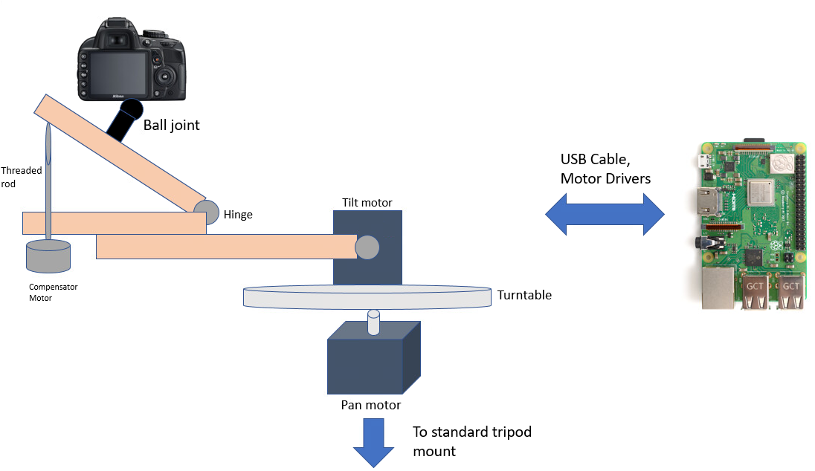
Complete Solution
Use the test setup to generate a sample starscape with laser pointers, with a single moving dot.
Track the dot with the camera mount, and perform a series of long exposures.
Each exposure, when stacked together, should show the dot as a single point (as opposed to a trail).

Slide 3
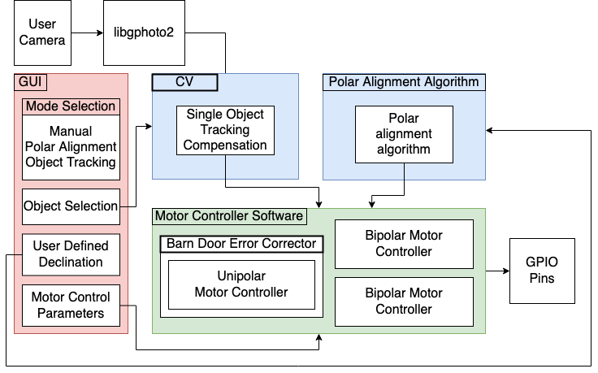
Solution Approach: Software

Slide 4
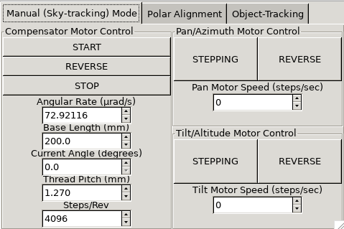
Solution Approach: Software

Slide 5
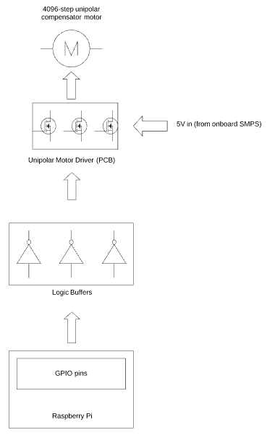
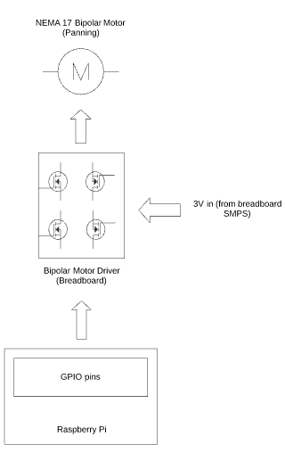
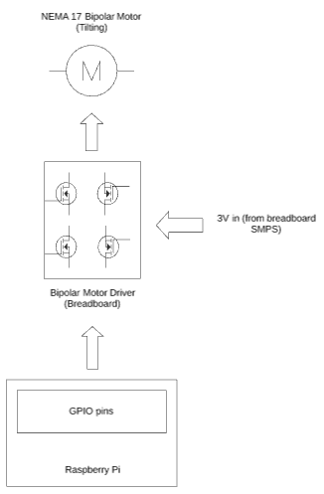
Solution Approach: Electronics

Slide 6
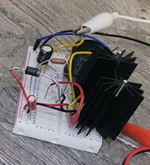
Metrics and Validation: Subsystem Tradeoffs
3V Buck Converter for Motor Power
 | Breadboard Design | Commercial Design 1 (SMAKN, https://tinyurl.com/ycvbbo5v)
Output Current Rating | 3.4 A | 3 A
Maximum Quiescent Operating Temperature | 51.3 C | 40 C
Degrees C/A | 15.1 | 13.3

Slide 7
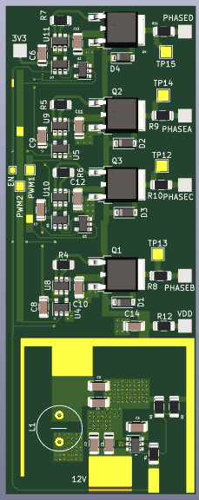
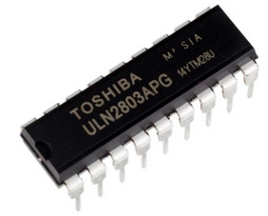
Metrics and Validation: Subsystem Tradeoffs
Unipolar Motor Driver PCB
 | PCB | ULN2803
Quiescent Operating Temperature | 31.6 C | 34.7 C
Output Current Per Phase (DC) | 179 mA | 175 mA
ULN2803 Motor Driver

Slide 8
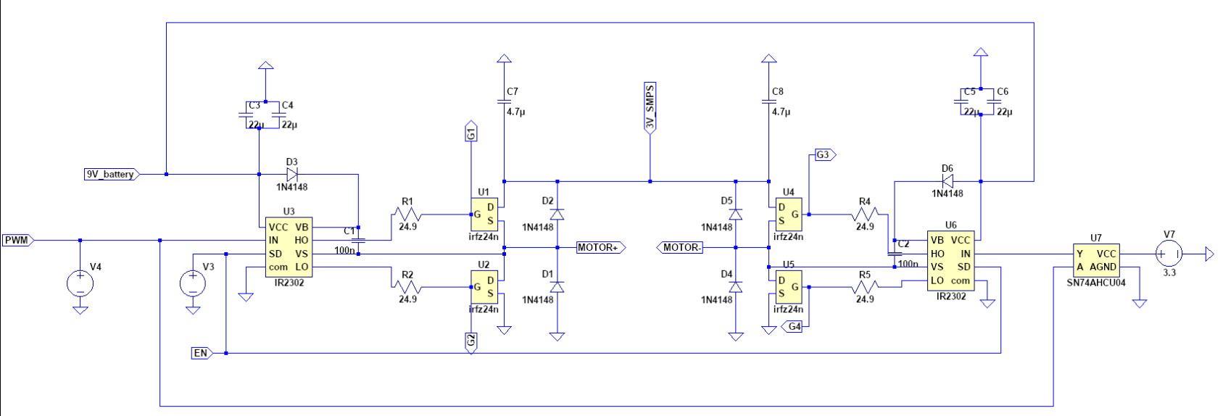
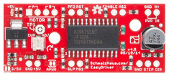
Metrics and Validation: Subsystem Tradeoffs
NEMA 17 Motor Driver: Breadboard Circuit
 | Custom Circuit | EasyDriver
Output Current/Phase (Loaded w/ NEMA 17 motor) | 1.95 A | 780 mA
Quiescent Operating Temperature (Loaded w/ NEMA 17 motor) | 36 C | 130 C
Bipolar EasyDriver (Commercial)

Slide 9
Metrics and Validation: Subsystem Tradeoffs
Preprocessing images to speed up CV tracking update:
Original size: 30-50 FPS
0.75 resizing: 30-50 FPS
0.5 resizing: 80-100 FPS
0.25 resizing: immediate tracking failure
Actually not very easy to quantify
resizing = downsampling

Slide 10
Metrics and Validation:
Criterion | Requirement | Result
Power consumption | 17.5 W | 21.1 W
Polar alignment accuracy | 5% error on a 60 sec Jupiter capture | TBD
Polar alignment time | <15 minutes | TBD

Slide 11
Remaining Work
Assembly:
Integration of motors + drivers into compensator
Integration of object-tracking routine into GUI
Debugging of polar alignment procedure mathematics
Testing:
Sky tracking error calculation (standard deviation of star positions across multiple exposures)
Object tracking blur calculation (equivalent blur for a 60 second Moon capture)

Slide 12
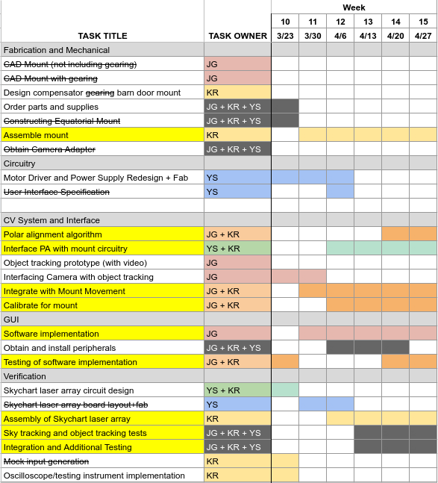
Schedule

