Slide 1
Robo Shopping Cart
Zeyi Huang, Zehong Lin, Carlos Gonzalez

Slide 2
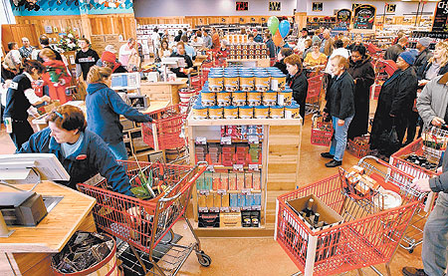
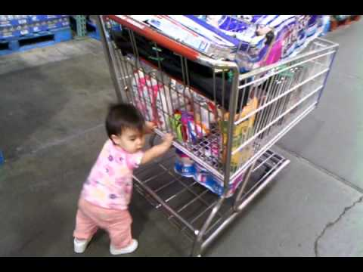
Use Case (Problems)
Shopping carts and baskets in Grocery stores are inconvenient
Grocery stores are full of people who want similar products and certain aisles become crowded which slows purchases
Some esoteric items are hard to find in grocery stores

Slide 3
Use Case (Solution)
Web app takes customer’s shopping list
Autonomous shopping cart then guides customers through store to pick up item on shopping list while carrying their items
Increasing efficiency through store increases revenue
Removing inconvenience of carrying basket / pushing cart increases customer satisfaction

Slide 4
Requirements
The cart should sense the items put onto cart in 90% of cases (pressure pad inconsistencies with light items)
The cart senses the item and starts driving to next item within 2 seconds (noticeable amount of lag time)
The cart should drive at 3.1 mph (avg. human walking speed)
The cart should stop within +-0.25m of object (comfortable reach distance)

Slide 5
Requirements (cont.)
The cart should never go to the incorrect location (eliminates efficiency)
The cart should take the optimal route to next item on list (increases efficiency)

Slide 6
Testing, Verification, Metrics
Item Placement Detection test: 20 Random items placed in cart. Detects at least 18.
Item Placement Response test: 20 detected items. Once item is detected, cart always starts moving to next item within 2 seconds.
Speed Test: Pick 10 most common items and measure cart average speed from each item to every other item (90 total paths)
Proximity test: Pick 10 most common items. Have cart drive to each from random initial location. Measure Average distance error between cart and item.

Slide 7
Testing, Verification, Metrics
5. Locate Item test: Pick random cart location. Have it navigate to 10 items.
6. Route Optimality test: Pick 10 items. Start cart at random location. Manually verify each path is optimal

Slide 8
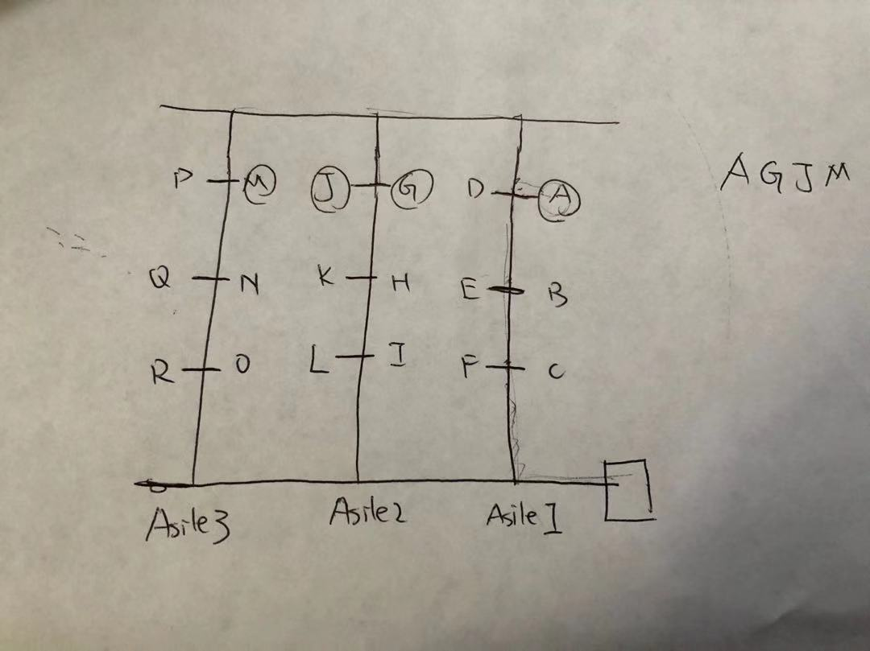
Solution Approach (Overview)
iRobot Create as base platform which follows planned path via lines on floor
Pre-generated map of the shopping environment (example below)
A web app that takes in user’s shopping list
Web app sends the list to Raspberry Pi
Raspberry Pi computes the shortest path using A* (manhattan distance heuristic)
Robot stops in front of each item to wait for user to place item in cart
Notes:
Our project will be an autonomous shopping cart. When presented with a map of the shopping mall and a list of items to be purchased, it plans the shortest route through the shopping mall and guides the user through it. It would be helpful in bringing more convenience to the shopping process: people will no longer be lost between the aisles and waste time going back and forth looking for specific items. This project can also aid those who have a hard time pushing the cart themselves.

Slide 9
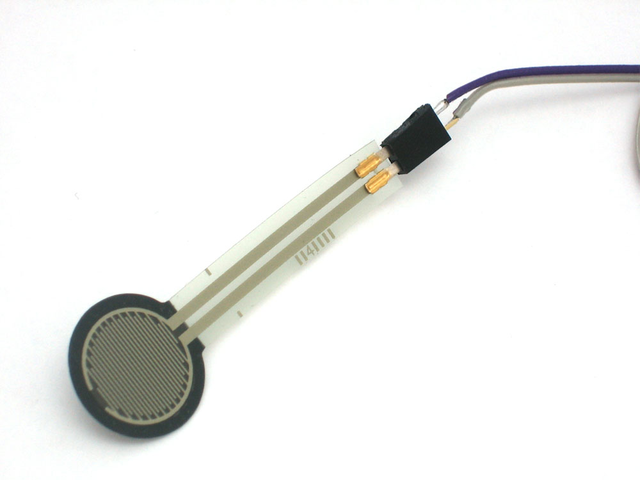
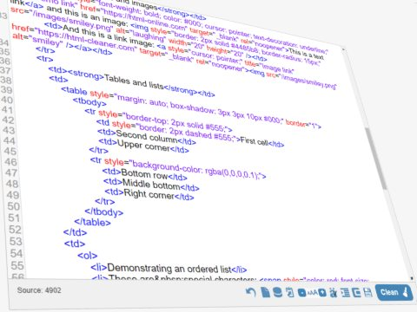
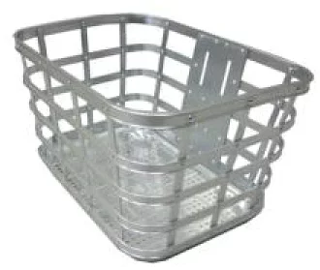
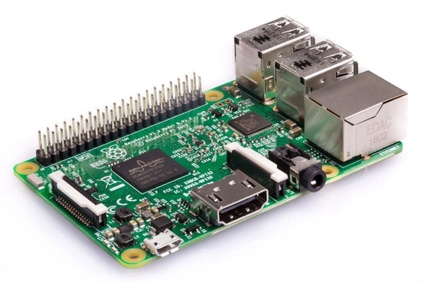
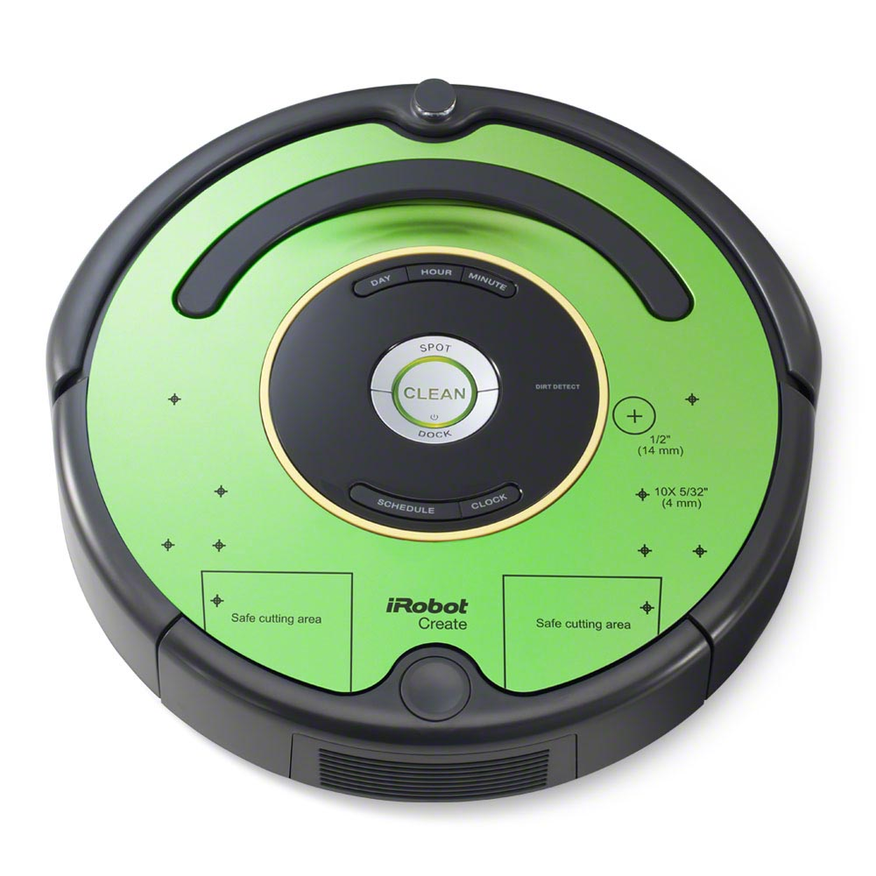
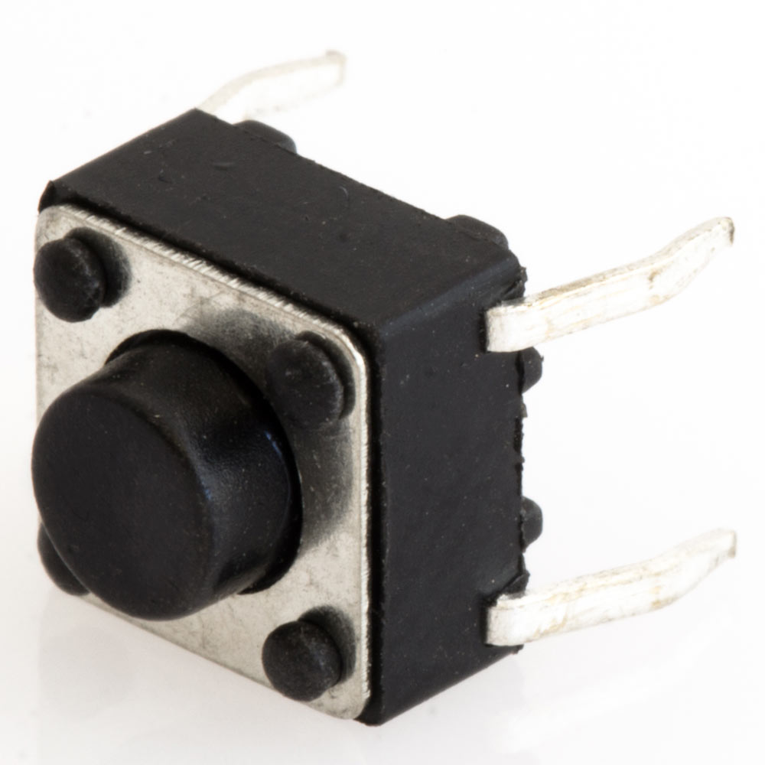
Solution Approach (Hardware)
Notes:
Our project will be an autonomous shopping cart. When presented with a map of the shopping mall and a list of items to be purchased, it plans the shortest route through the shopping mall and guides the user through it. It would be helpful in bringing more convenience to the shopping process: people will no longer be lost between the aisles and waste time going back and forth looking for specific items. This project can also aid those who have a hard time pushing the cart themselves.

Slide 10
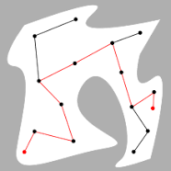
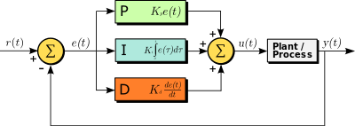
Tasks and Division of labor
Zehong - Path Planning & Computer Vision / Create onboard sensors
Zeyi - Roomba API & Webapp
Carlos - Controller & Path Planning

Slide 11
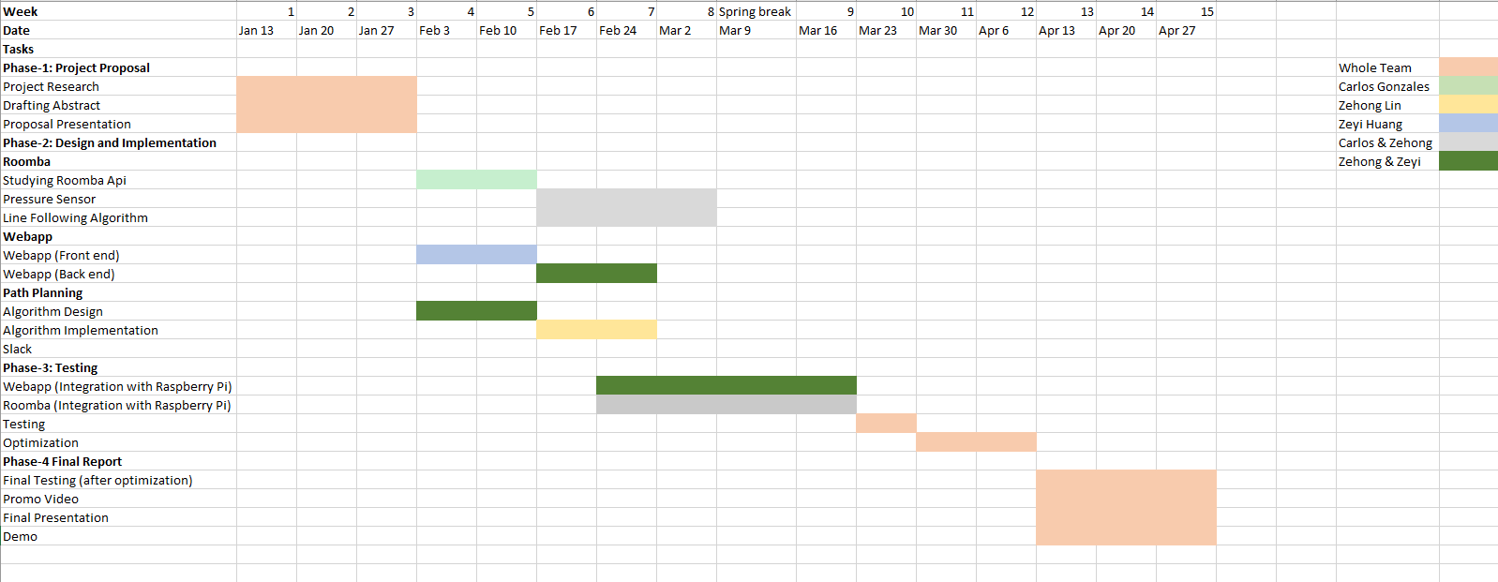
Schedule
Feb 10: Start implementing line following algorithms on Roomba & begin Web app development
Mar 2: Integrating Web app with RPI/ Roomba
April 13: Final testing starting

Slide 12
References
https://www.irobot.com/about-irobot/stem/create-2
http://roombots.mx.com/make_your_own
https://www.irobotweb.com/-/media/MainSite/PDFs/About/STEM/Create/RoboCam-WebInterface.pdf
https://www.irobot.com/about-irobot/stem/create-2/projects
https://www.irobotweb.com/~/media/MainSite/PDFs/About/STEM/Create/iRobot_Roomba_600_Open_Interface_Spec.pdf

