Slide 1
AutoCart Design
Team A2:
Zeyi Huang, Zehong Lin, Carlos Gonzalez

Slide 2
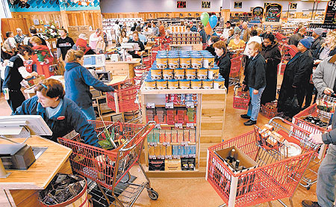
Application Area
Shopping carts and baskets in Grocery stores are inconvenient
Grocery stores are full of people who want similar products and certain aisles become crowded which slows purchases
Some esoteric items are hard to find in grocery stores

Slide 3
Solution Approach
User Interaction:
Web app allows customers to input shopping list at any time at any place
A monitor on the cart allows customers to monitor the shopping process
Path Planning:
Autonomous shopping cart then leads customers through store to pick up item on shopping list while carrying their items
Local path planning simplified by performing line following
Global optimality guaranteed by global path planning algorithm
Object Avoidance:
If shopping cart detects obstacles in front of it, it will stop and wait until obstacles disappear
Removing inconvenience of carrying basket / pushing cart / and at increases customer satisfaction

Slide 4
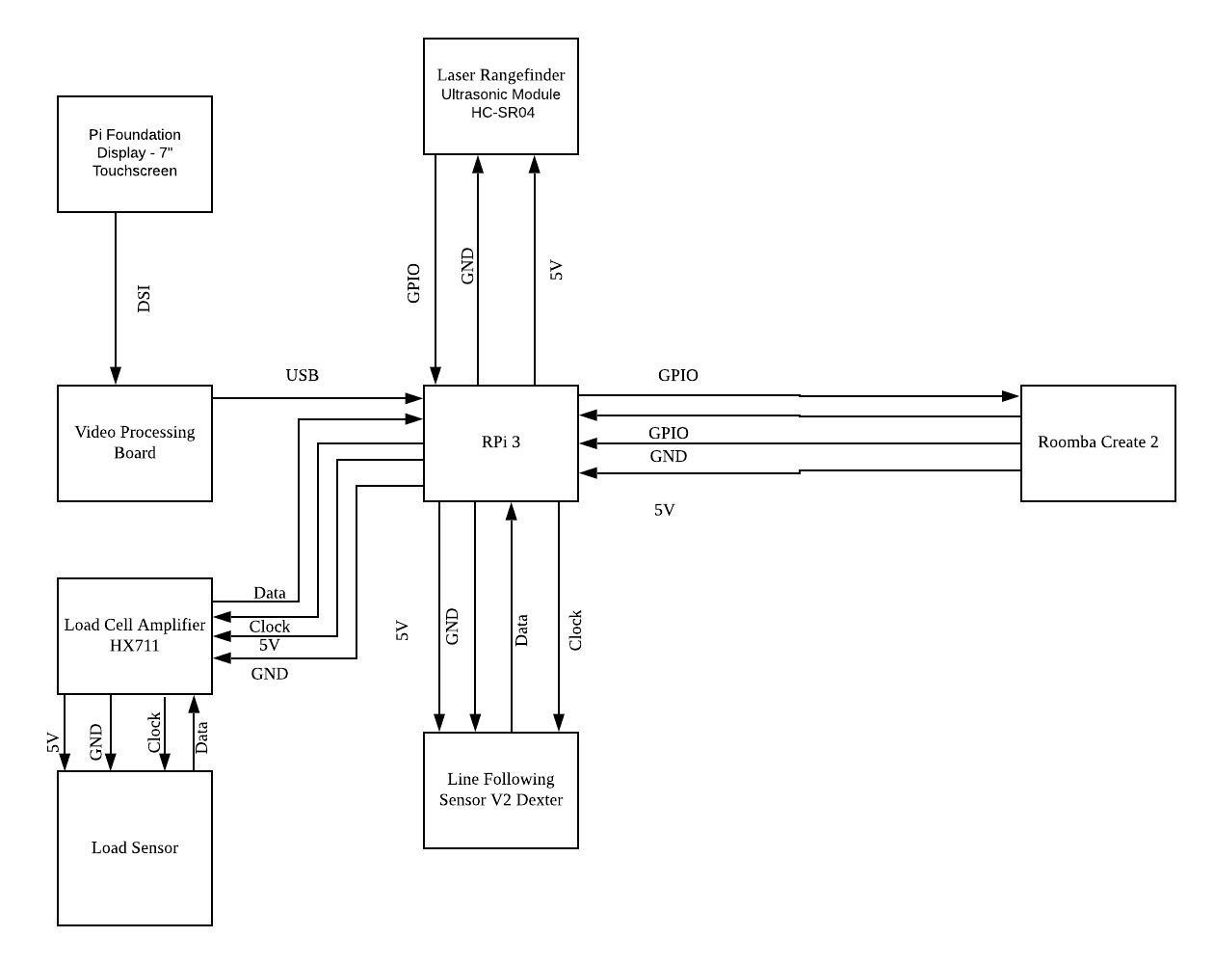
System Specification / Block Diagram

Slide 5
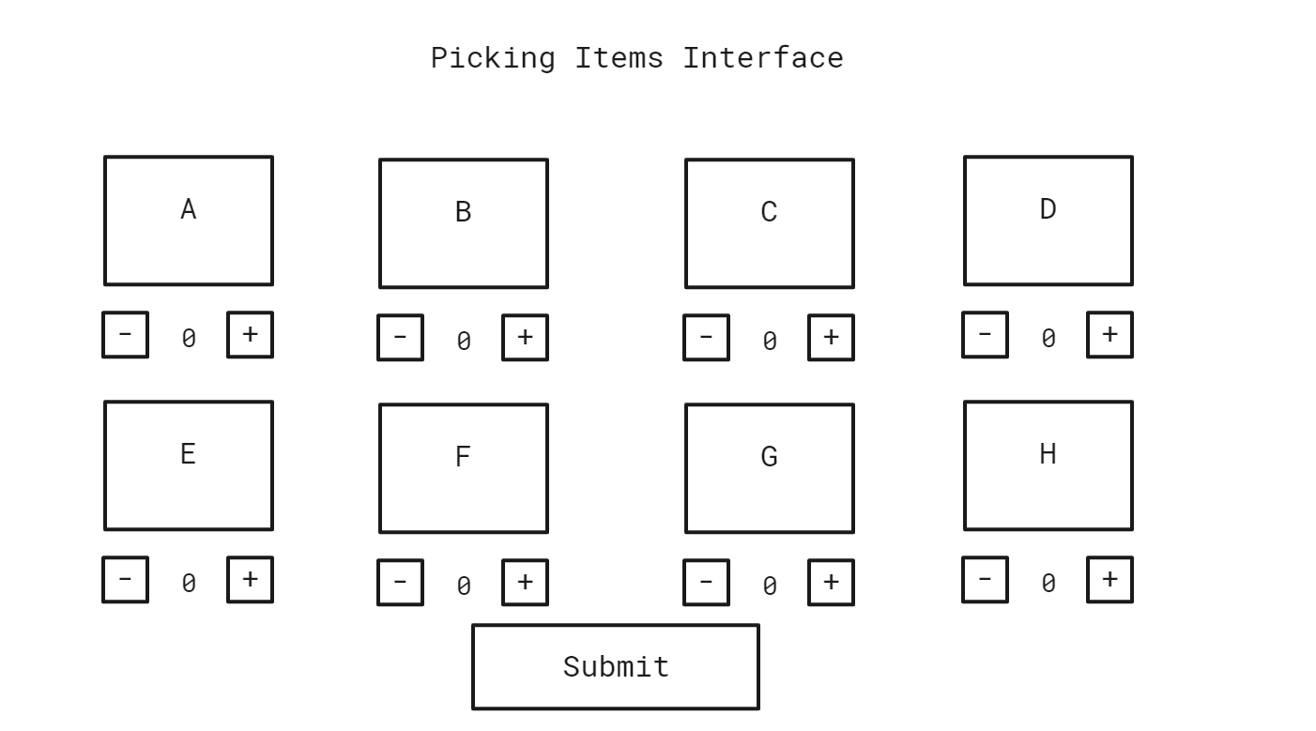
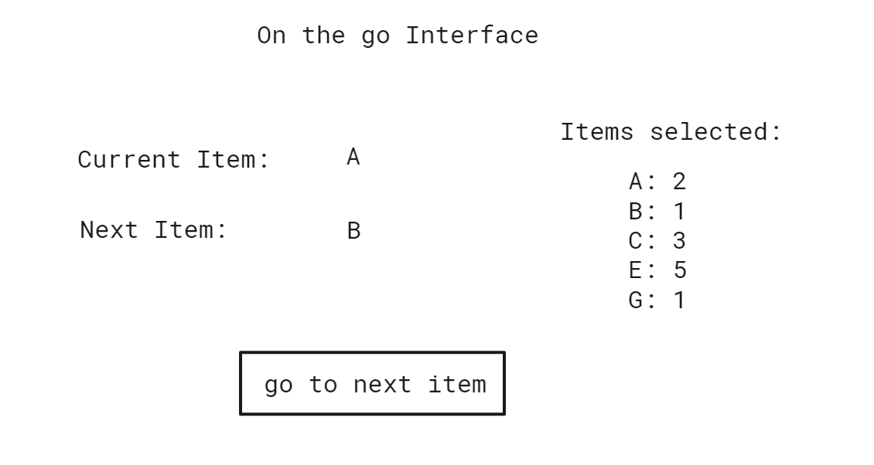
User Interaction

Slide 6
Implementation Plan
User Interface: touchscreen for interaction with user
Path Planning: line following sensor, codes stored on the Raspberry Pi
Control of Roomba: Load Sensor, Rangefinder, Python API

Slide 7
Metrics
The cart should sense the items put onto cart in 90% of cases (pressure pad inconsistencies with light items)
The cart senses the item and starts driving to next item within 2 seconds (noticeable amount of lag time)
The cart should drive at 3.1 mph (avg. human walking speed)
The cart should stop within +-0.25m of object (comfortable reach distance)

Slide 8
Metrics (cont.)
The cart should never go to the incorrect location (eliminates efficiency)
The cart should take the optimal route to next item on list (increases efficiency)

Slide 9
Validation Tests
Item Placement Detection test: 20 Random items placed in cart. Detects at least 18.
Item Placement Response test: 20 detected items. Once item is detected, cart always starts moving to next item within 2 seconds.
Speed Test: Pick 10 most common items and measure cart average speed from each item to every other item (90 total paths)
Proximity test: Pick 10 most common items. Have cart drive to each from random initial location. Measure Average distance error between cart and item.

Slide 10
Validation Tests
5. Locate Item test: Pick random cart location. Have it navigate to 10 items.
6. Route Optimality test: Pick 10 items. Start cart at random location. Manually verify each path is optimal

Slide 11
Risk Factors
Rangefinder failure?
What’s the backup plan?

Slide 12
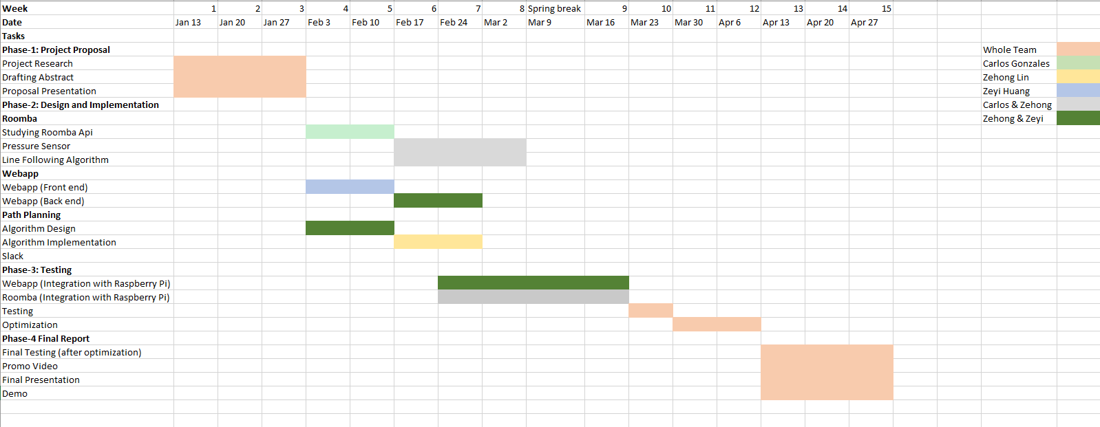
Project Management (GAANT Chart)
Zehong - Roomba API & Computer Vision / Create onboard sensors
Zeyi - User interface Display Implementation
Carlos - Controller & Path Planning

Slide 13
Zeyi | Zehong | Carlos
Tablet GUI | Path Planning | Sensor Interface
Web App | Roomba Interface | Control

