Slide 1
bot
Manini Amin, Joseph Wang, Karen Johnson

Slide 2
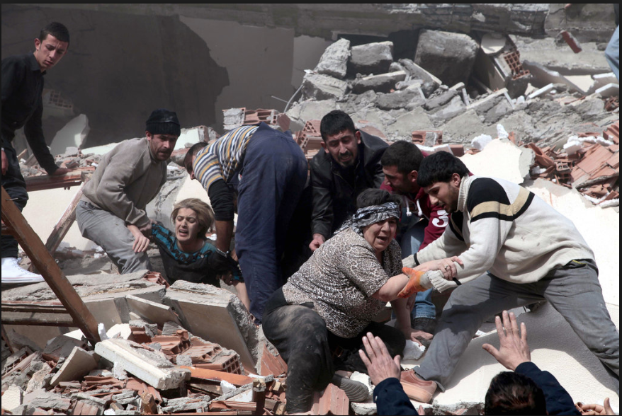
Immediate Disaster Information
How can we quickly report the number of victims in an area to first responders?
Key Features:
Detection of humans
Obstacle detection & avoidance
Areas:
Embedded systems: machinery
Signals: Image processing
Software: Detection algorithm

Slide 3
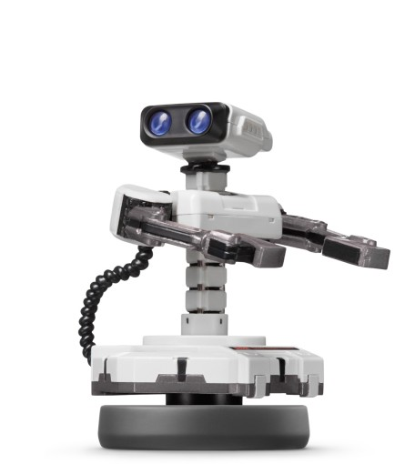
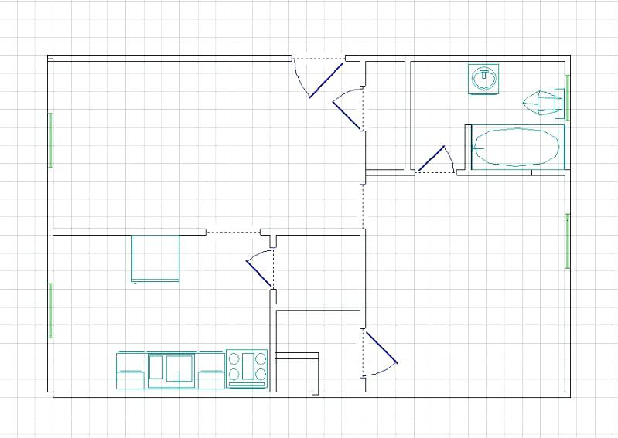
General Approach
1) Send SOS_bot room layout
2) SOS_bot navigates room and sends images back
3) Detect people in images from SOS_bot

Slide 4
Challenges
Pathfinding & Obstacle Avoidance
Traverse room to interest points to take images
Only outline of room is known
Obstacles may be placed around the room
Unideal situations
Overlapping images
Camera wobble
People may not be fully visible
Varying lighting conditions
Machine Learning model designed and implemented by us

Slide 5
Requirements
Fast and accurate machine learning
70% mAP on ImageNet dataset
Computation time < 5s per image on laptop CPU
Maximum error of +-2 when counting the number of people
Efficient pathfinding
Determine best path between interest points
Take best path around obstacle
May not be more than 2 feet off from an interest point at arrival to a point
Distance traveled may not be 20% more than calculated optimal distance with obstacles
High image quality
Resolution must be at least 1080p
Minimal quality loss from when photo is taken to when it is received
Notes:
mAP - mean Average Precision

Slide 6
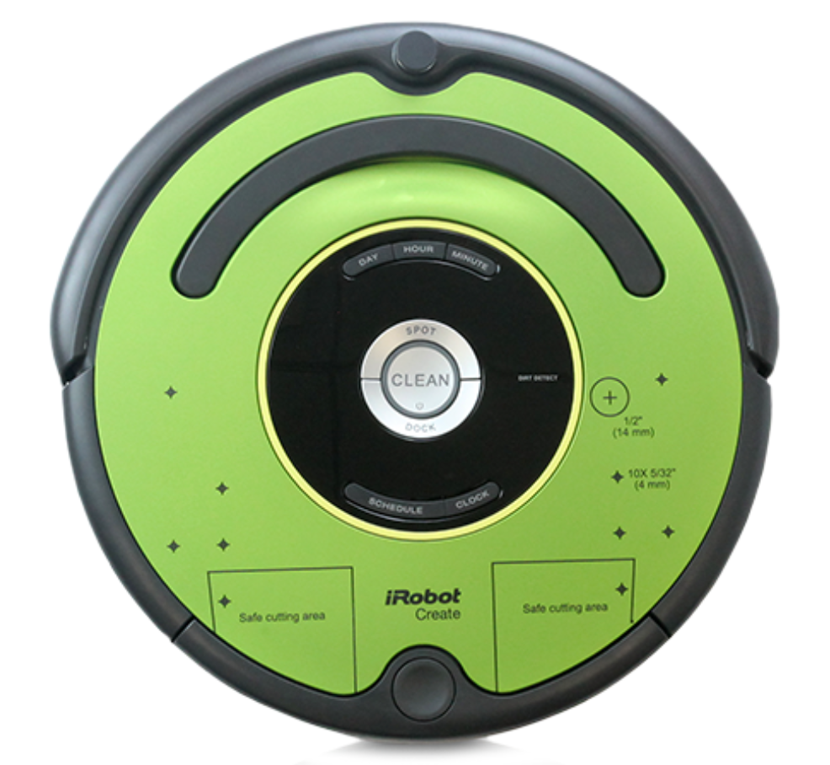
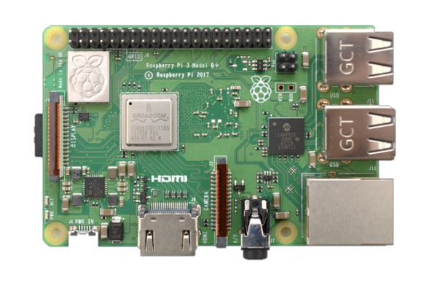
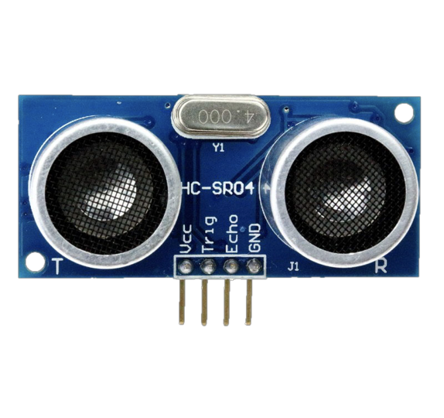
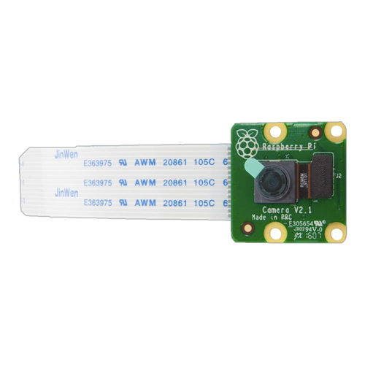
Solution Approach- Hardware Components
iRobot create 2
Raspberry pi 3 - Model B
Ultrasonic sensors (HC-SR04)
Raspberry Pi Camera Module V2

Slide 7
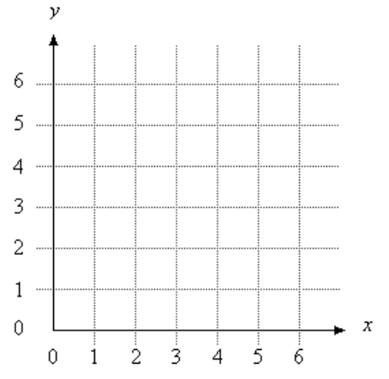
Movement
Object Detection from Sensors-> relay to Pi
- serial port connection
Still photo- sent over wifi to local computer
Occupancy Grid Map
Object avoidance

Slide 8
People Detection
Deep Learning Approach
Based on Faster RCNN
Implement using Pytorch
ImageNet Database
Trained on Amazon Web Services
Deployed on laptop
Notes:
952K Image Net pics for Person Class
Our model will be based on the pre existing Faster RCNN (Region based Convolutional Neural Networks) as we prefer higher accuracy for our model. Furthermore, we are not aiming to achieve real time detection as can be accomplished by other single shot detector models.

Slide 9
Obstacle Course
Built by us
Known grid layout
Interest points
Randomly place obstacles
Randomly place people of varying heights/positions
People may not be fully visible
Range of lighting conditions
SOS_bot must traverse this room to an interest point
Neural net must accurately detect the number of people

Slide 10
Verification Methods
Number of collisions with obstacles
Distance away from point of interest at arrival to point
Distance traveled vs optimal path distance
Photo clarity
Model inference speed
Number of people detected vs actual number of people

Slide 11
Division of Labor
Karen
Putting SOS_bot together
Roomba path planning
Obstacle Course Design
Manini
Model Implementation and Design
Model Testing and Parameter Tuning
Joseph
Model Design
Obstacle Avoidance
User Interface

Slide 12
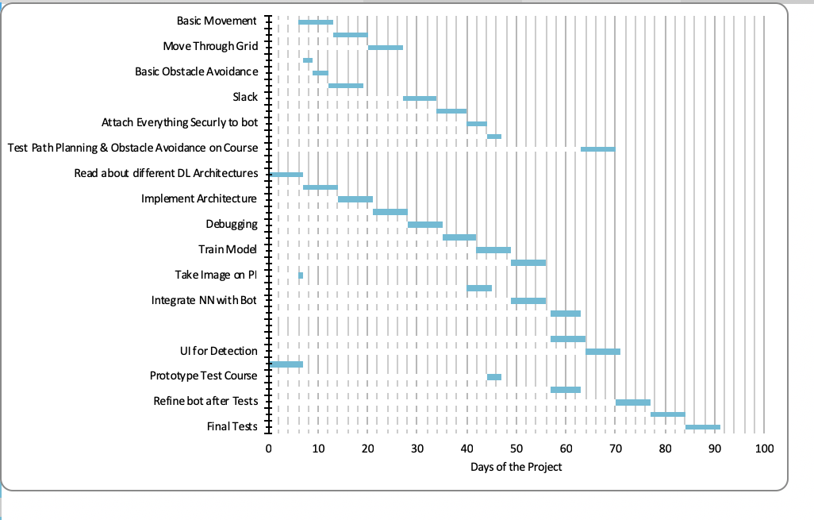
Schedule
Notes:
Basic Movement - first week
Obstacle avoidance- end of february- early march
Deep learning - April 1st
Obstacle Course - Early April
Bot fully assembled - april 6th
testing - month

