Slide 1
InteracTable
Suann Chi
Isha Iyer
Tanushree Mediratta

Slide 2
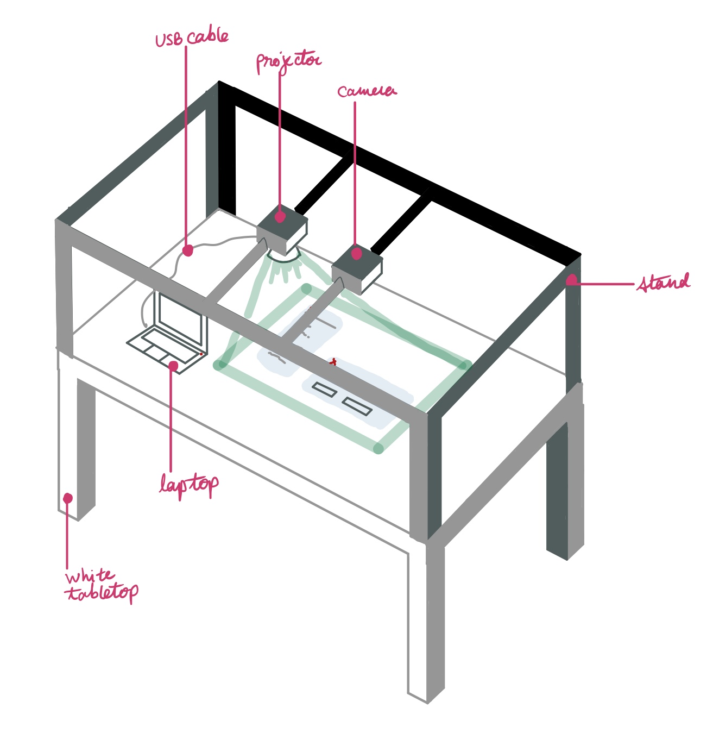
Project Description
An everyday table converted into a touch screen music system
Notes:
Main points:
What is the product?
Why is this product necessary? Promotes collaboration
Why not use other existing solutions like capacitive touchscreens? Cost effective and not constrained to an expensive surface that you cannot move
Maybe think about starting by telling a story really dramatically so that the idea sticks in their minds? Just a thought haha
On Sunday, February 3rd, at 11:40 pm, just 20 minutes before the presentation slides were due for ECE design capstone, both my and Isha’s laptop ran out of battery. We were horrified. If my team did not turn these slides in on time, we would face the wrath of Professor Sullivan! There were 5 slides left and the clock was ticking. Luckily, we had the InteracTable technology with us to save the day. With it, we were able to project Tanu’s laptop screen on the table and all edit the slides at the same time. We successfully made the deadline with plenty of time to spare.
That was obviously a hypothetical situation(fake news). But, imagine being able to walk up to any table and turning it into a touch screen that displays the same content as your laptop. No more looking over the shoulder of the person next to you, straining to see what is being typed when your own computer runs out of battery. This could change the way people exchange information when working together.
I think it may be important to say the following to argue that this is a significant design:
this is more cost effective than a normal touchscreen surface the size of a table
Since this technology can be applied to virtually any surface, it is superior to a capacitive touchscreen. If made portable, the implications are tremendous.
Capacitive touchscreen tables cost thousands of dollars. Our design is cost efficient since we are converting an ordinary table into an interactive device. Our design is a cost effective and portable alternative to using contemporary touchscreen tables. Any surface can be turned into an interactive device. Although our prototype will be a proof of concept, this idea can be expanded to a portable system that could be an invaluable tool in collaborative environments.
Our proof of concept laptop prototype converting any surface into a touch screen could change the way people interact with their smart devices. This can be expanded from a simple audio player into a suite of collaborative tools to promote better exchange of information.

Slide 3
ECE Areas Covered
Signals
Analyzing signals from the piezo sensor or accelerometer
Computer vision algorithms to detect finger placement
Software
Designing an interactive GUI
Matlab code for CV computations
Notes:
This project will cover two main areas in ECE: signals and software. The bulk of our project will be implementing the CV algorithms to track and detect the position of a user’s finger. We will also write an interactive GUI that will be projected on the table

Slide 4
Technical Requirements and Constraints
The projection must be bright enough to be visible on any white table top
The prototype must be affordable (less than $600)
The system must be able to connect to a laptop via USB cable
The system will be constrained to track a single finger
The buttons will be large enough and spaced enough to achieve 100% accuracy in selection
The delay between the detection and response to a finger tap should be under 1 second
The red dot should be large enough to ensure consistent detection
The dimensions of the projected screen should be variable
Notes:
Some of the technical requirements we have fixed include making it possible for the projected screen to have different dimensions every time the system is set up. We want the delay between the detection and response to a finger tap to be under a second to optimize the user experience. We will also track a single finger to simplify and constrain our system.
You may not want to list every single requirement on the slide - maybe only cover the most important ones. Not sure about this though

Slide 5
Technical Challenges
Challenges
Possible Solutions
Surfaces can be of varying dimensions
Project a border at the edge of the screen as reference for calculations
The red dot may be obstructed by the colors of the projected screen
Track the shape of the dot in conjunction with the color
A hand may distort the projected screen by interfering with light rays
Change the angle of the projection
Delays in processing data
Use the Matlab Parallel Computing Toolbox
Difficulty mounting the projector and camera on a custom stand
Fix the positions of the projector and camera and use tripods
Setting up the circuit for the piezo sensor
Use an existing accelerometer in a phone
Notes:
We will face many technical challenges while implementing this project. Some of the main ones we have identified include…
We recognize that surfaces can be of varying dimensions. To account for this variability, we plan on projecting a border at the edge of the screen. This border will enable us to calculate the coordinates of a finger tap by using the distance from the tap to the border. Furthermore, this border will confine the workspace to a restricted area, thus helping us control our environment.
We may face an issue in finding the perfect illumination under which the projected screen is clearly visible and the red dot on the finger is not obstructed by the colors of the projected screen. We do not know if this will be a significant problem.
We do not know how the projector light may change the color of the red dot we are tracking. A hand may also distort the projected screen by interfering with the light rays. We may have to bypass this by blob detection in conjunction with the color.
We expect there may be delays in processing data. We will try to resolve this delay by using the Matlab Parallel Computing Toolbox.
Since we do not have much experience with physical mounting systems, we may have some difficulty in mounting the projector and camera on a custom stand or lamp.
It may be a challenge to set up the right circuit for our piezo sensors which will pick up the vibrations of a tap. We also need to determine what kind of microcontroller we may need or if we need one at all for this circuit.
Same as the last slide, you may not want to list every single requirement on the slide - maybe only cover the most important ones when talking. But the ProposalPresentation guidelines document says we should know pretty much all of the challenges we will face at this point so not sure about this

Slide 6
Solution Approach: Overview
Color HD Camera to view finger movement
Projector to project screen on surface
Piezo sensors to detect finger tap
Qt used to create UI for projected screen
Matlab used for finger detection and tracking
Simple algorithm to convert analog signal to response
Notes:
LIKE THE LIST OF SPECS IN ABSTRACT (how we make and how we test)
To provide an overview of our approach: we will be using a projector to project the screen from our laptop onto a flat surface. The user interface for this projected screen will be made using Qt, a GUI module. To locate the user’s finger, we will be placing a red dot on it, which we will be able to view via an HD color camera. The purpose of the red dot is to help us track the finger. These calculations will be done in MATLAB. Lastly, to detect a finger tap, we propose to use piezo sensors. The signals from this sensor will be read through a simple circuit. Once the tap is confirmed, a sequence of appropriate responses will be triggered.

Slide 7
Solution Approach: Algorithms
Tracking
Lucas Kanade algorithm
Some of the assumptions might be violated in our case: brightness constancy
Computationally intensive: considers every frame of the video
Detection
Color Thresholding or blob detection
Only consider frame in which tap detected by sensors
Might be faster that tracking
Notes:
To talk in more detail about our algorithmic approach: we are currently in the process of implementing two different approaches of finger detection and tracking:
What is the essential difference between a tracking algorithm and a detection algorithm? A tracking algorithm looks at the position of an object over time which requires computation over several frames. A detection algorithm finds the location of an object in a single frame. We will implement both algorithms so that we can achieve our requirement of low latency.
One of the methods would be a standard tracking algorithm called Lucas Kanade. Some assumptions like brightness constancy will be broken since our demo will be using projected light. Additionally, this method is computationally heavy as it processes every frame of the video.
An alternative method we thought of is to only analyze the frame in which a tap occurs, and then try to detect the red dot on the finger in that static frame only. We are thinking of using color thresholding and/or blob detection to achieve this. This approach might be faster.
Our goal is to compare the efficiency and practicality of the two approaches, and choose the most optimal one for our given environment.
in which we will work, i.e., under darker illumination and projected light

Slide 8
Testing
Test tracking and detection algorithm: choose optimal method
Test single button system: correct response with finger location and tap
Test piezo sensor circuit: ensure accurate readings are obtained
Test multi button system:
audio files correctly manipulated by user input
Notes:
We have divided the project into several steps and our aim is test at the end of each stage: this can be worded better, but just putting basic thoughts down
Test the previous mentioned tracking and detection algorithms and choose the one which works best under our environment constraints. To make sure we are being able to localize the finger correctly, we will either create a box centered at the red dot or create a binary mask in the case of color thresholding.
Once we create the circuit that reads the analog signals from the piezo sensor, we will test to see how hard the user needs to tap in order to trigger an accurate response without false positives or false negatives.
We will then integrate these two steps together and test them together along with the GUI with a single button. Our goal is to provide a response within a second. (Obviously very optimistic)
Once our single button system works, we will expand it to an audio player interface with multiple buttons such as play/pause, track, volume, fast-forward, etc. This final integration step will then be tested multiple times. Do we want to add any metrics?
Testing these will help us evaluate these metrics:
Timing
User effort in terms of tap and motion
Accurate response (registered that you pressed play and not fast forward)

Slide 9
Tasks and Division of Labor
Isha
Object detection algorithms
Integrate sensor with tracking/detection algorithm
Testing tracking/detection in demo environment
MATLAB to python pipeline
Suann
Finish Lucas-Kanade - implement tracking algorithm
Set up mechanical parts + circuit for piezo sensor
Create skeleton for GUI and audio manipulation
Tanu
Start Lucas-Kanade - extract trackable features
Read sensor data and test
Complete the GUI and audio manipulation

Slide 10
Tasks and Division of Labor
Sprint 1
Sprint 2
Sprint 3
Isha: Object detection algorithms
Tanu: Start Lucas-Kanade - extract trackable features
Suann: Create skeleton for GUI and audio manipulation
Isha: MATLAB to python pipeline
Tanu: Complete the GUI and audio manipulation
Suann: Complete Lucas-Kanade Tracking
Isha: Simulate tap and integrate with tracking/detection
Tanu: Read sensor data to test for threshold value
Suann: Create circuit for sensor + set up mechanical parts
Notes:
We understand that there are many steps involved with this project. So we have divided this into three phases.
First phase …
Second phase …
Third phase ...

Slide 11
Tasks to be accomplished together
Integrate tap simulation and real sensor data
Test in demo environment
Write paper and get an A :)
Notes:
For the final stretch of the project, we plan to ...

Slide 12
 |  | Jan | Feb |  |  |  |  | Mar |  |  |  | Apr |  |  |  | May
Personal Deliverables |  | 28 | 3 | 6 | 13 | 20 | 27 | 6 | 13 | 20 | 27 | 3 | 10 | 17 | 24 | 1 | 8
Slack
Finish Object Detection
Tracking Algorithm Lucas Kanade
GUI + audio manipulation
Compare Tracking vs Object Detection
Integrate GUI with tracking/detection algorithm
Simulate tap and integrate with tracking/detection
Set up mechanical parts (stands, camera, projector)
Create sensor circuit
Read sensor data to decide threshold
Make tracking work with projector and camera set up
Integrate tap simulation and sensor data
Test in demo environment
Practice for presentation
Write paper
Notes:
This is the third iteration of our gantt chart, as you can see we put a lot of thought into task division. We have baked in individual slack weeks so if an emergency happens, there is plenty of time to deal with it.

Slide 13
Q & A

