Slide 1
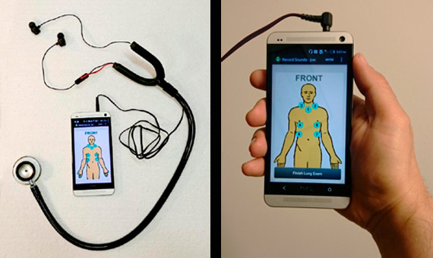
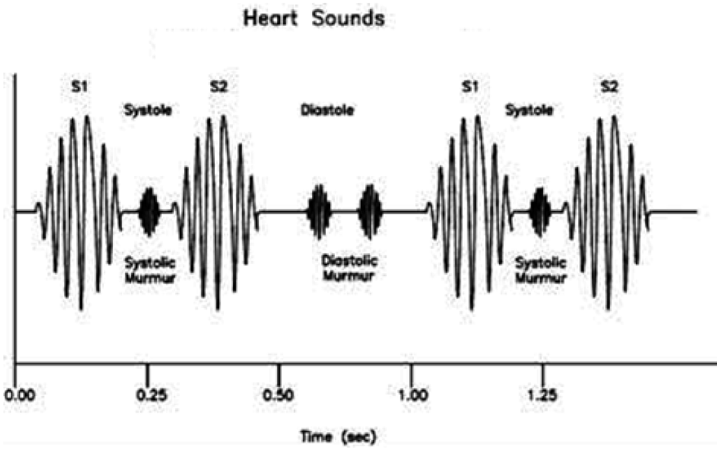
SMART STETHOSCOPE
A4 - Ari Jain, Ryan Lee, Eri Sugita

Slide 2
Use Case
Problem: Cardiologists using physical exams only caught 47% of abnormal heart sounds
2014 study in JACC Cardiovascular Imaging
Primary Actor: Medical staff and assistants (e.g. cardiologist, paramedics, medical assistants, physician assistants)

Slide 3
Use Case
Main Success Scenario: 1. User places stethoscope on patient’s heart 2. Patient’s heart sound waveform is continually collected and shown on the user’s computer 3. The system segments 5 full ‘lub’ ‘dub’ sounds 4. The system filters the heart sound to match that of the dataset we trained on 5. ML analysis will classify the patient’s heart sound as normal/abnormal 6. Indicator light on the computer will show up green for a normal heart and red for an abnormal heart
Covered areas:
Hardware, Signal Processing, Software, ML, Circuits

Slide 4
Requirements
A stethoscope modified with a microphone sensor
Sends data to a computer/phone using 3.5mm cable
Analyze the heart sound on external server using ML to detect any abnormalities with at least 85% accuracy
Add a LED to the stethoscope to indicate green for normal heart sound and red for abnormal heart sound
UI on the computer/phone to show heartbeat wave and other data
Notes:
Decide on bluetooth or cable

Slide 5
Technical Challenges
Ability to gather heart sound data from the patient with minimal noise electronically
Create front end software to display the patient’s heartbeat as well as analysis of it on a phone/computer
Developing a ML algorithm that accurately determines whether a given heart sound is normal/abnormal. Aim to be better than a doctor (85% according to research)
Demonstrate that the stethoscope correctly works

Slide 6
Solution Approach
Stethoscope
3.5mm cable
Sensor
(Mic)
Phone/Computer
Light Indicator
External Server for Analysis
Earpiece

Slide 7
Testing, Verification and Metrics
Step 1: Test ML algorithms first on a public dataset to verify that it classifies accurately
Dataset > 800 useful datas with both normal and abnormal heart sounds with various levels of noise.
Peter J. Bentley Heart Challenge dataset (http://www.peterjbentley.com/heartchallenge/)
Dataset is split into 4: 1 training data, 1 validation data, 2 testing data

Slide 8
Testing, Verification and Metrics
Step 2: Test segmentation algorithm of finding 5 consecutive ‘lub’ ‘dub’ beats
Segment must begin on the first ‘lub’ received and end on the 5th ‘dub’ received
Metric goal: 100% accuracy
Step 3: Test ML algorithms/filtering on data received from the electronic stethoscope
Test on the synthetic heart speaker to test on abnormal heart sounds
Modify filtering if the classification is not accurate
Metric goal: > 85% accuracy

Slide 9
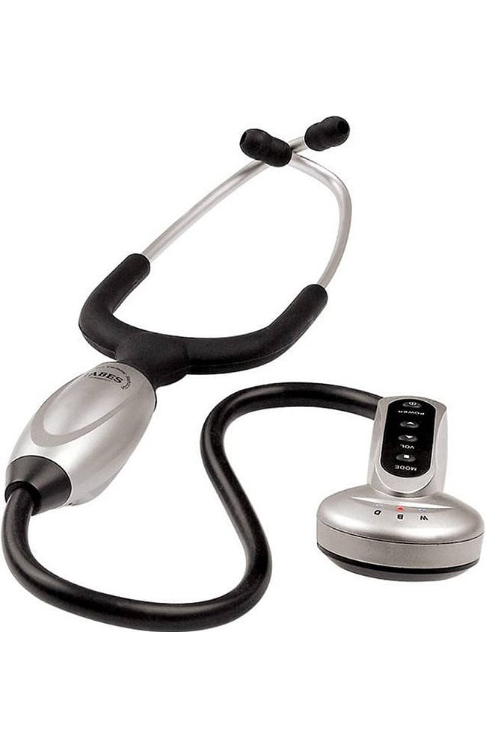
Tasks and Division of Labor - Stethoscope (Ari)
Design stethoscope hardware
Order parts
Build physical stethoscope
Connect microphone, earpiece, and transmission cable
Receive signal on phone/computer and transmit to external server for data processing
Test indicator light
Test signal quality
Test robustness

Slide 10
Tasks and Division of Labor - Data Processing, Classification, and Segmentation (Ryan & Eri)
Receive signal from stethoscope
Segment 5 full ‘lub’ ‘dub’ beats collected from stethoscope
Filter the heart sound to match that of the dataset we aim to train our algorithm on
Develop an algorithm that trains the stethoscope to classify a heart sound
First, classify as a normal/abnormal heart sound
Next, classify abnormal sounds as Aortic Regurgitation (AR), Aortic Stenosis (AS), Mitral Regurgitation (MR), Mitral Stenosis (MS)
Test stethoscope on the synthetic heart speaker and verify it reaches the desired accuracy

Slide 11
Tasks and Division of Labor - Software (All)
Build external server to receive data
Put processing algorithm on server
Make a web/mobile app for viewing data in more detail as well as sending data to our processing algorithm
Test web/mobile application
Test everything all together on ourselves and ballistic gel dummy with speaker

Slide 12
Schedule
https://docs.google.com/spreadsheets/d/1PRCphQJJN5vHCl8gASBjHpMXF_1_KJmHZ78V9qmw_bA/edit?usp=sharing

