Slide 1
Content
AWS Basics
EC2 Instances
EC2 Setup
Use Remote Server

Slide 2
AWS Basics
We will use AWS for homeworks and projects in this course
3 x 50 AWS credits will be assigned
EC2 instances is all we need for AWS
a virtual server

Slide 3
EC2 Instances
Create the EC2 instance following the steps:
Configure Amazon Machine Image (AMI)
Configure EC2 instances (CPU, GPU, Memory)
Setup SSH Configuration
Setup Storage Configuration

Slide 4
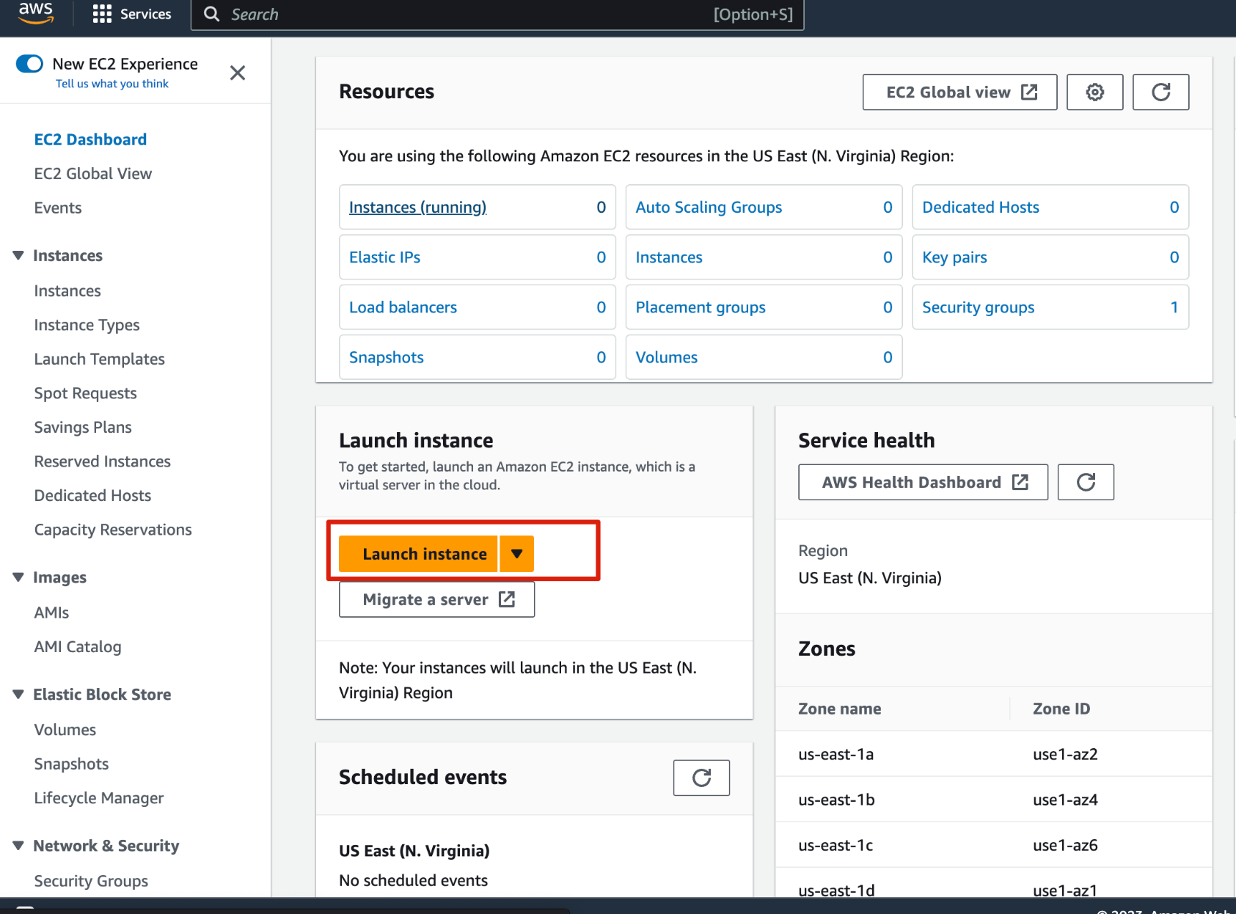
EC2 Setup
EC2 Dashboard

Slide 5
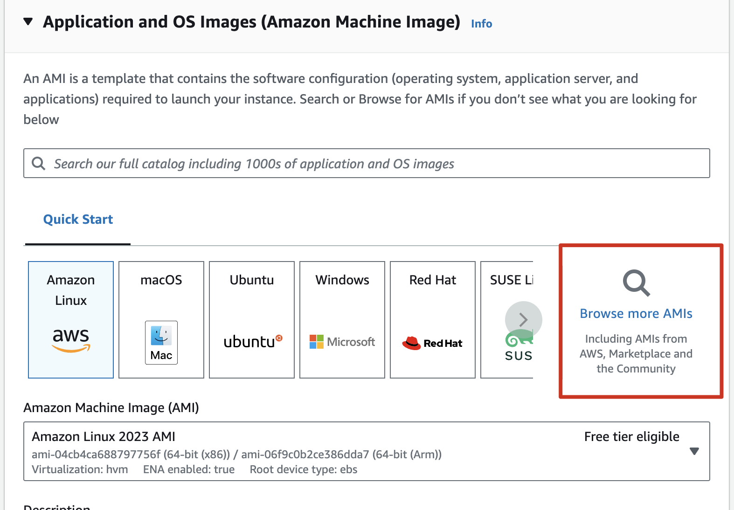
EC2 Setup - Configure AMIs
There are two images we recommend to use
 | DL Base GPU AMI | DL AML GPU
Boot Volume Size | >=60GB | >= 100GB
Packages | Drivers, CUDA, CUDNN | + Anaconda, Pytorch, ML Packages

Slide 6
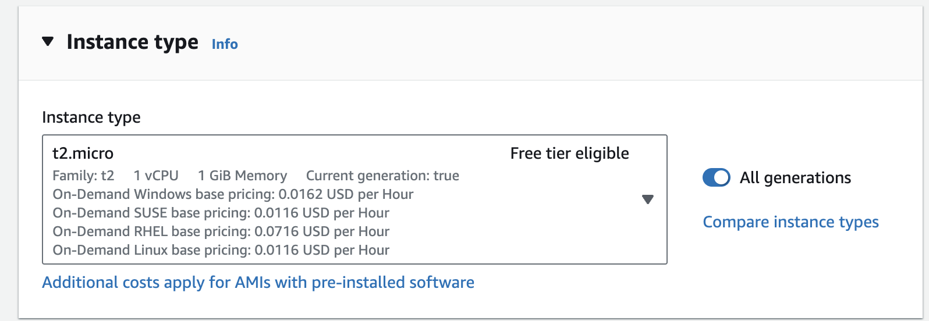
EC2 Setup - Configure Instance
Select Instance type according to the task
Type | vCores | RAM (GB) | GPU | Suitable for
t2.micro | 1 | 1 | - | Test only
c5.xlarge | 4 | 8 | - | Code dev w/o GPU
g4xdn.large | 4 | 16 | 1x Nvidia T4 | Code dev & Train
p3.2xlarge | 8 | 61 | 1x Nvidia V100 | Code dev & Train

Slide 7
EC2 Setup - Configure Instance
Amazon EC2 P3 - Instances have up to 8 NVIDIA Tesla V100 GPUs.
Amazon EC2 P4 - Instances have up to 8 NVIDIA Tesla A100 GPUs.
Amazon EC2 G3 - Instances have up to 4 NVIDIA Tesla M60 GPUs.
Amazon EC2 G4 - Instances have up to 4 NVIDIA T4 GPUs.
Amazon EC2 G5 - Instances have up to 8 NVIDIA A10G GPUs.
Amazon EC2 G5g - Instances have Arm-based AWS Graviton2 processors.

Slide 8
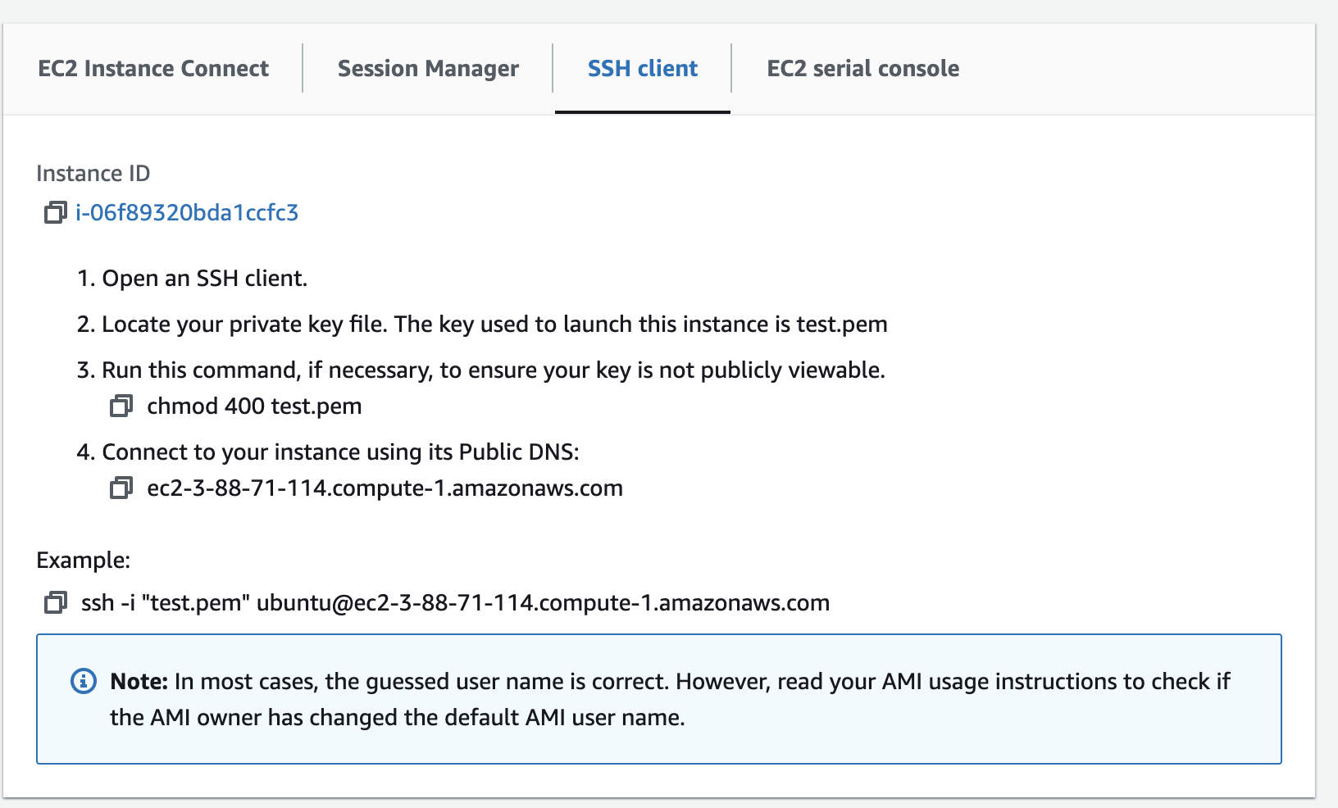
EC2 Setup - SSH
In ~/.ssh/config, add a section

Slide 9
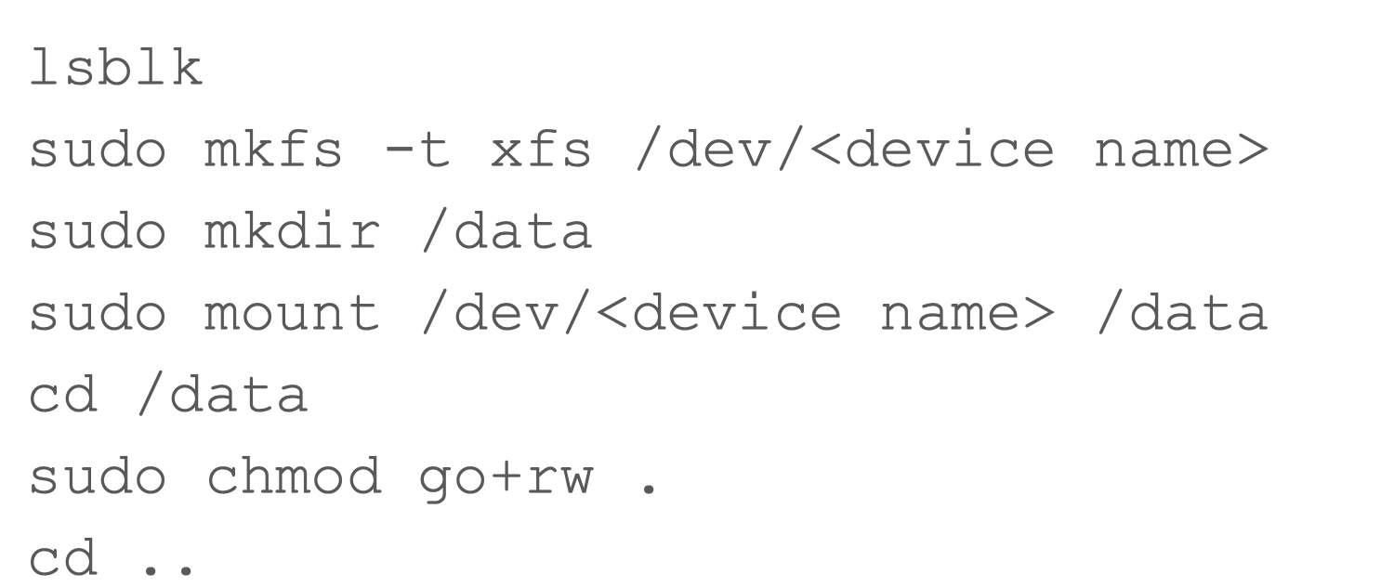
EC2 Setup - Storage
Normally, the device name should be nvme1n1
Instance storage will be reset after stopping the instance

Slide 10
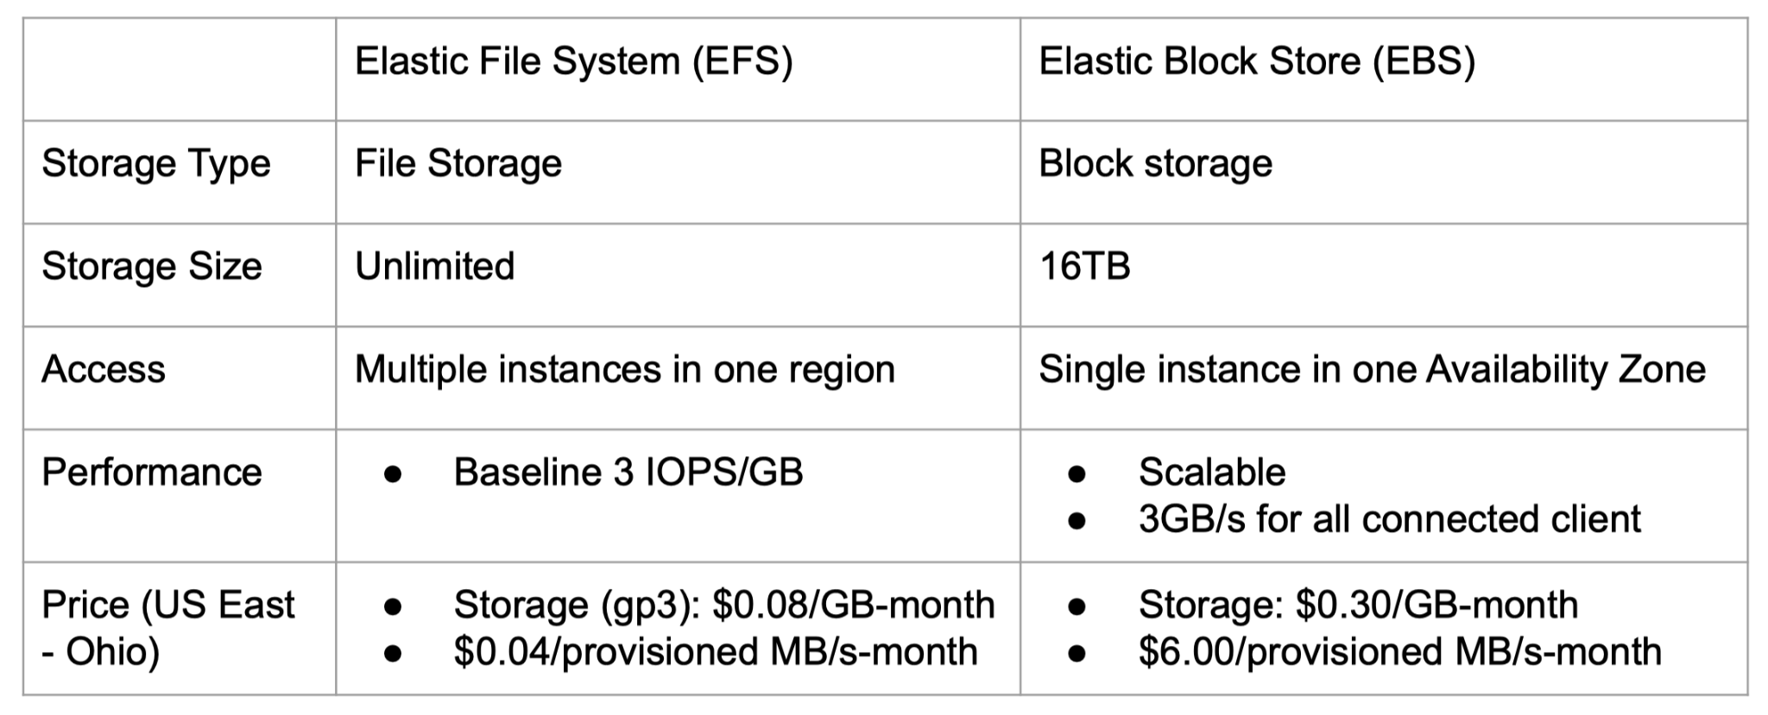
EC2 Setup - Persistent Storage (EFS & EBS)

Slide 11
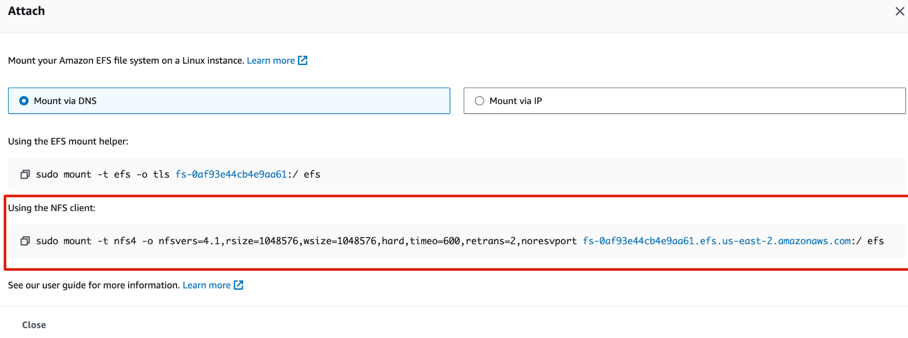
EC2 Setup - Persistent Storage (EFS & EBS)
Open EFS Dashboard - Create File System
Click File System ID and go to the details page, select “Network - Manage”, update the security groups to include the security group for your EC2 instance
Copy the command to attach through NFS

Slide 12
EC2 Setup - Persistent Storage (EFS & EBS)
Go to SSH connection to EC2 instance, mount the File System
sudo mkdir /efs
Paste the command copied from last step
cd /efs
sudo chmod go+rw .

Slide 13
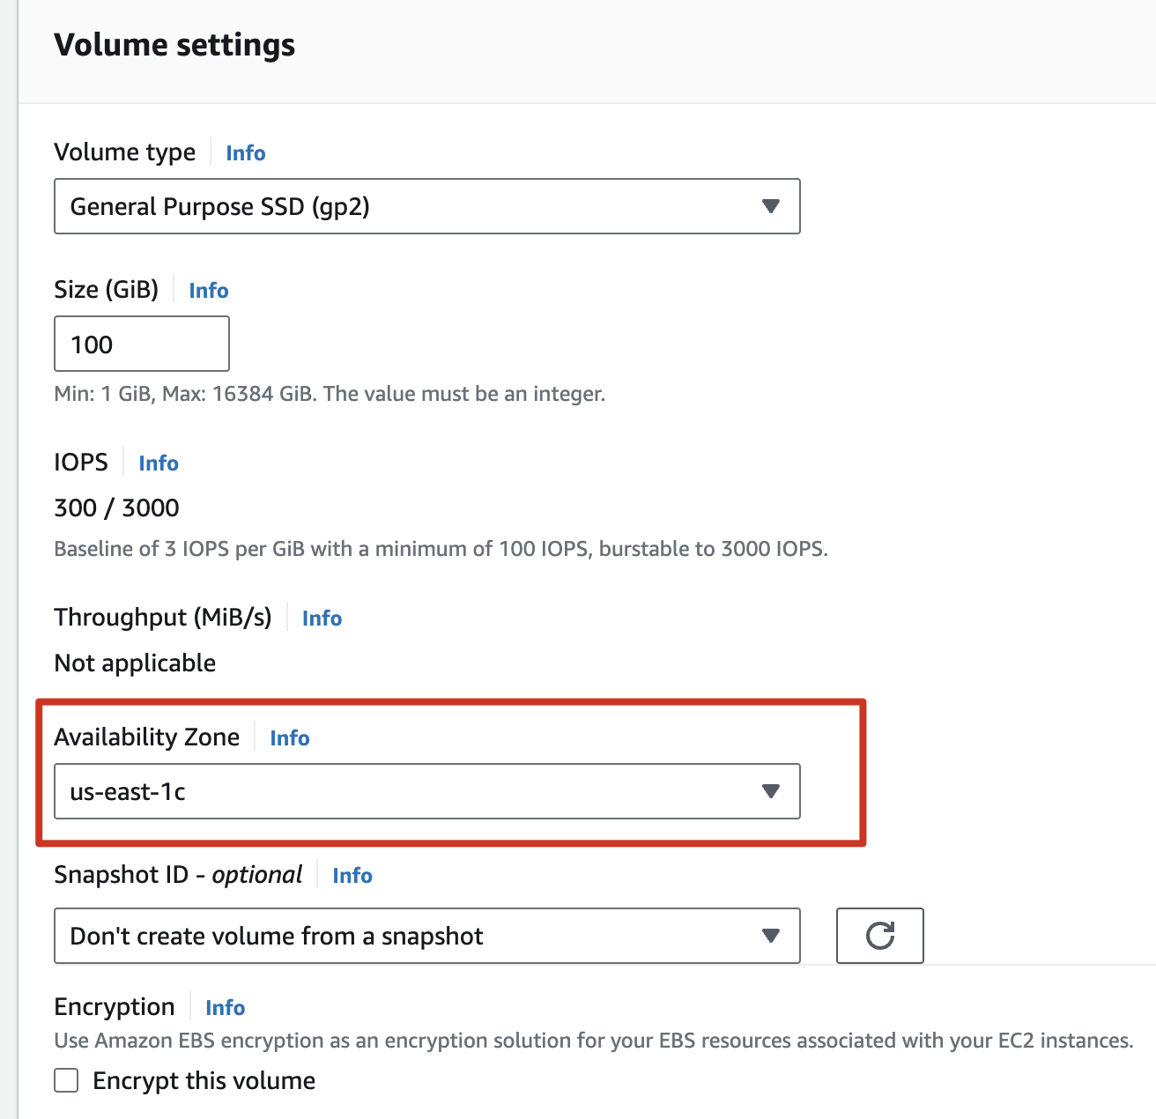
EC2 Setup - Persistent Storage (EFS & EBS)
On EC2 dashboard, select “Elastic Block Store - Volumes”
Click “Create Volume”, modify the availability zone to be the same as your running EC2 instance
Right-click on the created volume, select “Attach Volume” and choose your EC2 instance

Slide 14
EC2 Setup - Persistent Storage (EFS & EBS)
Go to SSH connection to EC2 instance, mount the volume
After stopping & restarting instance, only need to remount the volume
sudo mount /dev/<device name> /ebs

Slide 15
Use Remote Server - Screen Command
Create a new session
screen -S
screen -S <session_name>
Detach from current running session
Ctrl+A and then D
Attach to an existing session
screen -r
screen -r <session_name>

Slide 16
Use Remote Server - Tmux Command
Create a new session
tmux new -s <name>
Detach from current running session
Ctrl+B and then D
Attach to an existing session
tmux at -t <name>

Slide 17
Use Remote Server - Jupyter Notebook
Install jupyter notebook
pip install jupyter jupyterlab
Open a notebook
jupyter notebook --no-browser --port #PORT
Setup up an ssh tunnel from the local machine
ssh -i privite_key.pem -N -f -L localhost:#PORT:localhost:#PORT ubuntu@ec2-3-88-71-114.compute-1.amazonaws.com
Or ssh -N -f -L localhost:#PORT:localhost:#PORT test_aws
if you have setup the ssh config
On local machine, open jupyter link

Slide 18
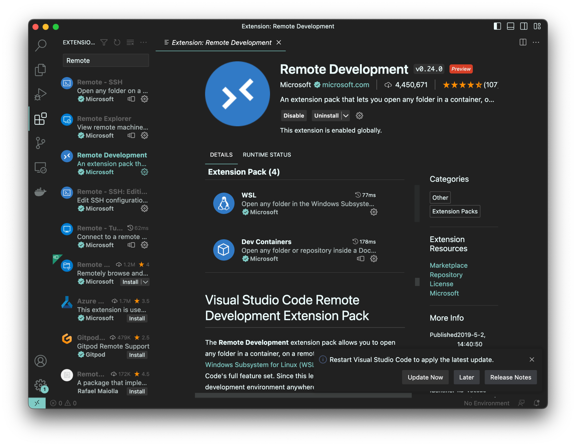
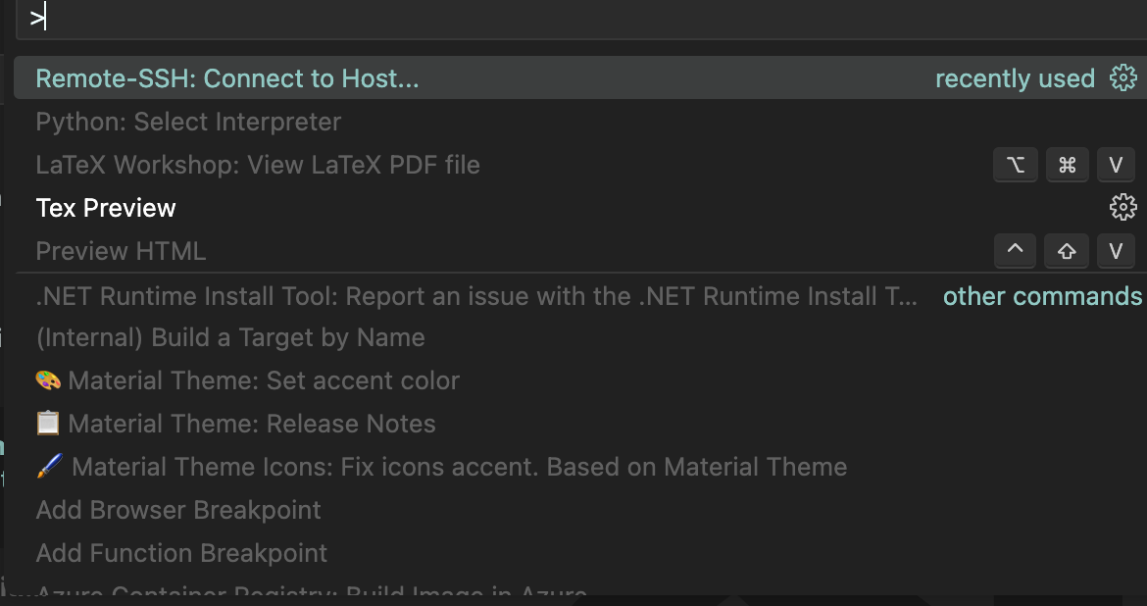
Use Remote Server - VSCode Remote
Install Remote Development Kit
Command + P to find the ssh connect
Connect remote server

