Slide 1
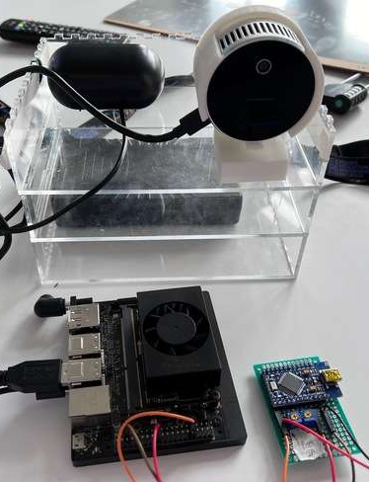
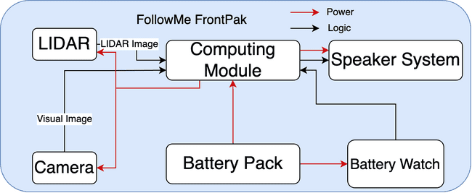
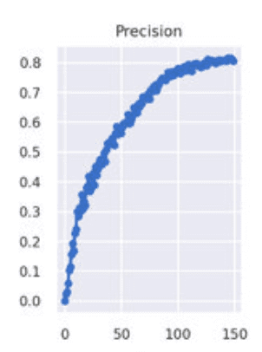
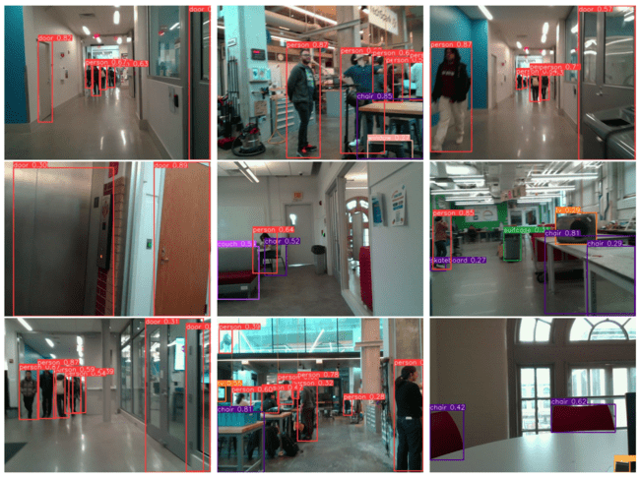
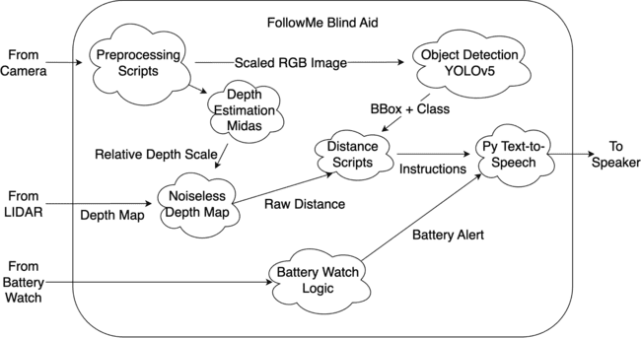
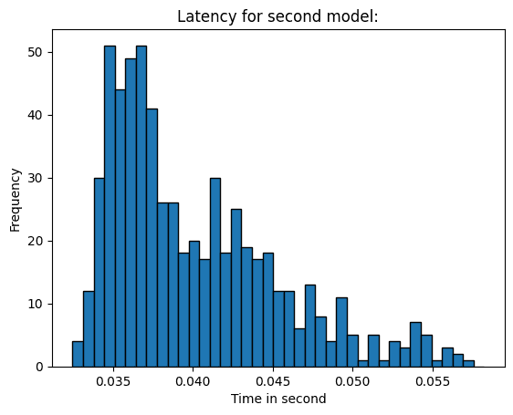
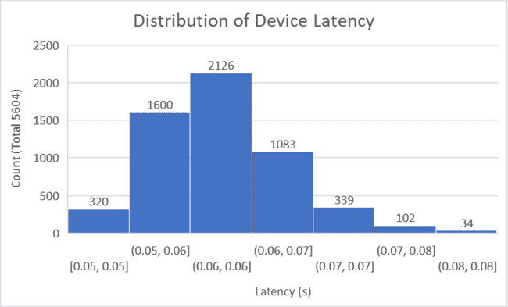
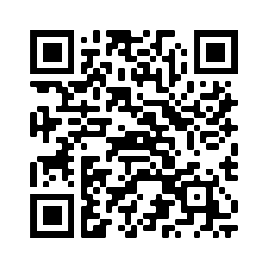
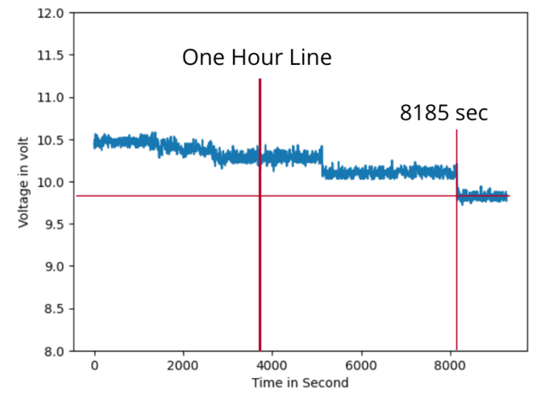
FollowMe
Team A5: George Chang, Ging Luo, Jeffery Cao
18-500 ECE Design Experience, Fall 2023
Department of Electrical and Computer Engineering
Carnegie Mellon University
Product Pitch
System Description
FollowMe is a blind aid system detecting and identifying obstacles in front of blind people. Specifically for walking in indoor, flat hallways.
Use Case: Blind people have trouble using walking sticks to navigate surroundings because they have little confidence of what and where are in front of them. Followme is an accessible, affordable solution.
Design Highlights: Built upon LIDAR and camera, it combines real-time object detection and depth calculation to output auditory guidance for users.
Requirements: Battery life > 2 hours and weight < 5lb for smooth user experience. To ensure safety, must have less than 200ms of response time and 80% overall detection accuracy. To be affordable, must be < $600.
Testing Results: Successfully meets our goal with 85% accuracy, 62ms latency,2.5h battery life, and 2.8lb weight. It uses an NVIDIA Jetson and Intel Realsense Camera which can be replaced with cellphone.
Camera+LIDAR
Software: A pre-trained YOLOv5 Nano as base object detection model for detecting people, as well as a self-trained YOLOv5 Small model that specializes in recognizing hallway-specific objects such as doors, chairs, windows, and desks.
A distance calculation algorithm based on the depth map from LIDAR. It estimates the closest point of the object.
A filtering algorithm to improve accuracy by detecting unstable YOLO outputs and whitelisting object classes.
Speaker
Battery
3D Printed Box
Arduino
NVIDIA Jetson Xavier NX
System Architecture
Hardware: three-layered box housing battery at the bottom, NVIDIA Jetson and Battery Watch in middle and Speaker-Camera on top. The battery watch is made with Arduino and 2 potentiometer as Voltage Divider.
Hardware Diagram
System Evaluation
Accuracy Testing
Visualization
The computing module is NVIDIA Jetson. After the sensors (LIDAR and Camera) collects images and depth maps, the computing module will run model and control script to trigger voice warning to the speaker. Battery pack and battery watch power the system with low-battery warning.
Software Diagram
Results: For self-trained model, precision is 0.76, recall rate is 0.7. Combined with the 95% accuracy pre-trained model, the overall system’s accuracy is 0.85 by real-world user tests.
Latency Testing
Results: The latency of the system is averaged 60ms, with the average latency for the neural model to be around 40ms. The overall latency is less than 500ms.
After preprocessing sensor’s outputs, YOLO outputs bounding boxes and labels, and distance calculation script processes closest object’s distance. Voice warning is then triggered based on fine-tuned thresholds.
Trade-off Studies
Key tradeoff between accuracy and inference speed. YOLO model, a single stage detector, balances the tradeoff by directly recognizing extracted features from raw images.
ML Model | Speed | Accuracy
Hough Transform | CPU Memory Intensive | Bad for complex
Segmentation | ~10s | Too Detailed
FRCNN | 500ms | 0.9
YOLO | 200ms | 0.76
Conclusions & Additional Information
- FollowMe meets our goal with 85% accuracy, 62ms latency, 2.8lb, 2.5h battery life.
- Summary: Self-trained YOLO + Battery watch + LIDAR depth measurement script.
- Highlights: User-centric blind aid promoting blind people’s public welfare
- Future work: incorporate GPS navigator like SLAM into the design that recognizes
Battery Watch Testing
Voltage Drop Across Time
Results: The battery life of the system is around 2.5 hours. Within one hour, the voltage is relatively stable.
blind people’s voice input and guides to the destination.
Lessons Learned:
As product managers, we learned user-centric design, iterative design, and the importance of carefully scoping designs.
As engineers, we learned how to analyze tradeoffs and make robust systems that adapt to changes.
https://course.ece.cmu.edu/
~ece500/projects/f23-teama5/

