Slide 1
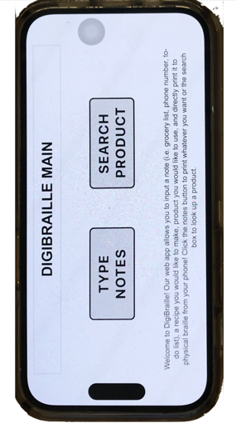
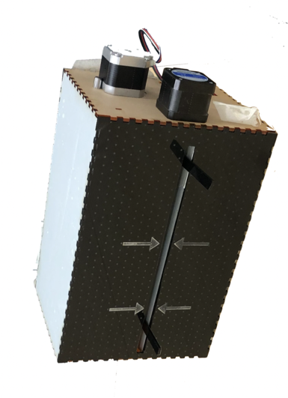
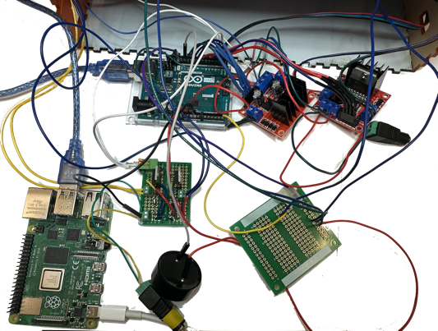
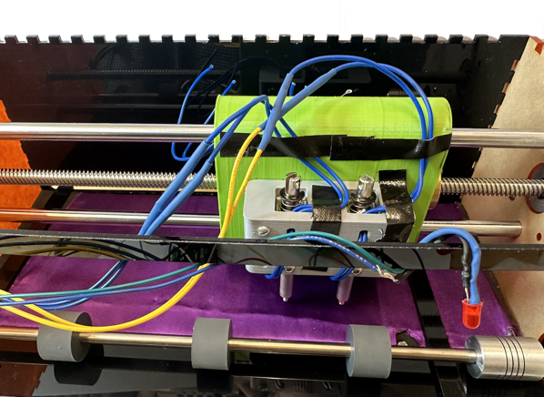
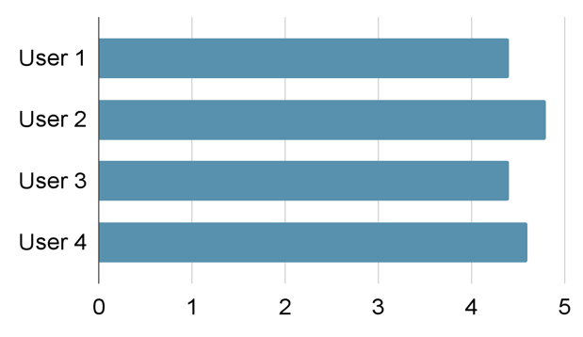
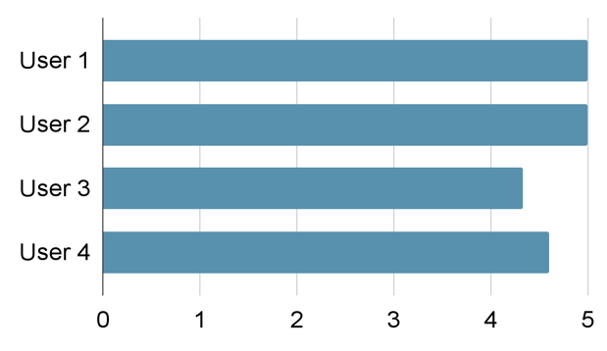
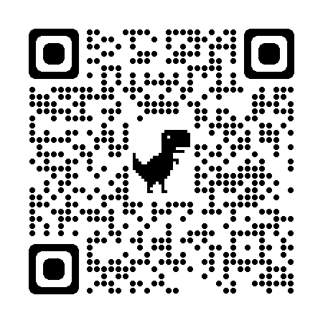
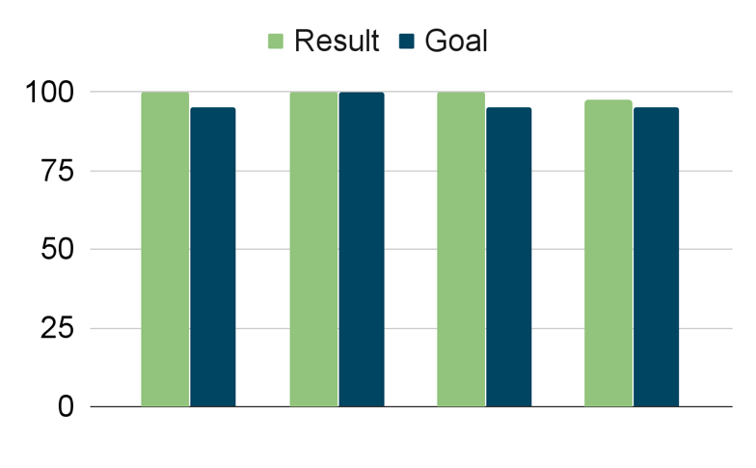
DigiBraille
Team A4: Zeynep Ozkaya, Joshna Iyengar, Becky Button
18-500 Capstone Design, Fall 2023
Electrical and Computer Engineering Department
Carnegie Mellon University
Product Pitch
System Description
Nearly 3.2 million Americans suffer from serious vision loss, and simple tasks for sighted people, such as reading a recipe or jotting down a quick note can become a complex undertaking for a visually impaired person, even with the aid of existing technologies. Current accessible technologies, such as braille printers, electronic braille readers, and braille writing slates, can be expensive and time consuming to use.
We propose a device that allows blind users to connect to a wireless braille printer directly from a web-app available via smartphone, which has many accessibility tools that blind users take advantage of everyday. Our web-app will allow users to either input notes or search a product name that they would like instructions for using accessibility features. They can then send a print request to our braille embosser, which will provide them with a braille version of their input at a lower cost and comparable timeframe to state-of-the-art devices.
Our systems consists of two primary components: a phone accessible web-app (Figure 2) and an electromechanical embosser (Figure 3). In the web-app, users can elect to enter notes or search a product name for instructions. Our web-app will connect to our embosser wirelessly over wifi. The embosser is comprised of 2 solenoids, a stepper motor with a lead screw, rollers, and a light sensor (Figure 4). The two solenoids move in the x direction and are responsible for the embossing of the braille. The stepper motor with the lead screw shifts the solenoids across the x-direction. The rollers will move the paper in the y-direction once a single line of raised dots is finished embossing. The light sensor will be used for paper registration, and we will have a speaker to communicate status to the user.
tactile surface
x motor
System Architecture
paper guides
y motor
Figure 2. Webapp homepage
Figure 3. Electromechanical embosser
linear rod
Users will input requests into a web-app developed using Flask and Python. Their requests will then be translated to braille, or input into our web scraping algorithm before translation, depending on the input type. The translation will then be mapped to motor and solenoid signals, which will be sent to our Raspberry Pi (RPi). The RPi communicates with an Arduino, which controls most of the circuitry, over UART. The solenoids will emboss the paper, the stepper motors will control movement in x/y directions.
solenoids
lead screw
Arduino
Solenoid circuit
Motor drivers
RPi
Speaker
LDR circuit
User Inputs Data
low-friction compliant surface
paper roller
LED
Figure 4. Circuit view
Figure 5. Gantry view
Flask interprets request
Text box
Product name
LDR
translation.py
cache search
System Evaluation
Selects print
map to solenoid and motor signal
database/query
Web-scrape w/ BeautifulSoup
Speed Results- based on timing runtimes for components
Info cleared; return to home
Google search
Component | Goal | Result
Emboss single braille cell | < 12.5 sec | 7.5 sec
Product search time with | < 1 sec | .5 sec average w/ database 5.32 sec average w/ query
Electromechanical Embosser
Button
Solenoid
Solenoid circuit
5 V
Raspberry Pi
Table 1. Speed Results
Solenoid
Solenoid circuit
Button
Accessibility Results - based on 1-5 satisfaction rating survey questions
Motor 1
Motor driver
5 V
Arduino
Ease of Use of Web-App
Ease of Use of Embosser
Motor 2
Motor driver
Speaker
LDR
KEY
Software
Front-end
Back-end
Hardware
Off-shelf
Designed
Figure 6. Web-app survey result
Figure 7. Embosser survey result
Figure 1. System block diagram
Completeness & Accuracy Results - tested against popular product websites and commercial translators
Trade-Offs
Conclusions & Additional Information
Design Choice | Trade-Off
Solenoid Quantity | Cost vs Speed
Database | Robustness/Storage vs Speed
Arduino + RPi | Cost vs Speed
Laser Cut parts | Cost vs Mechanical Robustness
Our low-cost phone-controlled embosser enables
information to be easily accessible through braille,
and streamlines the process for getting directions for
products, and leaves the possibility for inputting other
information. We learned about 3D modelling, modular
design, how to integrate complicated subsystems, and more about the braille alphabet. Future possibilities include integrating with Amazon Alexa and other accessible software features.
Accuracy of translation
Result Relevance
Web Scraping hit w/o Google search
Web Scraping hit w/ Google search
Total Cost: $184.76
Weight: 2.3 kg
Notes:
thinking about the speed?

