Slide 1
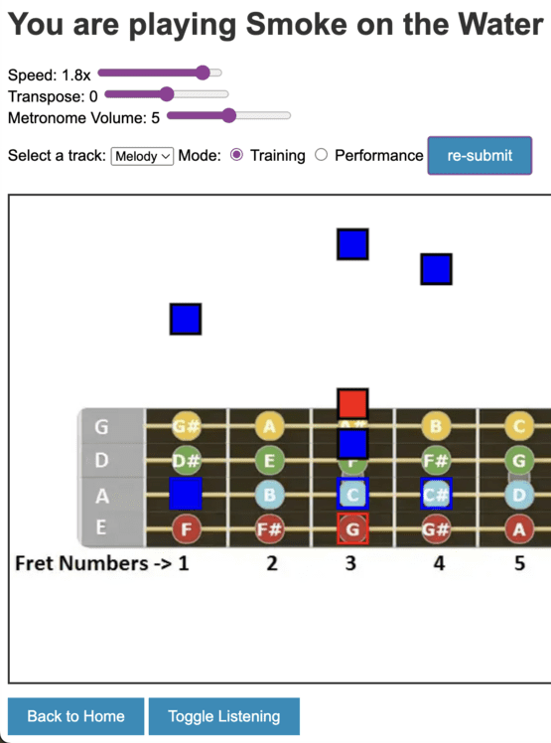
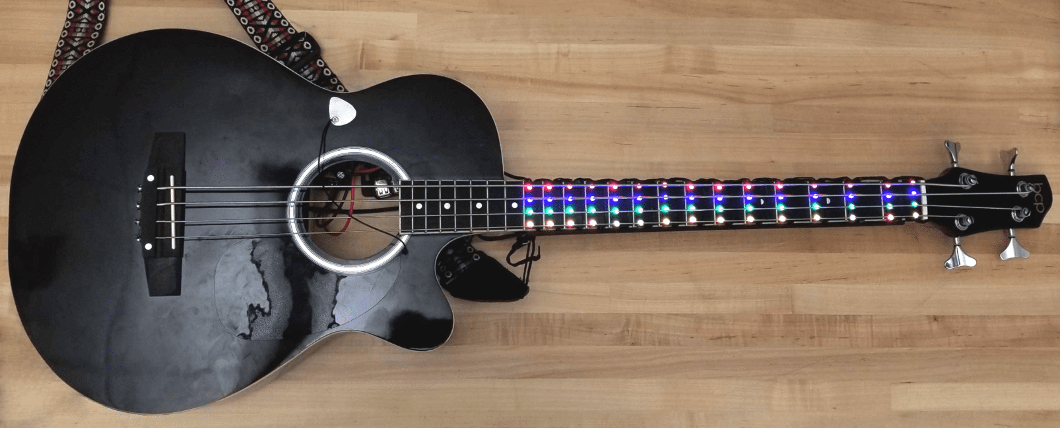
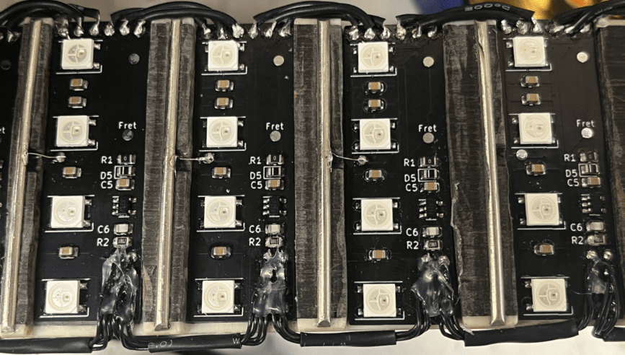
SuperFret
Team A2: Owen Ball, Tushaar Jain, Ashwin Godura
18-500 Capstone Design, Fall 2023
Electrical and Computer Engineering Department
Carnegie Mellon University
Product Pitch
System Description
Beginner guitar players have trouble associating fingering positions in images or guitar tabs with physical locations on the fretboard. SuperFret addresses this by guiding the user with lights. Our product has 2 modes. In “Training” mode, SuperFret waits for the user to strum the correct note. In “Performance” mode, the system flashes LEDs according to a song file and the user tries to keep up. In both modes, SuperFret will record the user’s performance and displays feedback in the form of statistics on the intuitive web app.
SuperFret provides 4 hours of fun on a charge! With SuperFret’s sub-2 millisecond LED latency and 99% strum and finger placement sensing, you can play with confidence and trust the system will keep up, even as your skills rapidly progress.
Software
Web App
Allows the user to upload and select MIDI files
Displays upcoming notes visually on a guitar
MIDI Parsing
Converts MIDI notes into string-fret tuple
Firmware
Teensy
Receives song and settings from web app
Directs LEDs to light up along with song
Hardware
Fretboard PCBs
Display target note using NeoPixel LEDs
Use D-flip-flops to drive each fret high sequentially
Pi-Hat PCB
Connects the Teensy and RPi with GPIOs and UART
Breaks out Teensy I/O to control hardware
System Architecture
The SuperFret system has 3 main subsystems:
Frontend UI: Constantly requests updates from the Raspberry Pi (RPi) over HTTP for low latency synchronization
Raspberry Pi 4B: Orchestrates communication between front-end user commands and back-end user feedback and maintains consistent system state
Teensy 4.1: Executes songs on the LEDs and analyzes the user’s playing. Reports playing data back to the RPi
Figure 2: Virtual Guitar on Web App
Custom PCB (Pi Hat)
Frontend on Browser
Teensy 4.1
Raspberry Pi 4B
User Controls
Pick Electrode
Fretboard PCBs
Buck Converter
Pi Hat
Teensy
RPi
NeoPixel Library
UART
Django Web Server
Virtual Guitar
Reading Frets
Interrupts
MIDI Preprocessing
MIDI Displaying
Reading Strums
Teensy Communication
5V Buck Converter
Determining Accuracy
Aggregating Statistics
Buzzer for Metronome
3S 2200mAh LiPo Battery
WS2812 Protocol
15
Clock and Data
Fretboard PCB
Fretboard PCB
Fretboard PCB
Figure 3: Full Guitar Assembly
Guitar Pick
NeoPixel LEDs
…
NeoPixel LEDs
NeoPixel LEDs
System Evaluation
Flip-Flop to Drive Fret
Flip-Flop to Drive Fret
* Used to indicate open strings
To ensure the system provides a positive user experience, numerous use-case and design requirements were developed. Using lab-bench ammeters and oscilloscopes, along with various accuracy testing procedures, we were able to verify that the system met all our target requirements.
Voltages on Guitar Strings
Software
Hardware
KEY
Custom Made
Purchased Component
Figure 1: System Block Diagram
Metric | Target | Actual
MIDI to fretboard LED conversion accuracy | 100% | 100%
Finger placement detection accuracy | ≥99% | 100%
Strums per minute supported | ≥200 | 300
Strum detection accuracy | ≥99% | 99%
Latency from strum to LEDs updating in response | ≤50ms | 1.85ms
Latency from strum to web app updating in response | ≤250ms | 215ms
Average current through body possible | ≤1mA | 5.37µA
Total system current with all LEDs at 50% brightness | <4.5A | 0.96A
Conclusions & Additional Information
Project documentation and weekly updates
SuperFret surpassed all expectations we set and has proven to be an enjoyable and effective way to learn guitar. Throughout the project, we faced numerous challenges including timing violations induced by signal propagation time and synchronizing the web app with user playing. We were able to overcome these challenges through collaborative debugging and integration testing. In the future, this project could be expanded on by using finger placement and strum detection to create MIDI files and sheet music as the user plays.
Figure 4: Test Results Table
https://course.ece.cmu.edu/~ece500/projects/f23-teama2/

