Slide 1
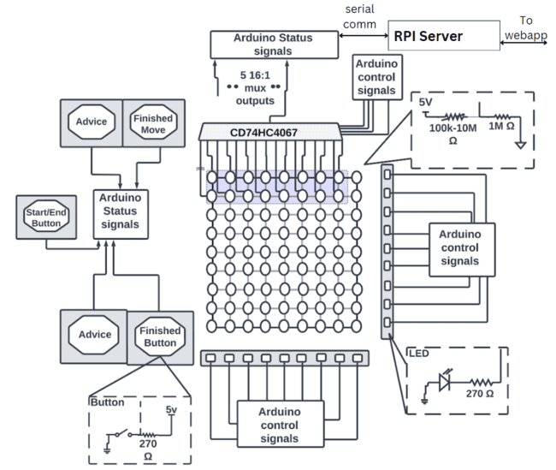
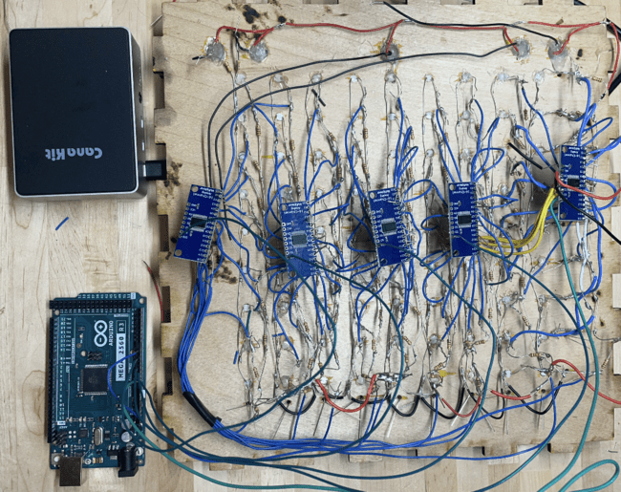
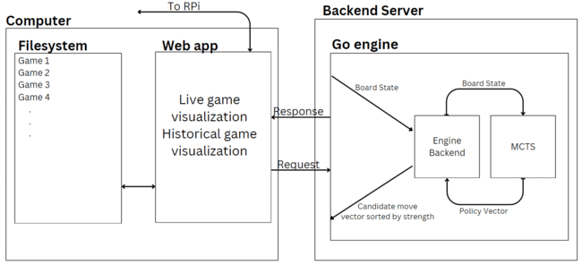
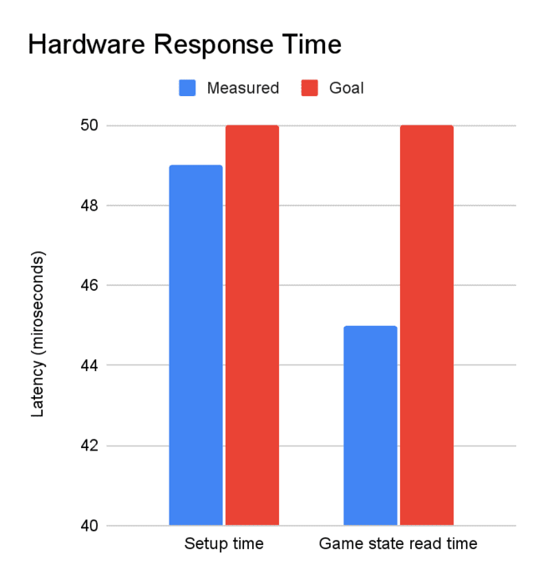
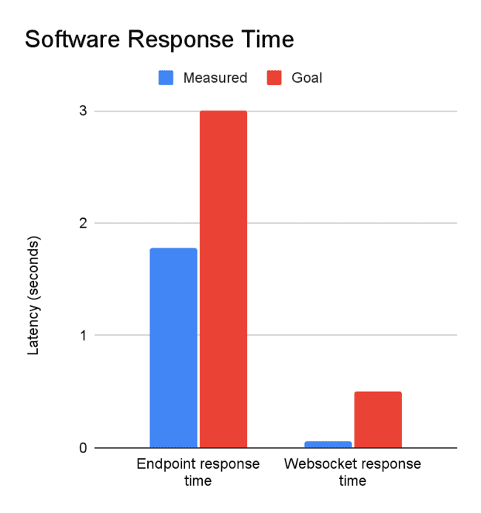
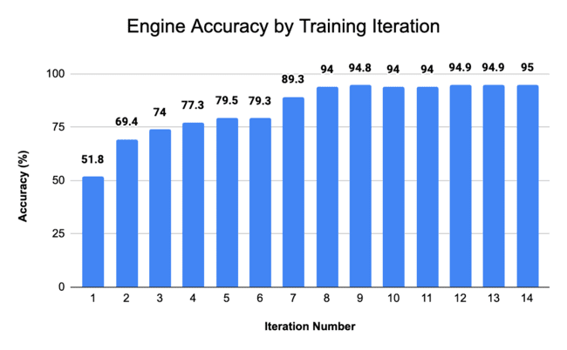
Go Learning Buddy
A0: Israel Escobar-Camacho, Nathaniel James, Hang Shu
18-500 Capstone Design, Fall 2023
Electrical and Computer Engineering Department
Carnegie Mellon University
Product Pitch
System Description
Go is a game popular in many parts of the world, but it is notoriously difficult to learn, especially as a beginner. Our project, the Go Learning Buddy provides a custom 9-by-9 Go board for beginners to play on, along with engine-backed real-time move suggestions and historical analysis.
The move suggestions are indicated via LEDs on the board itself, and the analysis and engine are available via web-app, which communicates wirelessly with the board via a Raspberry Pi server.
Our system consists of 3 main components: a physical board, web application, and game engine. The physical board has a 9x9 array of photoresistors who read the board state into an Arduino, and this Arduino sends the data to a Raspberry Pi via serial communication. The Pi and web app communicate via web-socket, and the web app simultaneously stores the state for later analysis and sends it to the engine, while displaying the gameplay live.
The engine uses Monte Carlo Tree Search to evaluate the strongest continuations of play, and calculate an expected win probability for each candidate move.
The best moves are sent back to the web-app, with the top five being stored for historical analysis, and the best one being sent back via the Pi and Arduino to the board. LEDs surrounding the board indicate the row and column of the best move to the player.
System Architecture
Series Resistors
Photoresistors
Signal Multiplexer
Raspberry Pi
Arduino
System Evaluation
49
50
50
3
45
1.7
.052
.5
Conclusions & Additional Information
We built a system that can effectively teach beginners Go via its board and attached analysis components. While we originally aimed our sights toward stronger amateur players with a 19-by-19 board, time constraints forced us to shift our focus towards beginners, who frequently learn the basics on smaller board like our 9-by-9.
Throughout the building process, we all familiarized ourselves with new technologies, including laser cutting, AutoCAD, and tensorflow. We also got a strong lesson in budgeting time, as almost every component took longer to build than expected.
With more time, we would like to extend our product back to the original use-case of a 19-by-19 board with an engine strong enough to teach all but the strongest amateur players.
Check out our website here!

