Slide 1
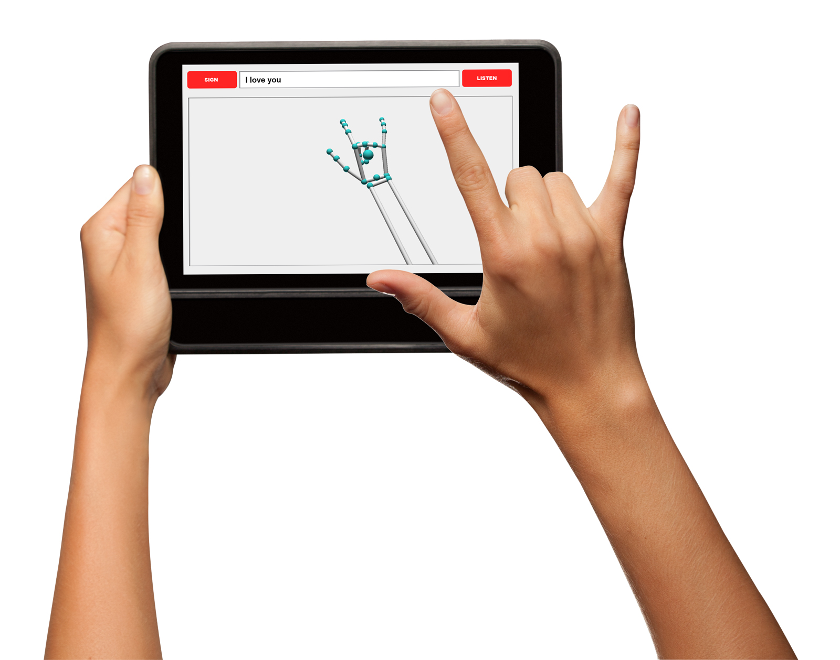
ASL Interpreter
Team B6: Aaron Selesi, Malcolm Fitts, Young Woo Kim

Slide 2
Application Area:
Use Case: Two way translation from English to ASL
Motivation: Assist communication between deaf and hearing individuals
Sign to Speech/Text
Speech to Text/Sign
Notes:
The application area of our project deals with two-way english to ASL translation. The use cases: classrooms, meetings, household. So we set restrictions on our scope such that we are reading signs in well-lit rooms, signer is facing the camera, at a distance of about 1-2 feet.

Slide 3
Solution Approach: Neural Network
Base of the project is convolutional neural network that can learn to recognize signs.
Softmax Activation for Multinomial Classification (y ∈ {1, 2, …, C})
Implementation: Tensorflow/Keras libraries
Categorical cross-entropy loss function, Adam optimizer,
Possible Architectures (order of complexity): LeNet-5, AlexNet, VGG, EfficientNet
Notes:
Y is output of neural network, C = size of output space / how many signs we are detecting (200 atm)
Neural networks seek to minimize a loss function, ours will be categorical cross entropy which is
When we make a mistake Adam optimizer (extension to stochastic gradient descent) is a learning optimization algorithm that combines AdaGrad (separate learning rate per weight parameter) and RMSProp(changing learning rate per iteration)
(aside from last, these are all very heavy) (dunno what to pick, maybe we just tell them we train some of these simultaneously and evaluate?)

Slide 4
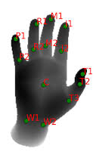
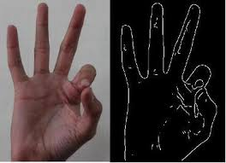
Solution Approach: Feature Extraction
Trying to pick important bits of data from the overall image to condense and input
Detect Region of Interest / Bounding Box
Detect hand outline
Detect 5 fingertips, 5 joints, 1 center of palm
Notes:
Picking up the impt parts of the images help reduce NN input size. By combining detection of 5 fingers, 5 joints, palm, hand outline, bounding box for hand, we can define a much smaller input space for the neural network.
But we need to be careful when extracting features since abstracting too much can cause the data to lose meaning. So to handle this we are creating as many feature extraction methods as we can and then training multiple iterations of the NN in parallel to find the best outcome.

Slide 5
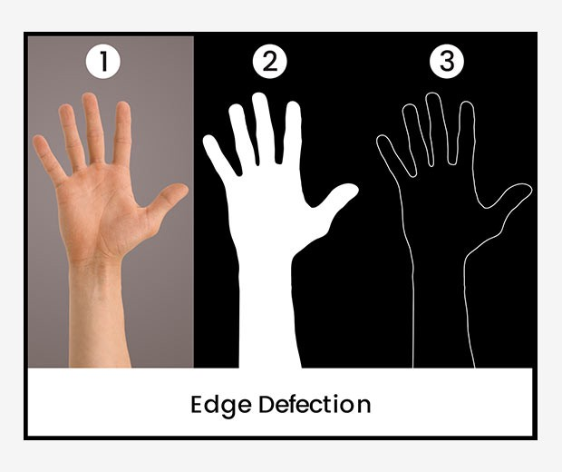
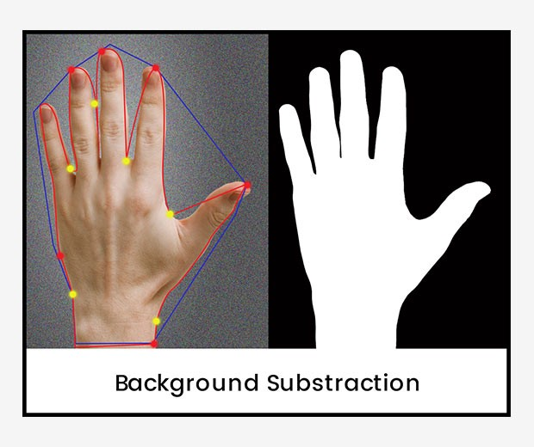
Solution Approach: Image Processing
Kindle Fire Tablet camera used to capture image data
OpenCV for image processing
Smoothing
Background Subtraction by Moving Averages for Dynamic gestures
Edge detection
Notes:
Background Subtraction by Moving Averages: Use avg values across frames to determine moving foreground vs background
Gauss blur and Canny for edge detection + smoothing
Convert video to 5fps since we don’t lose much info from going to this framerate, can also use 10fps. This is mostly to help input space size, and deal with temporal segmentation (10/20 frames max, NN input value for number valid frames is technically feature extract

Slide 6
System Specification: Training
Training Database
Team-defined data
Image Processing & Feature Extractor
Data Normalizer
Neural Network
Notes:
Block diagram for training data flow:
Accept both data from public datasets (BU ALS_LVD, etc.) and team-defined sources (creating our own sign samples/live testing) into data normalizer. For ex, BU Training DB includes full videos of the signer sessions, with info describing start and end frames of specific signs, as well as the dominant starting and ending hand pos.
This helps us be sure the data normalizer will convert videos to the same general format (640 x 480, max of 2 seconds, and can be read into openCV)
The training will take place using AWS so that we can train multiple iterations of the NN at once

Slide 7
System Specification: Usage
Django Backend Target
Fire Tablet
Data Normalizer:
Input → 5FPS, 640x480 px
Front-End:
Camera Feed
Web-App Communication
Image Processing &
Feature Extraction
Back-End:
Run Django Server
Communicate with BE target
Neural Network
Notes:
Front-End: Django web-app with some light HTML/CSS that captures camera feed and communicates with backend via HTTP requests
Back-End: contains our processing tools (normalizer, image proc/feat extract, nn) that can be run both on a tablet or laptop, processes django requests and responds with best estimate of sign recognition

Slide 8
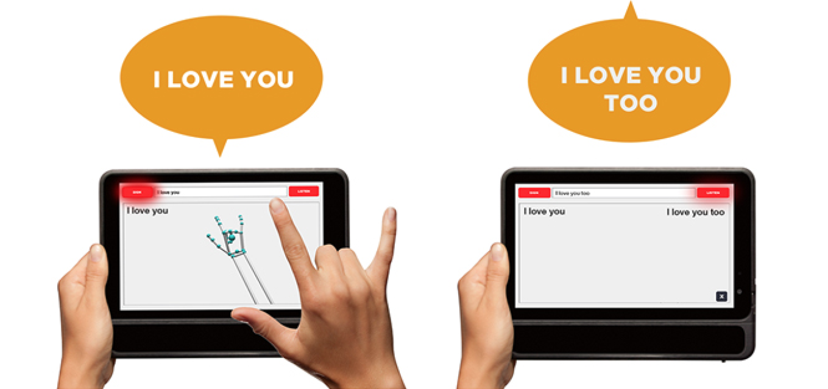
Implementation Plan: Django Web App
We are building a django web app that will serve as the interface for our ASL interpreter. It will run off our Kindle Fire 8 tablets that we purchased for this project and the final layout will look similar to an existing solution shown on the right.
By using a webapp we do not need to worry about platform making it accessible on many devices with a camera and internet connection.
Notes:
We decided to build a web app for our ASL interpreter because it is more easily accessible by multiple devices than native apps.
We chose to build in in Django because of the ease of use of python and the OpenCV api that is available for it
We plan to have a simple layout the show a live feed of the sign and outputs the text in real time

Slide 9
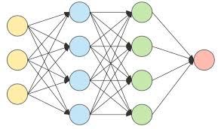
Implementation Plan: Neural Network
We are planning to architect the neural network based on available data and our ability to parse it. We process the training data so the layer size is reasonable and so the network can be trained efficiently.
Reducing Scope: Recognizing 200+ words requires an output layer of 200+ nodes. So we are designing with the goal of 200 word lexicon
Packages: Keras, Tensorflow, numpy
Notes:
Designing and tuning the NN comes down to how the feature extraction works. If we were to just read in raw data from the normalizer, the input space would be 640 * 480 * 10. Instead, by capturing a smaller subset of the video frame and identifying the relative pos of fingers and joints we can reduce input layer size and focus more on layering.
Since this is the part that we can test most rigorously, we plan on focusing a lot of time on testing, re-designing and re-tuning our layers.

Slide 10
Implementation Plan: OpenCV
To process the image data we are receiving from the Kindle Fire camera we will be using OpenCV. It will allow us to do edge detection of hand gestures.
This is made possible by the availability of the OpenCV api which allows for easy integration into python and the django web framework.
Notes:
We chose to use OpenCV as it is an accessible open source Computer Vision package that already has a working python API
That means we can easily integrate into our Django webapp without much friction
It will allow us to process the image data we receive from the tablet camera, which will enable us to do our edge detection and feature extraction

Slide 11
Metrics and Validation
Web-App Metrics: Can handle requests with 2 seconds worth of video, Can handle simultaneous requests
Neural Network Metrics: Estimation accuracy, Best-N Guesses
Image Processing Metrics: Manual Review
Validation: Neural Network testing and re-tuning since NN has most quantitative tests available
Notes:
Creating testing metrics is hard for image processing since we cannot explicitly define what makes a good “edge detection” result. However we can have explicit metrics for feature extraction and neural net accuracy. The testing of both of these is best led by our datasets, since we can test for how accurately we extract the correct features and how accurately the NN estimates a given sign.
Our biggest risk comes from re-training the neural net, since this will be computationally expensive. So to deal with this we plan on training multiple iterations of the NN in parallel, using different designs and features to see what works best. (diff feature extract inputs, diff loss/opti functions, diff layering) with the goals of hitting 80% and 85% accuracy for dynamic and static signs, respectively

Slide 12
Project Management / Gantt Chart
Notes:
Our schedule has stayed relatively the same. We’ve mostly added more time for certain tasks or edited task based on a change in our original project proposal

Slide 13
Project Design Summary
ASL Interpreter
Trained on data set of american sign language gestures using deep learning
Image data captured by camera on Kindle Fire tablet
Image data processed by OpenCV and edge detection/feature extraction algorithms
Run through a Django web app utilising the OpenCV api accessible through the Kindle Fire Tablets
Notes:
Summarize the main point of the project in a clear concise manner, and pause for questions

