Slide 1
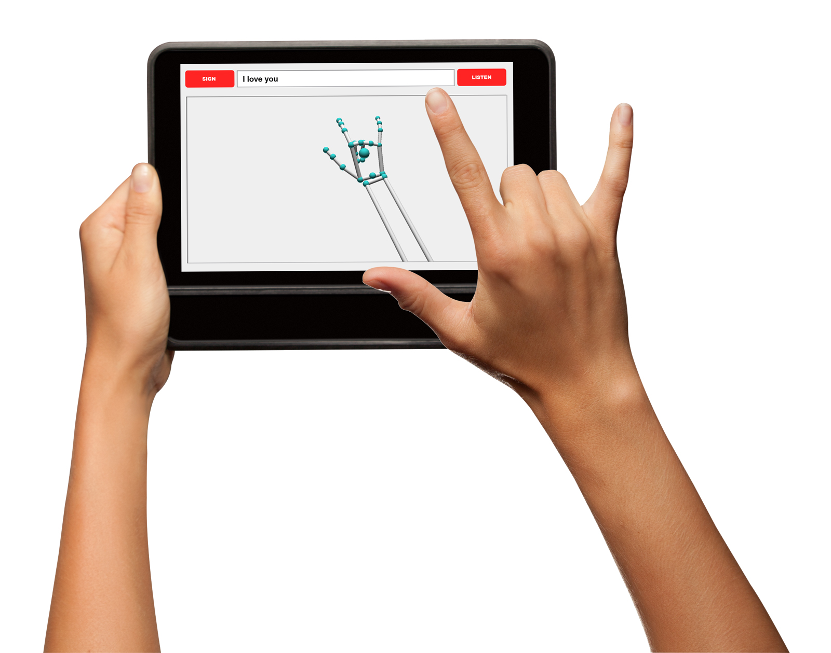
ASL Interpreter
Team B6: Malcolm Fitts, Young Woo Kim, Aaron Selesi

Slide 2
USE CASE
What is it going to do? English Speech ←→ ASL Translation
What problem area are we trying to improve? Streamline communication between deaf and hearing individuals
Scope? Recognize static signs i.e. letters, numbers, and 200 - 400 dynamic signs such as words. Speech → Text → ASL, incorporating existing voice recognition software
Areas of ECE:
Software Engineering - Amazon OS, Deep Learning (Pytorch/Tensorflow)
Signals Processing - Image Recognition and Filtering, Feature Extraction
Notes:
Currently, communication between ASL users and english speakers is not as accessible as it should as it requires both parties to be versed in ASL or for the ASL user to have and accompanying translator. Having a 3rd party translator all the time is not feasible so we want to autonomize this translation process to reduce the number of people needed for communication.
To that end, our product will be a two way American Sign Language Interpreter that takes in signs as input and outputs text and speech, as well as takes in speech or text and outputs an ASL demonstration, allowing ASL users to communicate more easily with non-ASL users.
Regarding scope, there’s two main classes of signs: static and dynamic. Static signs can be performed in a single picture or frame, a stationary sign. Dynamic signs are motions that must be captured by video. We want our project to recognize and classify all of the static signs and 200-400 dynamic signs. This number may change depending on the efficiency of the training, but we chose this range due to the coverage of our datasets.
The two areas we are covering are software engineering in the form of app development and designing the ML process, and signals processing in the form of mostly computer vision.

Slide 3
REQUIREMENTS: Key Challenges
Temporal Segmentation
Classifying and Formatting Training Data
Dynamic vs Static signs
Training Efficiency
Designing Convolution Neural Network
Notes:
Two main performance measures to optimize: Accurately detect and classify, Format data in a meaningful and concise to train efficiently
Our key challenges revolve around those.
______
Temporal Segmentation: when we capture a video of multiple signs, what marks the start and end of each individual sign. Important challenge to overcome in areas such as voice recognition. Keeping both scope and use context in mind, we decided to designate a terminal sign to indicate the end of a sign.
Next we want to classify the input, and by classifying here we dont mean the final labels of the input, which is obviously a challenge too, but an initial grouping of the data, since static and dynamic have different input dimensions. We plan to deal with this by having static dynamic, maybe # of hands, and feed them into different neural nets, based on their category.
Training efficiency: especially for dynamic signs, the input size is too large, so we would have to figure out a clever way to feature engineering the input such that all the necessary features we need are extracted, and represented in a concise way. Part of this will also be figuring out the lower bound of resolution and framerate we can get away with to achieve enough accuracy.
Little or no background in deep learning, so learning new content will also be a large part of our process

Slide 4
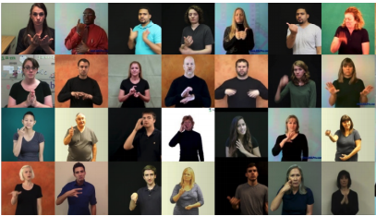
REQUIREMENTS: Data
Publicly Available Datasets:
Purdue RVL-SLLL ASL Database: 39 motion primitives, 14 signers
Boston ASLLVD: 2742 words, ~3.6 examples per word
RWTH-BOSTON-50 : 50 words, 2 signers, ~9.6 examples per word
RWTH-BOSTON-400: 400 words, 5 signers, 843 sentences
Potential Extra Datasets:
Word-Level American Sign Language (WLASL) datasets: 21,083 videos, 119 signers, one sign per frame
Notes:
Leveraging publicly available datasets is a necessity for our project. The task of gathering these datasets ourselves would take over a year, so we need to use these. However we still must test and verify the data from these to ensure that we can train our network correctly.
As you can see, the datasets here have multiple signers per word, with different backgrounds, positions, and appearances.
Hopefully this allows the NN to learn to decouple that kind of superficial information in the picture from the content that’s important to us
NOTE: WLASL has not been widely used so that would require the most testing/validation to ensure its usage.

Slide 5
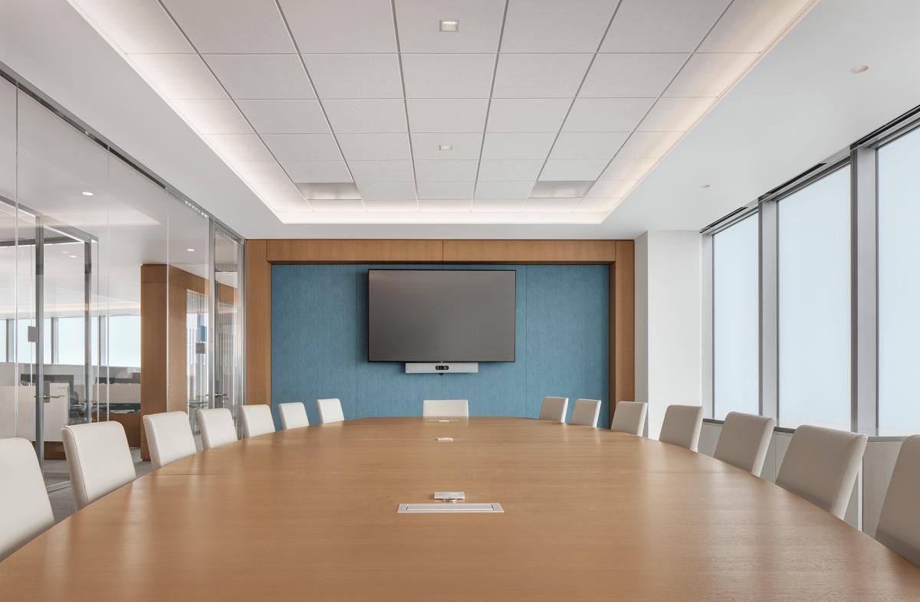
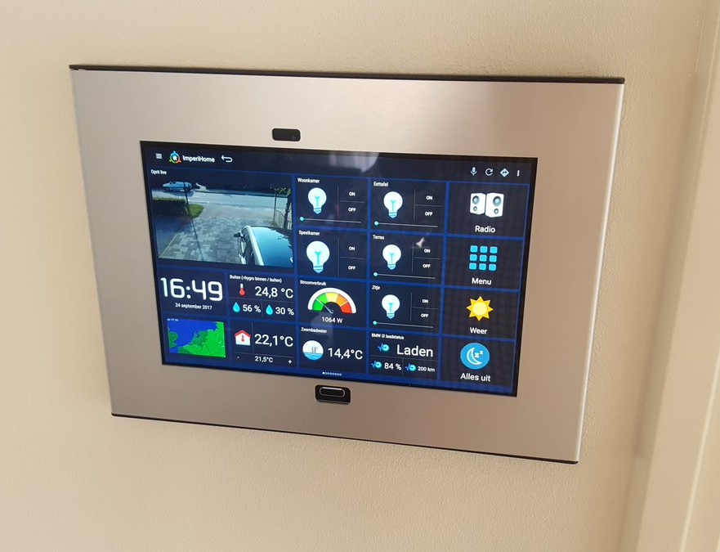
REQUIREMENTS: Environment
Light level: 100 - 1000 lux
Camera Quality: 30 fps
Camera Angle: Perpendicular to sign
Distance to Camera: 1 foot - 10 feet
Notes:
______
Environment is clearly a big factor for our computer vision based project.
The motivation for our environment specifications come from the settings we expect our app to be used in, which is mostly indoor situations such as presentations, conferences, conversations at home between family members.
For those purposes, 100 lux is a relatively low lit indoor illuminance level, i.e. living rooms. The average indoor home is lit at about 300 lx. Limiting the valid amount of illumination to this range allows to clearly detect the feature such as edges of hands, which would be drowned out if there is too much or too little lighting.
Camera quality: 30 fps will be enough for the camera. In fact, we will probably sample the frames at a much lower rate than that i.e. 5 fps, because there is not much movement between frames that are 1/30th sec apart and it would be inefficient for the training to use them all.
Perpendicular to Sign:
Distance to Camera: far enough so the entire sign is captured. Maybe user wants to hang the screen on a wall in their home, so it should be able to extract the sign from about 5 feet away

Slide 6
REQUIREMENTS: Execution
Performance:
Able to categorize static and dynamic gestures
Able to operate with a lexicon of 200-400 gestures
Translate gestures into ASL representation
Verify match between observed gesture and known gesture
1 second response time
Notes:
____________________________________
The minimum accuracy we will aim for is 90% accuracy for static symbols and 80% for dynamic gestures. We chose this because its very possible for o and c or m and n to be confused together. If we want our system to operate in real time, . 1 second response time is chosen relative to the time it takes to perform each sign+terminal (~2 or 3 seconds).

Slide 7
SOLUTION APPROACH:
Input Image Processing
Tablet camera for video input and screen for text output and speakers for audio feedback
OpenCV for real time computer vision using input from cameras
Finger edge detection
Filter out background noise
Feature engineering to speed up recognition (e.g. hand to joints, fingertips)
Notes:
We will be using the tablet camera to take in gesture input using opencv for computer vision
Our goal in the input image processing step is to remove as many unnecessary components from the input data and simplify it
In doing so we will be able to more easily recognize gestures thus speeding up our interpretation
_
Receiving video input from user and categorizing it as a static or dynamic sign, this is done by measuring variance in the video frames and splitting on a threshold value.
Perform Edge detection → black image with white lines representing lines. But there are going to be lines in the background we don’t care about so we want to filter those out by detecting a region of interest. Then we extract the necessary features, such as fingertips or joints, and format as efficient data structure to pass in as input.
Figuring out which features are important will take some experimentation

Slide 8
SOLUTION APPROACH: Classification
We will be utilizing an existing ASL dataset for learning gesture recognition
Deep Learning:
Pytorch/ Tensorflow will be used to build deep learning model based on existing ASL dataset
Possible autoregressive model for verification of correctly identifying the next sign
Compare input labels gained in gesture input process against the deep learning model to recognize gestures
Notes:
For the actual classification stage, we are going to design and train a convolutional neural net on the publicly available data we have access to. The ideal NN architecture will take some experimentation too, since there is tradeoff between the complexity of the network and accuracy. Autoregressive model is used for predicting a label based on the previous data. Less necessary than the CNN, so this is probably more of a scope extention, but allows a 2 factor authentication of the next label.

Slide 9
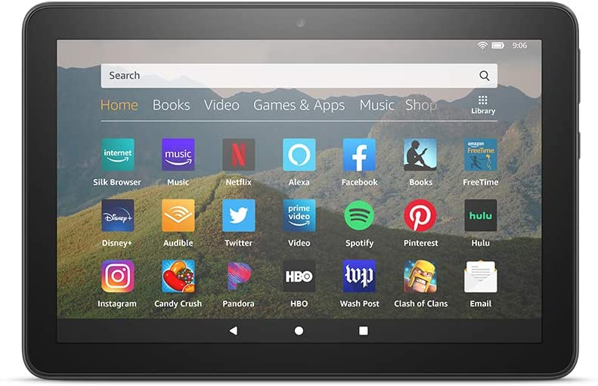
SOLUTION APPROACH: Budget and Tech
Amazon Web Service Credit for hosting our deep learning models in the cloud
3 (1 per team member) Kindle Fire HD 8 Tablet ($90 on Amazon) for video input and text and speech output
Obtain visual and audio data from the tablet camera and mic
Output interpreted text and speech
Notes:
Kindle Fire: We want our app to run properly on a tablet with an average camera so that it is widely accessible,
Tablet is more appropriate than laptop because it can be mounted on a wall in homes, more portable.
AWS Credit: Training can take a long time, especially when we start to expand the output space and NN architecture. We will also have to retrain multiple times, so speeding up training will save us a lot of time we can use on actual development.

Slide 10
SOLUTION APPROACH: Diagram
Image/Video Filter
Neural Network
Camera
Training
Web-App
Tablet
Front-End
Back-End
AWS
Training DB
Notes:
High level diagram of program data-flow. The tablet feeds its camera data to the front end of the web-app. The web app in turn uses this in conjunction with the image processing filter to get a result from the neural network. The neural net does its training using AWS computing

Slide 11
TESTING, VERIFICATION, AND METRICS
Testing Data Included in Datasets:
Static, Dynamic signs tested separately
Test using both provided test Data and manually
Test in different environments with our initial background specifications (illumination, distance)
Verification via Manual & Unit Testing:
Reviewing classification accuracy to understand match closeness
Different Metrics:
Binary Classification
Top-K Classification Accuracy With K = {1, 5, 10}
Static Accuracy Goal: {70%, 80%, 95%}
Dynamic Accuracy Goal: {60%, 70%, 90%}
Notes:
The actual testing procedure will involve
using both datasets and have the team members test out app in different backgrounds to make sure that our program can adjust to different noise.
We’ll also be keeping track of specifically which signs get mistaken for using confusion matrix

Slide 12
TASKS AND DIVISION OF LABOUR
Signal/Image Processing
Gesture recognition using OpenCV
Filtering out background noise
Simplifying gesture information
Machine Learning
Design and Experimentation of CNN architecture
Training neural network/deep learning model on ASL data set using pytorch/tensorflow
Comparing the deep learning model to gestures obtained through image processing
App Development
Building app to interface with the gesture recognition system
Django, OpenCV
Notes:
__
This is a rough list of tasks I’ve talked about and the 3 areas that they fall under. We are all working on all of these areas for the sake of learning to use new tech and concepts, but there will be division of labor of specific tasks so that we can parallelize

Slide 13
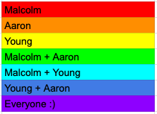
Gantt Chart:
Notes:
Here’s a more detailed schedule of those tasks.
In summary, we believe that this will greatly ease social interaction and improve the lives of people with hearing disabilities

