Slide 1
18-447 Computer Architecture Lecture 14: Out-of-Order Execution (Dynamic Instruction Scheduling)
Prof. Onur Mutlu
Carnegie Mellon University
Spring 2014, 2/19/2014

Slide 2
Announcements
Lab due Friday (Feb 21)
Homework 3 due next Wednesday (Feb 26)
Exam coming up (before Spring Break)

Slide 3
Reminder: Lab Late Day Policy Adjustment
Your total late days have increased to 7
Each late day beyond all exhausted late days costs you 15% of the full credit of the lab

Slide 4
Reminder: A Note on Testing Your Code
Testing is critical in developing any system
You are responsible for creating your own test programs and ensuring your designs work for all possible cases
That is how real life works also…
Noone gives you all possible test cases, workloads, users, etc. beforehand

Slide 5
Lab 2 Grade Distribution

Slide 6
Lab 2 Statistics
MAX 99.62
MIN 62.74
MEDIAN 92.59
MEAN 89.26
STD 10.21

Slide 7
HW 2 Grade Distribution

Slide 8
HW 2 Statistics
MAX 100
MIN 0
MEDIAN 92.98
MEAN 81.98
STD 24.82

Slide 9
Readings for Past Few Lectures (I)
P&H Chapter 4.9-4.11
Smith and Sohi, “The Microarchitecture of Superscalar Processors,” Proceedings of the IEEE, 1995
More advanced pipelining
Interrupt and exception handling
Out-of-order and superscalar execution concepts
McFarling, “Combining Branch Predictors,” DEC WRL Technical Report, 1993.
Kessler, “The Alpha 21264 Microprocessor,” IEEE Micro 1999.

Slide 10
Readings for Past Few Lectures (II)
Smith and Plezskun, “Implementing Precise Interrupts in Pipelined Processors,” IEEE Trans on Computers 1988 (earlier version in ISCA 1985).

Slide 11
Readings Specifically for Today
Smith and Sohi, “The Microarchitecture of Superscalar Processors,” Proceedings of the IEEE, 1995
More advanced pipelining
Interrupt and exception handling
Out-of-order and superscalar execution concepts
Kessler, “The Alpha 21264 Microprocessor,” IEEE Micro 1999.

Slide 12
Readings for Next Lecture
SIMD Processing
Basic GPU Architecture
Other execution models: VLIW, Dataflow
Lindholm et al., "NVIDIA Tesla: A Unified Graphics and Computing Architecture," IEEE Micro 2008.
Fatahalian and Houston, “A Closer Look at GPUs,” CACM 2008.
Stay tuned for more readings…

Slide 13
Maintaining Precise State
Reorder buffer
History buffer
Future register file
Checkpointing
Readings
Smith and Plezskun, “Implementing Precise Interrupts in Pipelined Processors,” IEEE Trans on Computers 1988 and ISCA 1985.
Hwu and Patt, “Checkpoint Repair for Out-of-order Execution Machines,” ISCA 1987.

Slide 14
Registers versus Memory
So far, we considered mainly registers as part of state
What about memory?
What are the fundamental differences between registers and memory?
Register dependences known statically – memory dependences determined dynamically
Register state is small – memory state is large
Register state is not visible to other threads/processors – memory state is shared between threads/processors (in a shared memory multiprocessor)

Slide 15
Maintaining Speculative Memory State: Stores
Handling out-of-order completion of memory operations
UNDOing a memory write more difficult than UNDOing a register write. Why?
One idea: Keep store address/data in reorder buffer
How does a load instruction find its data?
Store/write buffer: Similar to reorder buffer, but used only for store instructions
Program-order list of un-committed store operations
When store is decoded: Allocate a store buffer entry
When store address and data become available: Record in store buffer entry
When the store is the oldest instruction in the pipeline: Update the memory address (i.e. cache) with store data

Slide 16
Out-of-Order Execution (Dynamic Instruction Scheduling)

Slide 17
An In-order Pipeline
Integer add
E
Integer mul
E
E
E
E
R
W
F
D
FP mul
E
E
E
E
E
E
E
E
. . .
E
E
E
E
E
E
E
E
Cache miss
Problem: A true data dependency stalls dispatch of younger instructions into functional (execution) units
Dispatch: Act of sending an instruction to a functional unit

Slide 18
Can We Do Better?
What do the following two pieces of code have in common (with respect to execution in the previous design)?
Answer: First ADD stalls the whole pipeline!
ADD cannot dispatch because its source registers unavailable
Later independent instructions cannot get executed
How are the above code portions different?
Answer: Load latency is variable (unknown until runtime)
What does this affect? Think compiler vs. microarchitecture
IMUL R3 ← R1, R2
ADD R3 ← R3, R1
ADD R1 ← R6, R7
IMUL R5 ← R6, R8
ADD R7 ← R9, R9
LD R3 ← R1 (0)
ADD R3 ← R3, R1
ADD R1 ← R6, R7
IMUL R5 ← R6, R8
ADD R7 ← R9, R9

Slide 19
Preventing Dispatch Stalls
Multiple ways of doing it
You have already seen THREE:
1. Fine-grained multithreading
2. Value prediction
3. Compile-time instruction scheduling/reordering
What are the disadvantages of the above three?
Any other way to prevent dispatch stalls?
Actually, you have briefly seen the basic idea before
Dataflow: fetch and “fire” an instruction when its inputs are ready
Problem: in-order dispatch (scheduling, or execution)
Solution: out-of-order dispatch (scheduling, or execution)

Slide 20
Out-of-order Execution (Dynamic Scheduling)
Idea: Move the dependent instructions out of the way of independent ones
Rest areas for dependent instructions: Reservation stations
Monitor the source “values” of each instruction in the resting area
When all source “values” of an instruction are available, “fire” (i.e. dispatch) the instruction
Instructions dispatched in dataflow (not control-flow) order
Benefit:
Latency tolerance: Allows independent instructions to execute and complete in the presence of a long latency operation

Slide 21
In-order vs. Out-of-order Dispatch
In order dispatch + precise exceptions:
Out-of-order dispatch + precise exceptions:
16 vs. 12 cycles
F
D
E
E
E
E
R
W
IMUL R3 ← R1, R2
ADD R3 ← R3, R1
ADD R1 ← R6, R7
IMUL R5 ← R6, R8
ADD R7 ← R3, R5
F
D
STALL
E
R
W
F
STALL
D
E
R
W
F
D
E
E
E
E
E
R
W
F
D
STALL
E
R
W
F
D
E
E
E
E
R
W
F
D
WAIT
E
R
W
F
D
E
R
W
F
D
E
E
E
E
R
W
F
D
WAIT
E
R
W

Slide 22
Enabling OoO Execution
1. Need to link the consumer of a value to the producer
Register renaming: Associate a “tag” with each data value
2. Need to buffer instructions until they are ready to execute
Insert instruction into reservation stations after renaming
3. Instructions need to keep track of readiness of source values
Broadcast the “tag” when the value is produced
Instructions compare their “source tags” to the broadcast tag → if match, source value becomes ready
4. When all source values of an instruction are ready, need to dispatch the instruction to its functional unit (FU)
Instruction wakes up if all sources are ready
If multiple instructions are awake, need to select one per FU

Slide 23
Tomasulo’s Algorithm
OoO with register renaming invented by Robert Tomasulo
Used in IBM 360/91 Floating Point Units
Read: Tomasulo, “An Efficient Algorithm for Exploiting Multiple Arithmetic Units,” IBM Journal of R&D, Jan. 1967.
What is the major difference today?
Precise exceptions: IBM 360/91 did NOT have this
Patt, Hwu, Shebanow, “HPS, a new microarchitecture: rationale and introduction,” MICRO 1985.
Patt et al., “Critical issues regarding HPS, a high performance microarchitecture,” MICRO 1985.
Variants used in most high-performance processors
Initially in Intel Pentium Pro, AMD K5
Alpha 21264, MIPS R10000, IBM POWER5, IBM z196, Oracle UltraSPARC T4, ARM Cortex A15

Slide 24
Two Humps in a Modern Pipeline
Hump 1: Reservation stations (scheduling window)
Hump 2: Reordering (reorder buffer, aka instruction window or active window)
TAG and VALUE Broadcast Bus
S
C
H
E
D
U
L
E
R
E
O
R
D
E
R
E
Integer add
Integer mul
F
D
E
E
E
E
W
FP mul
E
E
E
E
E
E
E
E
. . .
E
E
E
E
E
E
E
E
Load/store
in order
out of order
in order

Slide 25
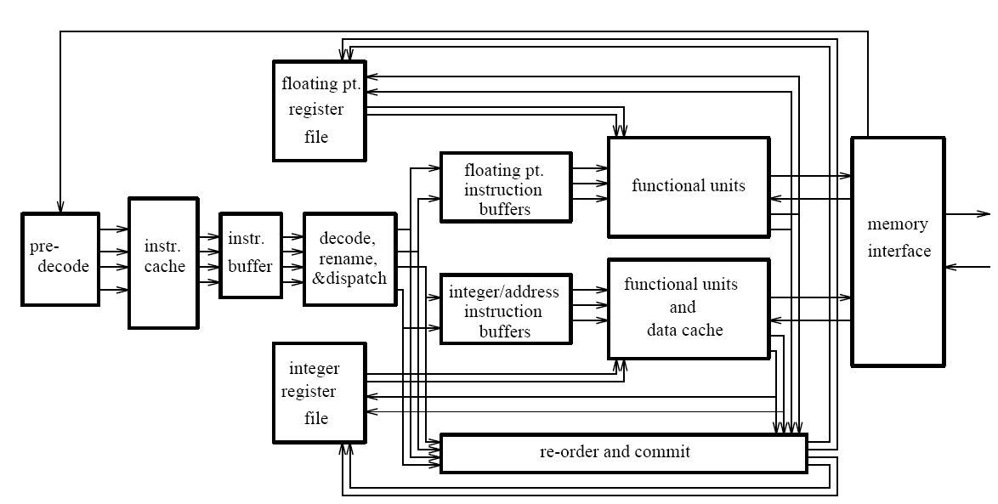
General Organization of an OOO Processor
Smith and Sohi, “The Microarchitecture of Superscalar Processors,” Proc. IEEE, Dec. 1995.

Slide 26
Tomasulo’s Machine: IBM 360/91
FP registers
from memory
from instruction unit
load
buffers
store buffers
operation bus
reservation
stations
to memory
FP FU
FP FU
Common data bus

Slide 27
Register Renaming
Output and anti dependencies are not true dependencies
WHY? The same register refers to values that have nothing to do with each other
They exist because not enough register ID’s (i.e. names) in the ISA
The register ID is renamed to the reservation station entry that will hold the register’s value
Register ID → RS entry ID
Architectural register ID → Physical register ID
After renaming, RS entry ID used to refer to the register
This eliminates anti- and output- dependencies
Approximates the performance effect of a large number of registers even though ISA has a small number

Slide 28
Tomasulo’s Algorithm: Renaming
Register rename table (register alias table)
tag
value
valid?
R0
1
R1
1
R2
1
R3
1
R4
1
R5
1
R6
1
R7
1
R8
1
R9
1

Slide 29
Tomasulo’s Algorithm
If reservation station available before renaming
Instruction + renamed operands (source value/tag) inserted into the reservation station
Only rename if reservation station is available
Else stall
While in reservation station, each instruction:
Watches common data bus (CDB) for tag of its sources
When tag seen, grab value for the source and keep it in the reservation station
When both operands available, instruction ready to be dispatched
Dispatch instruction to the Functional Unit when instruction is ready
After instruction finishes in the Functional Unit
Arbitrate for CDB
Put tagged value onto CDB (tag broadcast)
Register file is connected to the CDB
Register contains a tag indicating the latest writer to the register
If the tag in the register file matches the broadcast tag, write broadcast value into register (and set valid bit)
Reclaim rename tag
no valid copy of tag in system!

Slide 30
An Exercise
Assume ADD (4 cycle execute), MUL (6 cycle execute)
Assume one adder and one multiplier
How many cycles
in a non-pipelined machine
in an in-order-dispatch pipelined machine with imprecise exceptions (no forwarding and full forwarding)
in an out-of-order dispatch pipelined machine imprecise exceptions (full forwarding)
MUL R3 ← R1, R2
ADD R5 ← R3, R4
ADD R7 ← R2, R6
ADD R10 ← R8, R9
MUL R11 ← R7, R10
ADD R5 ← R5, R11
F
D
E
W

Slide 31
Exercise Continued

Slide 32
Exercise Continued

Slide 33
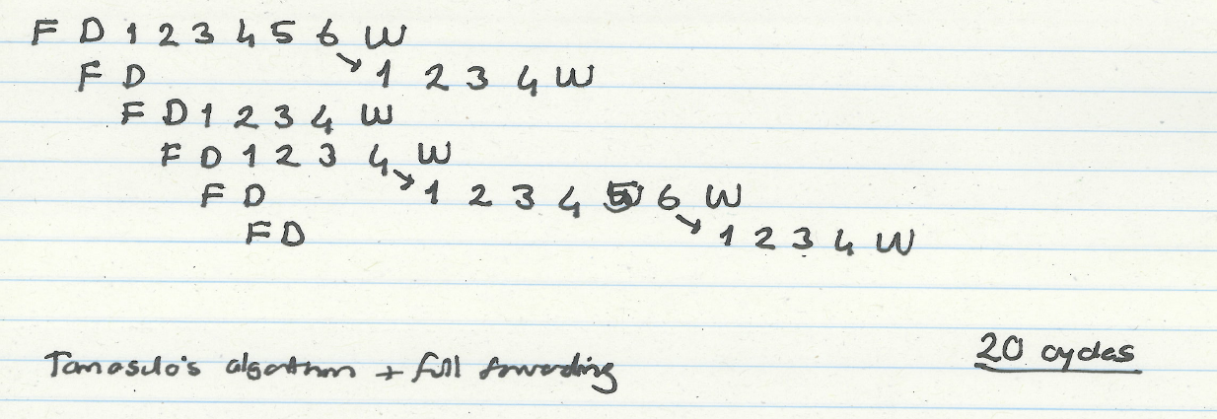
Exercise Continued
MUL R3 ← R1, R2
ADD R5 ← R3, R4
ADD R7 ← R2, R6
ADD R10 ← R8, R9
MUL R11 ← R7, R10
ADD R5 ← R5, R11

Slide 34
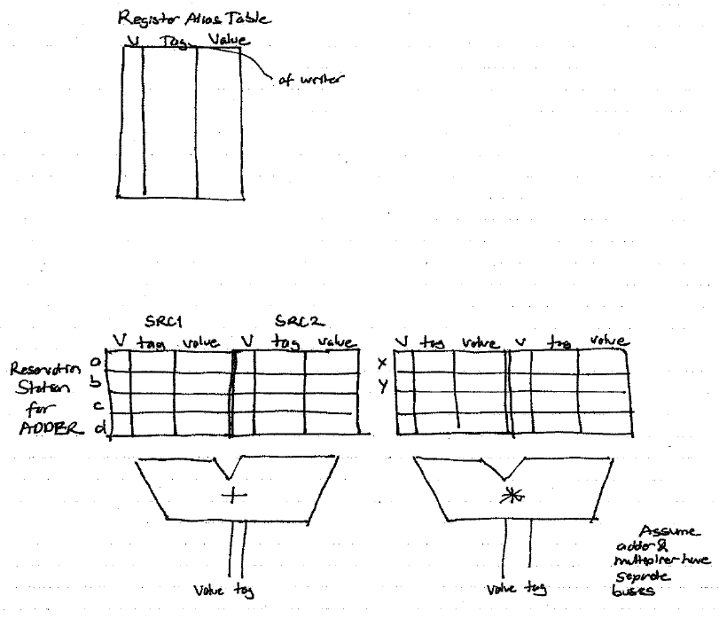
How It Works

Slide 35
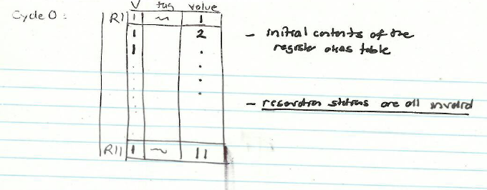
Cycle 0

Slide 36
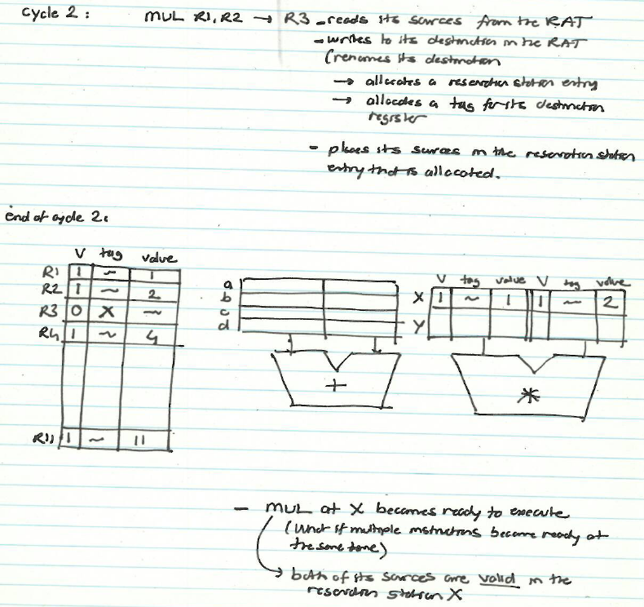
Cycle 2

Slide 37
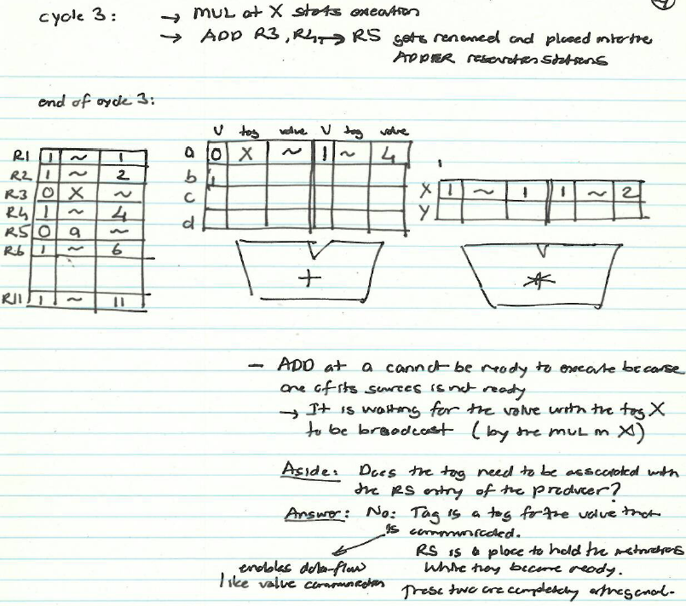
Cycle 3

Slide 38
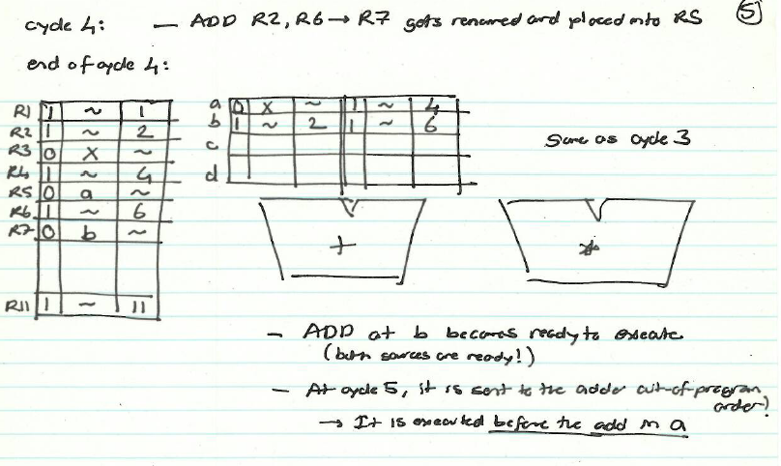
Cycle 4

Slide 39
Cycle 7

Slide 40
Cycle 8

Slide 41
An Exercise, with Precise Exceptions
Assume ADD (4 cycle execute), MUL (6 cycle execute)
Assume one adder and one multiplier
How many cycles
in a non-pipelined machine
in an in-order-dispatch pipelined machine with reorder buffer (no forwarding and full forwarding)
in an out-of-order dispatch pipelined machine with reorder buffer (full forwarding)
MUL R3 ← R1, R2
ADD R5 ← R3, R4
ADD R7 ← R2, R6
ADD R10 ← R8, R9
MUL R11 ← R7, R10
ADD R5 ← R5, R11
F
D
E
R
W

Slide 42
Out-of-Order Execution with Precise Exceptions
Idea: Use a reorder buffer to reorder instructions before committing them to architectural state
An instruction updates the register alias table (essentially a future file) when it completes execution
An instruction updates the architectural register file when it is the oldest in the machine and has completed execution

Slide 43
Out-of-Order Execution with Precise Exceptions
Hump 1: Reservation stations (scheduling window)
Hump 2: Reordering (reorder buffer, aka instruction window or active window)
TAG and VALUE Broadcast Bus
S
C
H
E
D
U
L
E
R
E
O
R
D
E
R
E
Integer add
Integer mul
F
D
E
E
E
E
W
FP mul
E
E
E
E
E
E
E
E
. . .
E
E
E
E
E
E
E
E
Load/store
in order
out of order
in order

Slide 44
Enabling OoO Execution, Revisited
1. Link the consumer of a value to the producer
Register renaming: Associate a “tag” with each data value
2. Buffer instructions until they are ready
Insert instruction into reservation stations after renaming
3. Keep track of readiness of source values of an instruction
Broadcast the “tag” when the value is produced
Instructions compare their “source tags” to the broadcast tag → if match, source value becomes ready
4. When all source values of an instruction are ready, dispatch the instruction to functional unit (FU)
Wakeup and select/schedule the instruction

Slide 45
Summary of OOO Execution Concepts
Register renaming eliminates false dependencies, enables linking of producer to consumers
Buffering enables the pipeline to move for independent ops
Tag broadcast enables communication (of readiness of produced value) between instructions
Wakeup and select enables out-of-order dispatch

