Slide 1
18-447 Computer Architecture Lecture 17: GPUs, VLIW, Systolic Arrays
Prof. Onur Mutlu
Carnegie Mellon University
Spring 2014, 2/26/2014

Slide 2
Midterm I Next Week
March 5, during class time
We will likely take the entire 2 hours: 12:30-2:30pm
Please come early
Closed book, closed notes
No electronic devices allowed
You can bring one letter-sized cheat sheet
The exam will test understanding, not memorization

Slide 3
Lab 4 Reminder
Lab 4a out
Branch handling and branch predictors
Lab 4b out
Fine-grained multithreading
Due March 21st
You have 4 weeks!
Get started very early – Exam and S. Break are on the way
Finish Lab 4a first and check off
Finish Lab 4b next and check off
Do the extra credit

Slide 4
GPU Readings
Required
Lindholm et al., "NVIDIA Tesla: A Unified Graphics and Computing Architecture," IEEE Micro 2008.
Fatahalian and Houston, “A Closer Look at GPUs,” CACM 2008.
Recommended
Narasiman et al., “Improving GPU Performance via Large Warps and Two-Level Warp Scheduling,” MICRO 2011.
Fung et al., “Dynamic Warp Formation and Scheduling for Efficient GPU Control Flow,” MICRO 2007.
Jog et al., “Orchestrated Scheduling and Prefetching for GPGPUs,” ISCA 2013.

Slide 5
Graphics Processing Units SIMD not Exposed to Programmer (SIMT)

Slide 6
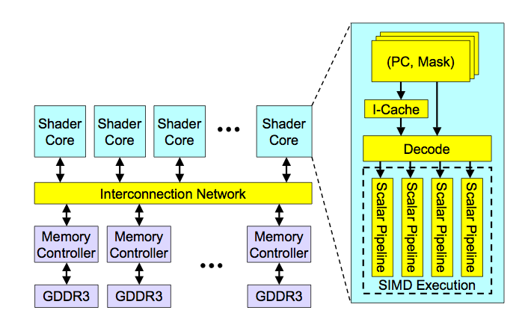
High-Level View of a GPU

Slide 7
Concept of “Thread Warps” and SIMT
Warp: A set of threads that execute the same instruction (on different data elements) → SIMT (Nvidia-speak)
All threads run the same code
Warp: The threads that run lengthwise in a woven fabric …
Thread Warp 3
Thread Warp 8
Thread Warp
Common PC
Scalar
Scalar
Scalar
Scalar
Thread Warp 7
Thread
Thread
Thread
Thread
W
X
Y
Z
SIMD Pipeline
Notes:
In SIMD, you need to specify the data array + an instruction (on which to operate the data on) + THE INSTRUCTION WIDTH. Eg: You might want to add 2 integer arrays of length 16, then a SIMD instruction would look like (the instruction has been cooked-up by me for demo) add.16 arr1 arr2 However, SIMT doesn't bother about the instruction width. So, essentially, you could write the above example as: arr1[i] + arr2[i] and then launch as many threads as the length of the array, as you want. Note that, if the array size was, let us say, 32, then SIMD EXPECTS you to explicitly call two such 'add.16' instructions! Whereas, this is not the case with SIMT.

Slide 8
Loop Iterations as Threads
for (i=0; i < N; i++)
C[i] = A[i] + B[i];
Scalar Sequential Code
Vectorized Code
load
load
load
Iter. 1
load
load
load
Time
add
add
add
store
store
store
load
Iter. 1
Iter. 2
Iter. 2
load
Vector Instruction
add
store
Slide credit: Krste Asanovic

Slide 9
SIMT Memory Access
Same instruction in different threads uses thread id to index and access different data elements
Let’s assume N=16, blockDim=4 → 4 blocks
0
1
2
3
4
5
6
7
8
9
10
11
12
13
14
15
+
0
1
2
3
4
5
6
7
8
9
10
11
12
13
14
15
+
+
+
+
Slide credit: Hyesoon Kim

Slide 10
Sample GPU SIMT Code (Simplified)
CPU code
for (ii = 0; ii < 100; ++ii) {
C[ii] = A[ii] + B[ii];
}
CUDA code
// there are 100 threads
__global__ void KernelFunction(…) {
int tid = blockDim.x * blockIdx.x + threadIdx.x;
int varA = aa[tid];
int varB = bb[tid];
C[tid] = varA + varB;
}
Slide credit: Hyesoon Kim

Slide 11
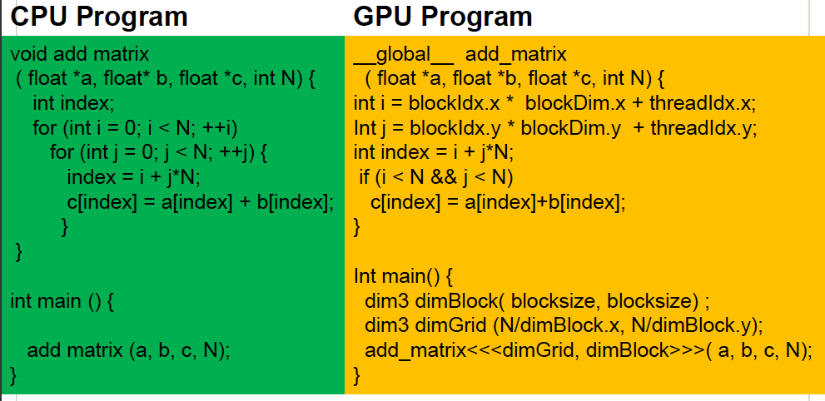
Sample GPU Program (Less Simplified)
Slide credit: Hyesoon Kim

Slide 12
Latency Hiding with “Thread Warps”
Warp: A set of threads that execute the same instruction (on different data elements)
Fine-grained multithreading
One instruction per thread in pipeline at a time (No branch prediction)
Interleave warp execution to hide latencies
Register values of all threads stay in register file
FGMT enables long latency tolerance
Graphics has millions of pixels
Thread Warp 3
Warps available
Thread Warp 8
for scheduling
Thread Warp 7
SIMD Pipeline
I-Fetch
Decode
R
R
R
F
F
F
Warps accessing
A
A
A
memory hierarchy
L
L
L
U
U
U
Miss?
D-Cache
Thread Warp 1
All Hit?
Data
Thread Warp 2
Writeback
Thread Warp 6
Slide credit: Tor Aamodt
Notes:
With a large number of shader threads multiplexed on the same execution re- sources, our architecture employs fine-grained multithreading where individual threads are interleaved by the fetch unit to proactively hide the potential latency of stalls before they occur. As illustrated by Figure, warps are issued fairly in a round-robin queue. When a thread is blocked by a memory request, shader core simply removes that thread’s warp from the pool of “ready” warps and thereby allows other threads to proceed while the memory system processes its request.
With a large number of threads (1024 per shader core) interleaved on the same pipeline, FGMT effectively hides the latency of most memory operations since the pipeline is occupied with instructions from other threads while memory operations complete. also hides the pipeline latency so that data bypassing logic can potentially be omitted to save area with minimal impact on performance. simplify the dependency check logic design by restricting each thread to have at most one instruction running in the pipeline at any time.

Slide 13
Warp-based SIMD vs. Traditional SIMD
Traditional SIMD contains a single thread
Lock step
Programming model is SIMD (no threads) → SW needs to know vector length
ISA contains vector/SIMD instructions
Warp-based SIMD consists of multiple scalar threads executing in a SIMD manner (i.e., same instruction executed by all threads)
Does not have to be lock step
Each thread can be treated individually (i.e., placed in a different warp) → programming model not SIMD
SW does not need to know vector length
Enables memory and branch latency tolerance
ISA is scalar → vector instructions formed dynamically
Essentially, it is SPMD programming model implemented on SIMD hardware

Slide 14
SPMD
Single procedure/program, multiple data
This is a programming model rather than computer organization
Each processing element executes the same procedure, except on different data elements
Procedures can synchronize at certain points in program, e.g. barriers
Essentially, multiple instruction streams execute the same program
Each program/procedure can 1) execute a different control-flow path, 2) work on different data, at run-time
Many scientific applications are programmed this way and run on MIMD computers (multiprocessors)
Modern GPUs programmed in a similar way on a SIMD computer

Slide 15
Branch Divergence Problem in Warp-based SIMD
SPMD Execution on SIMD Hardware
NVIDIA calls this “Single Instruction, Multiple Thread” (“SIMT”) execution
A
Thread Warp
Common PC
B
Thread
1
Thread
2
Thread
3
Thread
4
C
D
F
E
G
Slide credit: Tor Aamodt

Slide 16
Control Flow Problem in GPUs/SIMD
GPU uses SIMD pipeline to save area on control logic.
Group scalar threads into warps
Branch divergence occurs when threads inside warps branch to different execution paths.
Branch
Branch
Path A
Path A
Path B
Path B
Slide credit: Tor Aamodt

Slide 17
Branch Divergence Handling (I)
Stack
A
A/1111
Reconv. PC
Next PC
Active Mask
TOS
TOS
TOS
TOS
-
-
-
-
-
-
-
G
A
E
E
B
E
E
1111
1111
1111
1111
1111
1111
1111
E
E
D
D
0110
TOS
E
D
0110
0110
B
B/1111
TOS
TOS
E
E
C
E
1001
1001
C/1001
D/0110
C
D
F
Thread Warp
Common PC
E
E/1111
Thread
1
Thread
2
Thread
3
Thread
4
G
G/1111
A
B
C
D
E
G
A
Time
Slide credit: Tor Aamodt

Slide 18
Branch Divergence Handling (II)
A;
if (some condition) {
B;
} else {
C;
}
D;
One per warp
Control Flow Stack
Next PC
Recv PC
Amask
TOS
A
D
--
--
1111
1111
B
D
1110
A
C
D
D
0001
Execution Sequence
B
C
A
C
B
D
1
1
1
1
0
0
0
1
1
1
1
0
1
1
1
1
D
Time
Slide credit: Tor Aamodt

Slide 19
Dynamic Warp Formation/Merging
Idea: Dynamically merge threads executing the same instruction (after branch divergence)
Form new warp at divergence
Enough threads branching to each path to create full new warps

Slide 20
Dynamic Warp Formation/Merging
Idea: Dynamically merge threads executing the same instruction (after branch divergence)
Fung et al., “Dynamic Warp Formation and Scheduling for Efficient GPU Control Flow,” MICRO 2007.
Branch
Branch
Path A
Path A
Path B

Slide 21
Dynamic Warp Formation Example
A
x/1111
y/1111
Legend
B
A
A
x/1110
y/0011
Execution of Warp x
Execution of Warp y
at Basic Block A
at Basic Block A
C
x/1000
D
x/0110
F
x/0001
y/0010
y/0001
y/1100
D
E
A new warp created from scalar threads of both Warp x and y executing at Basic Block D
x/1110
y/0011
G
x/1111
y/1111
A
A
B
B
C
C
D
D
E
E
F
F
G
G
A
A
Baseline
Time
Dynamic
Warp
Formation
A
A
B
B
C
D
E
E
F
G
G
A
A
Time
Slide credit: Tor Aamodt

Slide 22
What About Memory Divergence?
Modern GPUs have caches
Ideally: Want all threads in the warp to hit (without conflicting with each other)
Problem: One thread in a warp can stall the entire warp if it misses in the cache.
Need techniques to
Tolerate memory divergence
Integrate solutions to branch and memory divergence

Slide 23
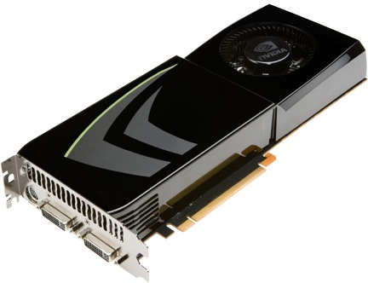
NVIDIA GeForce GTX 285
NVIDIA-speak:
240 stream processors
“SIMT execution”
Generic speak:
30 cores
8 SIMD functional units per core
Slide credit: Kayvon Fatahalian

Slide 24
NVIDIA GeForce GTX 285 “core”
64 KB of storage
for fragment contexts (registers)
…
= SIMD functional unit, control
shared across 8 units
= instruction stream decode
= multiply-add
= execution context storage
= multiply
Slide credit: Kayvon Fatahalian
Notes:
30 * 32 * 32 = 30 * 1024 = 30K fragments
64KB register file = 16 32-bit registers per thread = 64B (1/32 that of LRB)
16KB of shared scratch
80KB / core available to software

Slide 25
NVIDIA GeForce GTX 285 “core”
64 KB of storage
for thread contexts (registers)
…
Groups of 32 threads share instruction stream (each group is a Warp)
Up to 32 warps are simultaneously interleaved
Up to 1024 thread contexts can be stored
Slide credit: Kayvon Fatahalian
Notes:
To get maximal latency hiding:
Run 1/32 of the time
16 words per thread = 64B

Slide 26
NVIDIA GeForce GTX 285
Tex
Tex
…
…
…
…
…
…
Tex
Tex
…
…
…
…
…
…
Tex
Tex
…
…
…
…
…
…
Tex
Tex
…
…
…
…
…
…
Tex
Tex
…
…
…
…
…
…
30 cores on the GTX 285: 30,720 threads
Slide credit: Kayvon Fatahalian
Notes:
If you’re running a CUDA program, and your not launching 30K threads, you are certainly not getting full latency hiding, and you might not be using the GPU well

Slide 27
VLIW and DAE

Slide 28
Remember: SIMD/MIMD Classification of Computers
Mike Flynn, “Very High Speed Computing Systems,” Proc. of the IEEE, 1966
SISD: Single instruction operates on single data element
SIMD: Single instruction operates on multiple data elements
Array processor
Vector processor
MISD? Multiple instructions operate on single data element
Closest form: systolic array processor?
MIMD: Multiple instructions operate on multiple data elements (multiple instruction streams)
Multiprocessor
Multithreaded processor

Slide 29
SISD Parallelism Extraction Techniques
We have already seen
Superscalar execution
Out-of-order execution
Are there simpler ways of extracting SISD parallelism?
VLIW (Very Long Instruction Word)
Decoupled Access/Execute

Slide 30
VLIW

Slide 31
VLIW (Very Long Instruction Word)
A very long instruction word consists of multiple independent instructions packed together by the compiler
Packed instructions can be logically unrelated (contrast with SIMD)
Idea: Compiler finds independent instructions and statically schedules (i.e. packs/bundles) them into a single VLIW instruction
Traditional Characteristics
Multiple functional units
Each instruction in a bundle executed in lock step
Instructions in a bundle statically aligned to be directly fed into the functional units

Slide 32
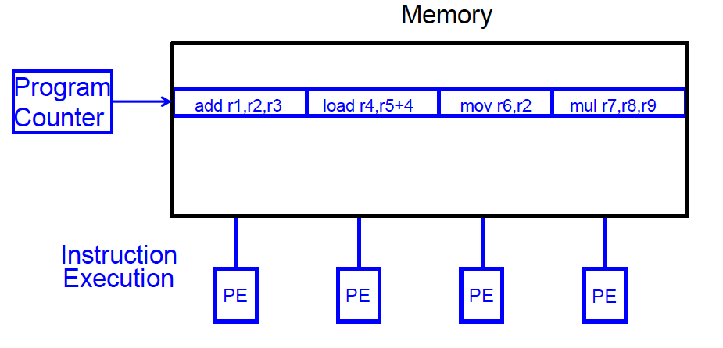
VLIW Concept
Fisher, “Very Long Instruction Word architectures and the ELI-512,” ISCA 1983.
ELI: Enormously longword instructions (512 bits)

Slide 33
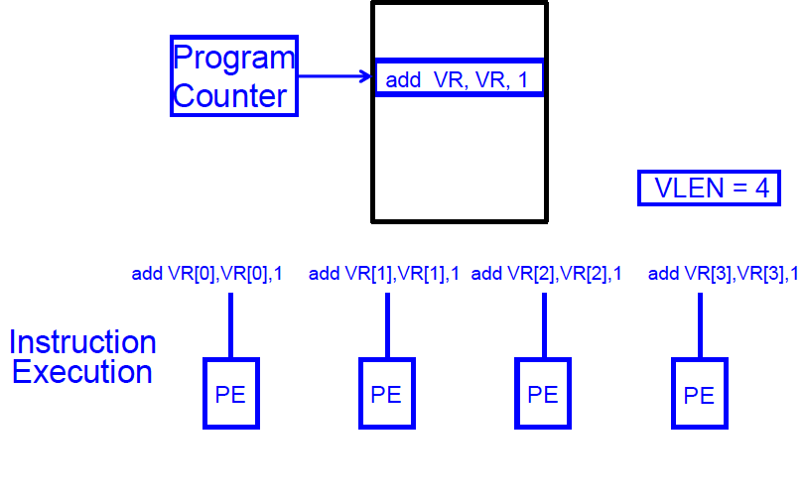
SIMD Array Processing vs. VLIW
Array processor

Slide 34
VLIW Philosophy
Philosophy similar to RISC (simple instructions and hardware)
Except multiple instructions in parallel
RISC (John Cocke, 1970s, IBM 801 minicomputer)
Compiler does the hard work to translate high-level language code to simple instructions (John Cocke: control signals)
And, to reorder simple instructions for high performance
Hardware does little translation/decoding → very simple
VLIW (Fisher, ISCA 1983)
Compiler does the hard work to find instruction level parallelism
Hardware stays as simple and streamlined as possible
Executes each instruction in a bundle in lock step
Simple → higher frequency, easier to design

Slide 35
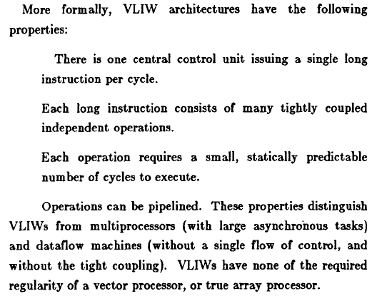
VLIW Philosophy (II)
Fisher, “Very Long Instruction Word architectures and the ELI-512,” ISCA 1983.

Slide 36
Commercial VLIW Machines
Multiflow TRACE, Josh Fisher (7-wide, 28-wide)
Cydrome Cydra 5, Bob Rau
Transmeta Crusoe: x86 binary-translated into internal VLIW
TI C6000, Trimedia, STMicro (DSP & embedded processors)
Most successful commercially
Intel IA-64
Not fully VLIW, but based on VLIW principles
EPIC (Explicitly Parallel Instruction Computing)
Instruction bundles can have dependent instructions
A few bits in the instruction format specify explicitly which instructions in the bundle are dependent on which other ones

Slide 37
VLIW Tradeoffs
Advantages
+ No need for dynamic scheduling hardware → simple hardware
+ No need for dependency checking within a VLIW instruction → simple hardware for multiple instruction issue + no renaming
+ No need for instruction alignment/distribution after fetch to different functional units → simple hardware
Disadvantages
-- Compiler needs to find N independent operations
-- If it cannot, inserts NOPs in a VLIW instruction
-- Parallelism loss AND code size increase
-- Recompilation required when execution width (N), instruction latencies, functional units change (Unlike superscalar processing)
-- Lockstep execution causes independent operations to stall
-- No instruction can progress until the longest-latency instruction completes

Slide 38
VLIW Summary
VLIW simplifies hardware, but requires complex compiler techniques
Solely-compiler approach of VLIW has several downsides that reduce performance
-- Too many NOPs (not enough parallelism discovered)
-- Static schedule intimately tied to microarchitecture
-- Code optimized for one generation performs poorly for next
-- No tolerance for variable or long-latency operations (lock step)
++ Most compiler optimizations developed for VLIW employed in optimizing compilers (for superscalar compilation)
Enable code optimizations
++ VLIW successful in embedded markets, e.g. DSP

Slide 39
DAE

Slide 40
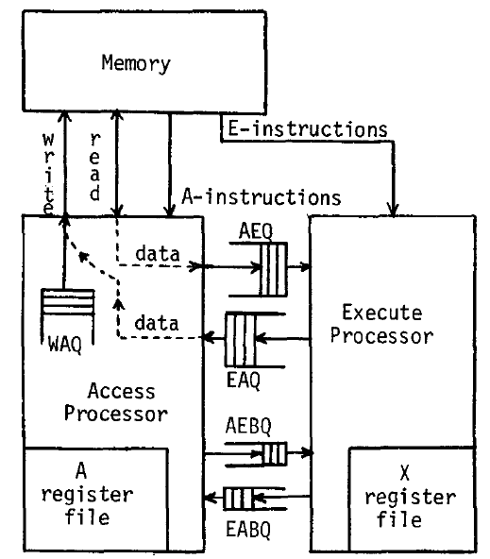
Decoupled Access/Execute
Motivation: Tomasulo’s algorithm too complex to implement
1980s before HPS, Pentium Pro
Idea: Decouple operand
access and execution via
two separate instruction
streams that communicate
via ISA-visible queues.
Smith, “Decoupled Access/Execute
Computer Architectures,” ISCA 1982,
ACM TOCS 1984.

Slide 41
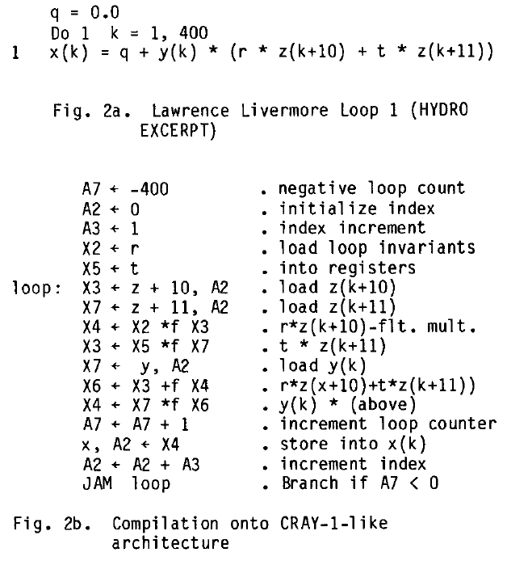
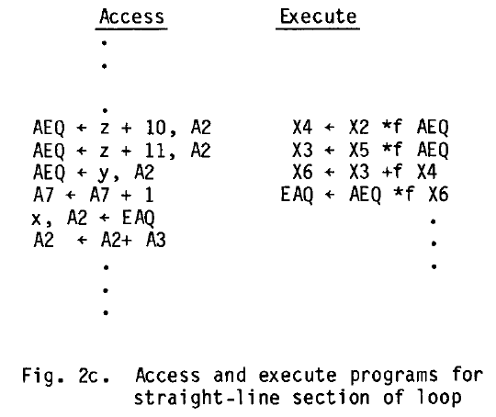
Decoupled Access/Execute (II)
Compiler generates two instruction streams (A and E)
Synchronizes the two upon control flow instructions (using branch queues)

Slide 42
Decoupled Access/Execute (III)
Advantages:
+ Execute stream can run ahead of the access stream and vice versa
+ If A takes a cache miss, E can perform useful work
+ If A hits in cache, it supplies data to lagging E
+ Queues reduce the number of required registers
+ Limited out-of-order execution without wakeup/select complexity
Disadvantages:
-- Compiler support to partition the program and manage queues
-- Determines the amount of decoupling
-- Branch instructions require synchronization between A and E
-- Multiple instruction streams (can be done with a single one, though)

Slide 43
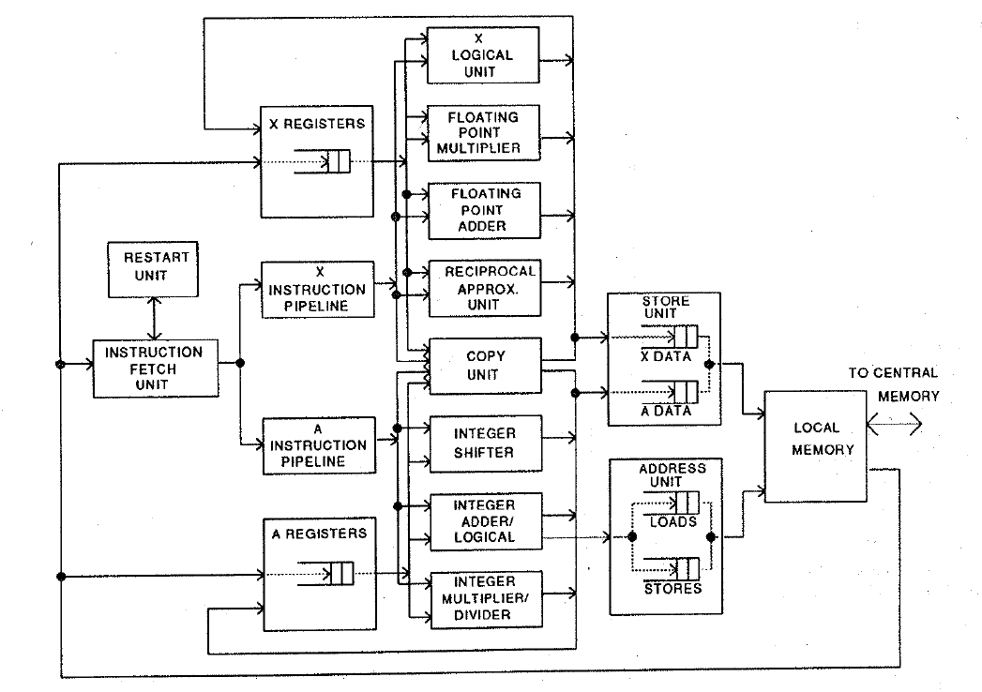
Astronautics ZS-1
Single stream steered into A and X pipelines
Each pipeline in-order
Smith et al., “The ZS-1 central processor,” ASPLOS 1987.
Smith, “Dynamic Instruction Scheduling and the Astronautics ZS-1,” IEEE Computer 1989.

Slide 44
Astronautics ZS-1 Instruction Scheduling
Dynamic scheduling
A and X streams are issued/executed independently
Loads can bypass stores in the memory unit (if no conflict)
Branches executed early in the pipeline
To reduce synchronization penalty of A/X streams
Works only if the register a branch sources is available
Static scheduling
Move compare instructions as early as possible before a branch
So that branch source register is available when branch is decoded
Reorder code to expose parallelism in each stream
Loop unrolling:
Reduces branch count + exposes code reordering opportunities

Slide 45
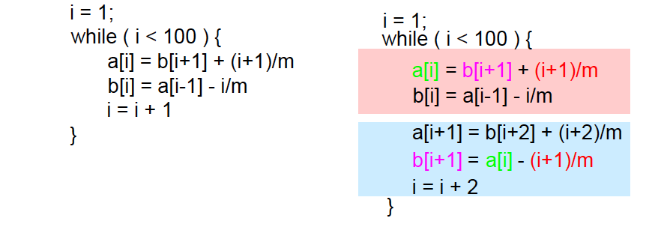
Loop Unrolling
Idea: Replicate loop body multiple times within an iteration
+ Reduces loop maintenance overhead
Induction variable increment or loop condition test
+ Enlarges basic block (and analysis scope)
Enables code optimization and scheduling opportunities
-- What if iteration count not a multiple of unroll factor? (need extra code to detect this)
-- Increases code size

Slide 46
Systolic Arrays

Slide 47
Why Systolic Architectures?
Idea: Data flows from the computer memory in a rhythmic fashion, passing through many processing elements before it returns to memory
Similar to an assembly line
Different people work on the same car
Many cars are assembled simultaneously
Can be two-dimensional
Why? Special purpose accelerators/architectures need
Simple, regular designs (keep # unique parts small and regular)
High concurrency → high performance
Balanced computation and I/O (memory access)

Slide 48
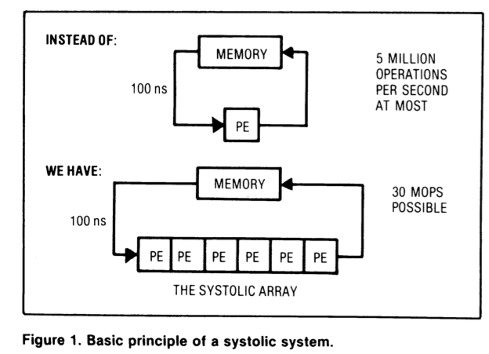
Systolic Architectures
H. T. Kung, “Why Systolic Architectures?,” IEEE Computer 1982.
Memory: heart
PEs: cells
Memory pulses
data through
cells

Slide 49
Systolic Architectures
Basic principle: Replace a single PE with a regular array of PEs and carefully orchestrate flow of data between the PEs → achieve high throughput w/o increasing memory bandwidth requirements
Differences from pipelining:
Array structure can be non-linear and multi-dimensional
PE connections can be multidirectional (and different speed)
PEs can have local memory and execute kernels (rather than a piece of the instruction)

Slide 50
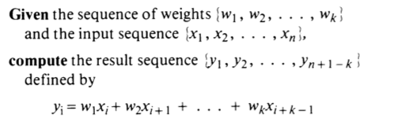
Systolic Computation Example
Convolution
Used in filtering, pattern matching, correlation, polynomial evaluation, etc …
Many image processing tasks

Slide 51
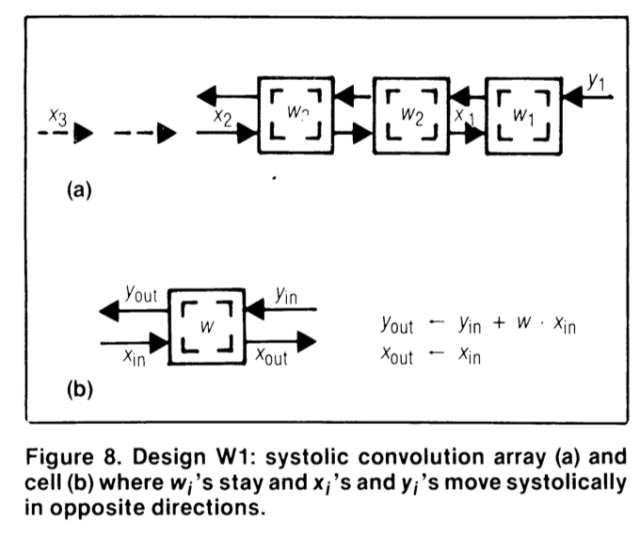
Systolic Computation Example: Convolution
y1 = w1x1 + w2x2 + w3x3
y2 = w1x2 + w2x3 + w3x4
y3 = w1x3 + w2x4 + w3x5

Slide 52
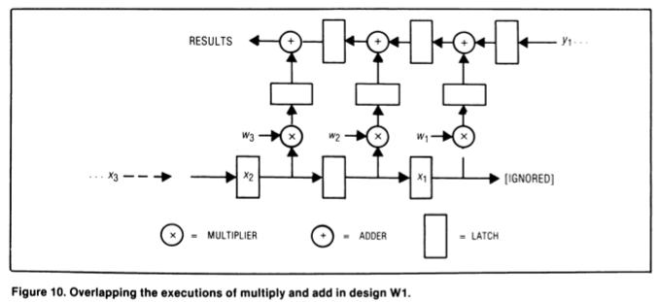
Systolic Computation Example: Convolution
Worthwhile to implement adder and multiplier separately to allow overlapping of add/mul executions

Slide 53
More Programmability
Each PE in a systolic array
Can store multiple “weights”
Weights can be selected on the fly
Eases implementation of, e.g., adaptive filtering
Taken further
Each PE can have its own data and instruction memory
Data memory → to store partial/temporary results, constants
Leads to stream processing, pipeline parallelism
More generally, staged execution

Slide 54
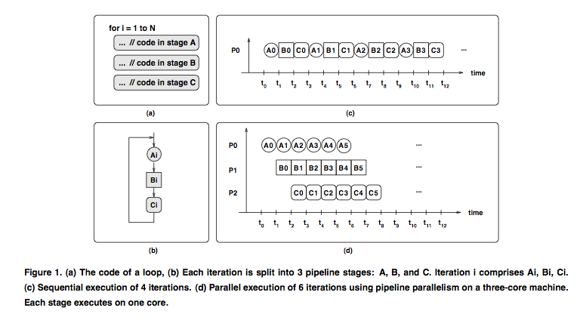
Pipeline Parallelism

Slide 55
File Compression Example

Slide 56
Systolic Array
Advantages
Makes multiple uses of each data item → reduced need for fetching/refetching
High concurrency
Regular design (both data and control flow)
Disadvantages
Not good at exploiting irregular parallelism
Relatively special purpose → need software, programmer support to be a general purpose model

Slide 57
The WARP Computer
HT Kung, CMU, 1984-1988
Linear array of 10 cells, each cell a 10 Mflop programmable processor
Attached to a general purpose host machine
HLL and optimizing compiler to program the systolic array
Used extensively to accelerate vision and robotics tasks
Annaratone et al., “Warp Architecture and Implementation,” ISCA 1986.
Annaratone et al., “The Warp Computer: Architecture, Implementation, and Performance,” IEEE TC 1987.

Slide 58
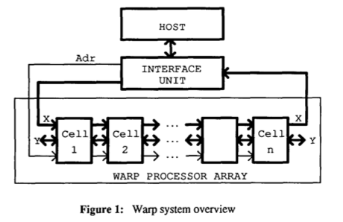
The WARP Computer

Slide 59
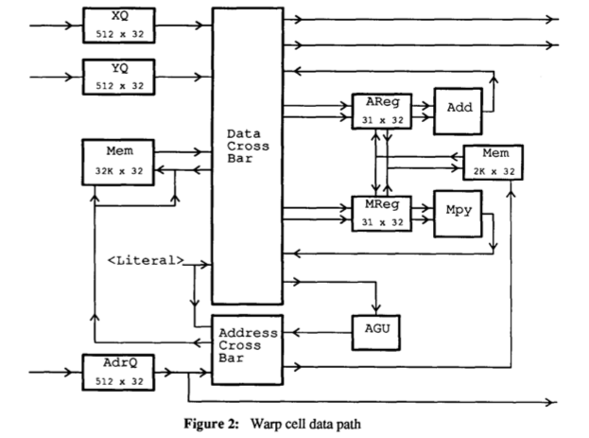
The WARP Computer

Slide 60
Systolic Arrays vs. SIMD
Food for thought…

Slide 61
Some More Recommended Readings
Recommended:
Fisher, “Very Long Instruction Word architectures and the ELI-512,” ISCA 1983.
Huck et al., “Introducing the IA-64 Architecture,” IEEE Micro 2000.
Russell, “The CRAY-1 computer system,” CACM 1978.
Rau and Fisher, “Instruction-level parallel processing: history, overview, and perspective,” Journal of Supercomputing, 1993.
Faraboschi et al., “Instruction Scheduling for Instruction Level Parallel Processors,” Proc. IEEE, Nov. 2001.

