Slide 1
18-447 Computer Architecture Lecture 10: Branch Handling and Branch Prediction (II)
Prof. Onur Mutlu
Carnegie Mellon University
Spring 2014, 2/5/2014

Slide 2
Announcements
No office hours today for me
Review Session and Recitation Friday during lecture – please bring questions and problems
Homework 1 and Lab 1 grades posted
Lab 2 due this Friday (Feb 7)
Do not forget the extra credit!
Suggestion: Be frugal with your late days
Homework 2 due next Wednesday (Feb 12)
Lab 3 available online (due Feb 21)

Slide 3
Readings for Next Few Lectures (I)
P&H Chapter 4.9-4.11
Smith and Sohi, “The Microarchitecture of Superscalar Processors,” Proceedings of the IEEE, 1995
More advanced pipelining
Interrupt and exception handling
Out-of-order and superscalar execution concepts
McFarling, “Combining Branch Predictors,” DEC WRL Technical Report, 1993.
Kessler, “The Alpha 21264 Microprocessor,” IEEE Micro 1999.

Slide 4
Readings for Next Few Lectures (II)
Smith and Plezskun, “Implementing Precise Interrupts in Pipelined Processors,” IEEE Trans on Computers 1988 (earlier version in ISCA 1985).

Slide 5
Review: More Sophisticated Direction Prediction
Compile time (static)
Always not taken
Always taken
BTFN (Backward taken, forward not taken)
Profile based (likely direction)
Program analysis based (likely direction)
Run time (dynamic)
Last time prediction (single-bit)
Two-bit counter based prediction
Two-level prediction (global vs. local)
Hybrid

Slide 6
Review: Importance of The Branch Problem
Assume a 5-wide superscalar pipeline with 20-cycle branch resolution latency
How long does it take to fetch 500 instructions?
Assume 1 out of 5 instructions is a branch
100% accuracy
100 cycles (all instructions fetched on the correct path)
No wasted work
99% accuracy
100 (correct path) + 20 (wrong path) = 120 cycles
20% extra instructions fetched
98% accuracy
100 (correct path) + 20 * 2 (wrong path) = 140 cycles
40% extra instructions fetched
95% accuracy
100 (correct path) + 20 * 5 (wrong path) = 200 cycles
100% extra instructions fetched

Slide 7
Can We Do Better?
Last-time and 2BC predictors exploit only “last-time” predictability for a given branch
Realization 1: A branch’s outcome can be correlated with other branches’ outcomes
Global branch correlation
Realization 2: A branch’s outcome can be correlated with past outcomes of the same branch (in addition to the outcome of the branch “last-time” it was executed)
Local branch correlation

Slide 8
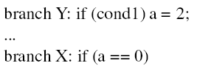
Global Branch Correlation (I)
Recently executed branch outcomes in the execution path is correlated with the outcome of the next branch
If first branch not taken, second also not taken
If first branch taken, second definitely not taken

Slide 9
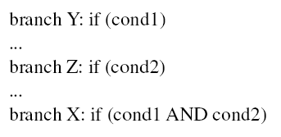
Global Branch Correlation (II)
If Y and Z both taken, then X also taken
If Y or Z not taken, then X also not taken

Slide 10
Global Branch Correlation (III)
Eqntott, SPEC 1992
if (aa==2) ;; B1
aa=0;
if (bb==2) ;; B2
bb=0;
if (aa!=bb) { ;; B3
….
}
If B1 is not taken (i.e., aa==0@B3) and B2 is not taken (i.e. bb=0@B3) then B3 is certainly taken

Slide 11
Capturing Global Branch Correlation
Idea: Associate branch outcomes with “global T/NT history” of all branches
Make a prediction based on the outcome of the branch the last time the same global branch history was encountered
Implementation:
Keep track of the “global T/NT history” of all branches in a register → Global History Register (GHR)
Use GHR to index into a table that recorded the outcome that was seen for each GHR value in the recent past → Pattern History Table (table of 2-bit counters)
Global history/branch predictor
Uses two levels of history (GHR + history at that GHR)

Slide 12
Two Level Global Branch Prediction
First level: Global branch history register (N bits)
The direction of last N branches
Second level: Table of saturating counters for each history entry
The direction the branch took the last time the same history was seen
Pattern History Table (PHT)
00 …. 00
1 1 ….. 1 0
00 …. 01
2
3
previous one
00 …. 10
GHR
(global history register)
index
0
1
11 …. 11
Yeh and Patt, “Two-Level Adaptive Training Branch Prediction,” MICRO 1991.

Slide 13
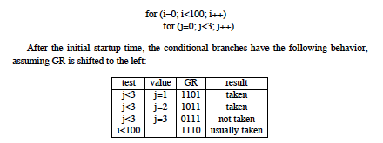
How Does the Global Predictor Work?
McFarling, “Combining Branch Predictors,” DEC WRL TR 1993.
Notes:
Start with j=3, last iteration that is not taken…

Slide 14
Intel Pentium Pro Branch Predictor
4-bit global history register
Multiple pattern history tables (of 2 bit counters)
Which pattern history table to use is determined by lower order bits of the branch address

Slide 15
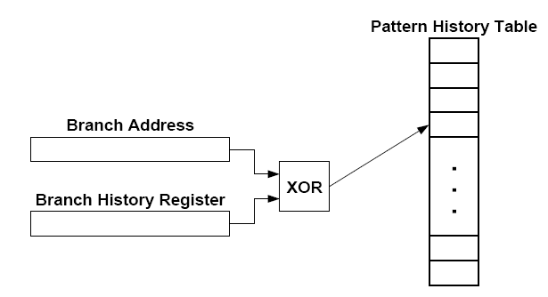
Improving Global Predictor Accuracy
Idea: Add more context information to the global predictor to take into account which branch is being predicted
Gshare predictor: GHR hashed with the Branch PC
+ More context information
+ Better utilization of PHT
-- Increases access latency
McFarling, “Combining Branch Predictors,” DEC WRL Tech Report, 1993.

Slide 16
Review: One-Level Branch Predictor
Direction predictor (2-bit counters)
taken?
PC + inst size
Next Fetch
Address
Program
Counter
hit?
Address of the
current instruction
target address
Cache of Target Addresses (BTB: Branch Target Buffer)

Slide 17
Two-Level Global History Branch Predictor
Which direction earlier
branches went
Direction predictor (2-bit counters)
taken?
Global branch
history
PC + inst size
Next Fetch
Address
Program
Counter
hit?
Address of the
current instruction
target address
Cache of Target Addresses (BTB: Branch Target Buffer)

Slide 18
Two-Level Gshare Branch Predictor
Which direction earlier
branches went
Direction predictor (2-bit counters)
taken?
Global branch
history
PC + inst size
Next Fetch
Address
XOR
Program
Counter
hit?
Address of the
current instruction
target address
Cache of Target Addresses (BTB: Branch Target Buffer)

Slide 19
Can We Do Better?
Last-time and 2BC predictors exploit only “last-time” predictability for a given branch
Realization 1: A branch’s outcome can be correlated with other branches’ outcomes
Global branch correlation
Realization 2: A branch’s outcome can be correlated with past outcomes of the same branch (in addition to the outcome of the branch “last-time” it was executed)
Local branch correlation

Slide 20
Local Branch Correlation
McFarling, “Combining Branch Predictors,” DEC WRL TR 1993.

Slide 21
Capturing Local Branch Correlation
Idea: Have a per-branch history register
Associate the predicted outcome of a branch with “T/NT history” of the same branch
Make a prediction based on the outcome of the branch the last time the same local branch history was encountered
Called the local history/branch predictor
Uses two levels of history (Per-branch history register + history at that history register value)

Slide 22
Two Level Local Branch Prediction
First level: A set of local history registers (N bits each)
Select the history register based on the PC of the branch
Second level: Table of saturating counters for each history entry
The direction the branch took the last time the same history was seen
Pattern History Table (PHT)
00 …. 00
1 1 ….. 1 0
00 …. 01
2
3
00 …. 10
index
0
1
Local history registers
11 …. 11
Yeh and Patt, “Two-Level Adaptive Training Branch Prediction,” MICRO 1991.

Slide 23
Two-Level Local History Branch Predictor
Which directions earlier instances of *this branch* went
Direction predictor (2-bit counters)
taken?
PC + inst size
Next Fetch
Address
Program
Counter
hit?
Address of the
current instruction
target address
Cache of Target Addresses (BTB: Branch Target Buffer)

Slide 24
Hybrid Branch Predictors
Idea: Use more than one type of predictor (i.e., multiple algorithms) and select the “best” prediction
E.g., hybrid of 2-bit counters and global predictor
Advantages:
+ Better accuracy: different predictors are better for different branches
+ Reduced warmup time (faster-warmup predictor used until the slower-warmup predictor warms up)
Disadvantages:
-- Need “meta-predictor” or “selector”
-- Longer access latency
McFarling, “Combining Branch Predictors,” DEC WRL Tech Report, 1993.

Slide 25
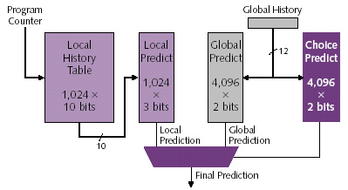
Alpha 21264 Tournament Predictor
Minimum branch penalty: 7 cycles
Typical branch penalty: 11+ cycles
48K bits of target addresses stored in I-cache
Predictor tables are reset on a context switch
Kessler, “The Alpha 21264 Microprocessor,” IEEE Micro 1999.

Slide 26
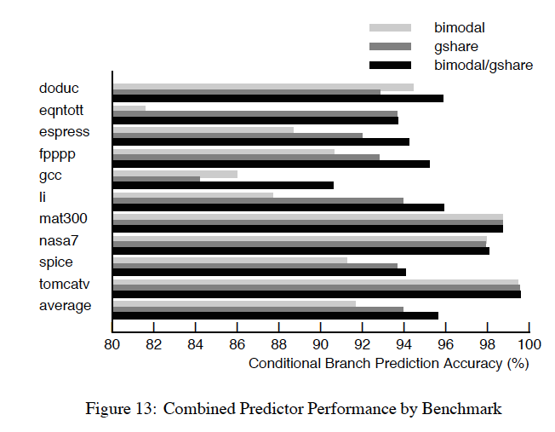
Branch Prediction Accuracy (Example)
Bimodal: table of 2bc indexed by branch address

Slide 27
Biased Branches
Observation: Many branches are biased in one direction (e.g., 99% taken)
Problem: These branches pollute the branch prediction structures → make the prediction of other branches difficult by causing “interference” in branch prediction tables and history registers
Solution: Detect such biased branches, and predict them with a simpler predictor
Chang et al., “Branch classification: a new mechanism for improving branch predictor performance,” MICRO 1994.

Slide 28
Some Other Branch Predictor Types
Loop branch detector and predictor
Works well for loops with small number of iterations, where iteration count is predictable
Perceptron branch predictor
Learns the direction correlations between individual branches
Assigns weights to correlations
Jimenez and Lin, “Dynamic Branch Prediction with Perceptrons,” HPCA 2001.
Geometric history length predictor
Your predictor?

Slide 29
How to Handle Control Dependences
Critical to keep the pipeline full with correct sequence of dynamic instructions.
Potential solutions if the instruction is a control-flow instruction:
Stall the pipeline until we know the next fetch address
Guess the next fetch address (branch prediction)
Employ delayed branching (branch delay slot)
Do something else (fine-grained multithreading)
Eliminate control-flow instructions (predicated execution)
Fetch from both possible paths (if you know the addresses of both possible paths) (multipath execution)

Slide 30
Review: Predicate Combining (not Predicated Execution)
Complex predicates are converted into multiple branches
if ((a == b) && (c < d) && (a > 5000)) { … }
3 conditional branches
Problem: This increases the number of control dependencies
Idea: Combine predicate operations to feed a single branch instruction
Predicates stored and operated on using condition registers
A single branch checks the value of the combined predicate
+ Fewer branches in code → fewer mipredictions/stalls
-- Possibly unnecessary work
-- If the first predicate is false, no need to compute other predicates
Condition registers exist in IBM RS6000 and the POWER architecture

Slide 31
Predication (Predicated Execution)
Idea: Compiler converts control dependence into data dependence → branch is eliminated
Each instruction has a predicate bit set based on the predicate computation
Only instructions with TRUE predicates are committed (others turned into NOPs)
(normal branch code)
(predicated code)
A
T
N
A
if (cond) {
b = 0;
}
else {
b = 1;
}
C
B
B
C
D
D
A
p1 = (cond)
branch p1, TARGET
A
p1 = (cond)
(!p1) mov b, 1
(p1) mov b, 0
B
B
mov b, 1
jmp JOIN
C
C
TARGET:
mov b, 0
D
add x, b, 1
D
add x, b, 1

Slide 32
Conditional Move Operations
Very limited form of predicated execution
CMOV R1 ← R2
R1 = (ConditionCode == true) ? R2 : R1
Employed in most modern ISAs (x86, Alpha)

Slide 33
Review: CMOV Operation
Suppose we had a Conditional Move instruction…
CMOV condition, R1 ← R2
R1 = (condition == true) ? R2 : R1
Employed in most modern ISAs (x86, Alpha)
Code example with branches vs. CMOVs
if (a == 5) {b = 4;} else {b = 3;}
CMPEQ condition, a, 5;
CMOV condition, b ← 4;
CMOV !condition, b ← 3;

Slide 34
Predicated Execution (II)
Predicated execution can be high performance and energy-efficient
Predicated Execution
A
Fetch Decode Rename Schedule RegisterRead Execute
C
B
F
E
E
F
D
F
D
E
F
C
A
B
A
E
F
C
D
B
F
D
E
B
C
A
F
E
C
D
A
B
E
D
B
C
A
D
C
A
B
C
B
A
B
A
E
A
A
F
D
E
F
C
D
E
B
C
D
A
B
A
C
D
A
B
B
A
C
C
B
nop
Branch Prediction
D
Fetch Decode Rename Schedule RegisterRead Execute
F
E
D
B
A
E
Pipeline flush!!
F

Slide 35
Predicated Execution (III)
Advantages:
+ Eliminates mispredictions for hard-to-predict branches
+ No need for branch prediction for some branches
+ Good if misprediction cost > useless work due to predication
+ Enables code optimizations hindered by the control dependency
+ Can move instructions more freely within predicated code
Disadvantages:
-- Causes useless work for branches that are easy to predict
-- Reduces performance if misprediction cost < useless work
-- Adaptivity: Static predication is not adaptive to run-time branch behavior. Branch behavior changes based on input set, program phase, control-flow path.
-- Additional hardware and ISA support
-- Cannot eliminate all hard to predict branches
-- Loop branches

Slide 36
Predicated Execution in Intel Itanium
Each instruction can be separately predicated
64 one-bit predicate registers
each instruction carries a 6-bit predicate field
An instruction is effectively a NOP if its predicate is false
cmp
p1 p2 ←cmp
br
p2
else1
else1
p1
then1
join1
else2
p1
then2
br
p2
else2
then1
join2
then2
join1
join2

Slide 37
Conditional Execution in the ARM ISA
Almost all ARM instructions can include an optional condition code.
An instruction with a condition code is executed only if the condition code flags in the CPSR meet the specified condition.

Slide 38
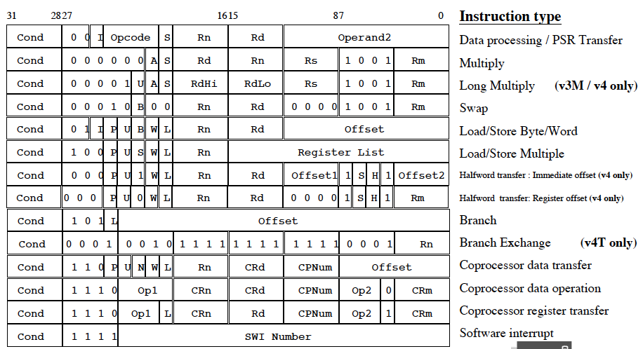
Conditional Execution in ARM ISA

Slide 39
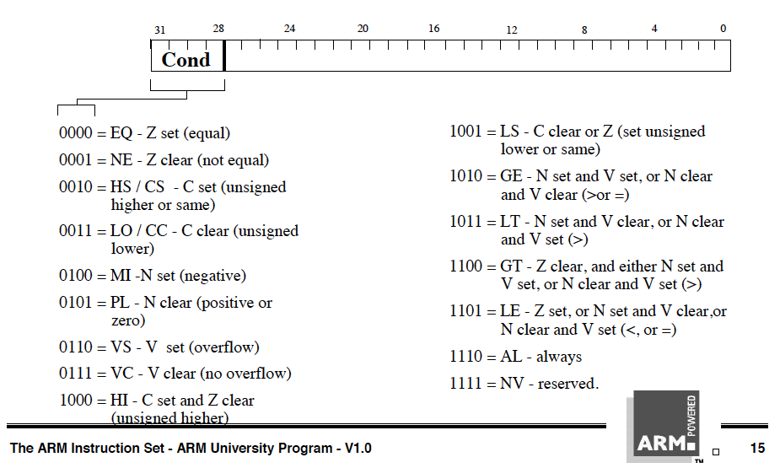
Conditional Execution in ARM ISA

Slide 40
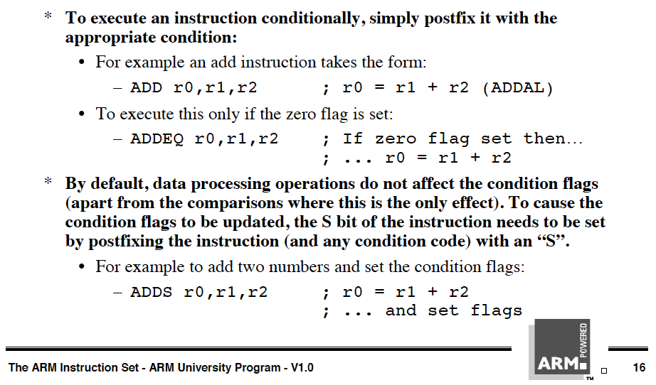
Conditional Execution in ARM ISA

Slide 41
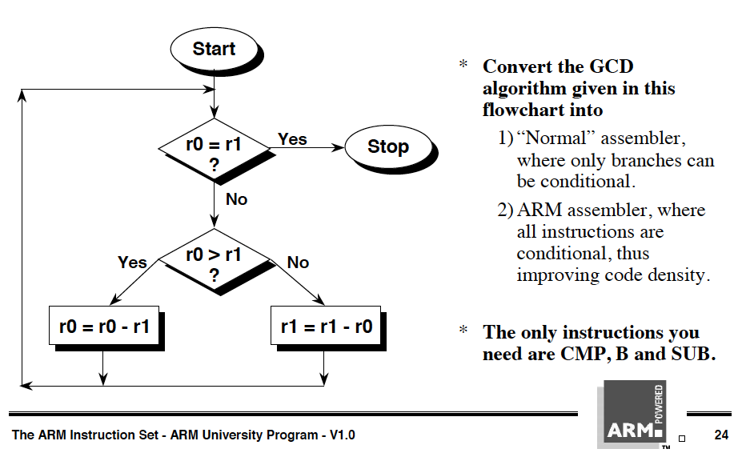
Conditional Execution in ARM ISA

Slide 42
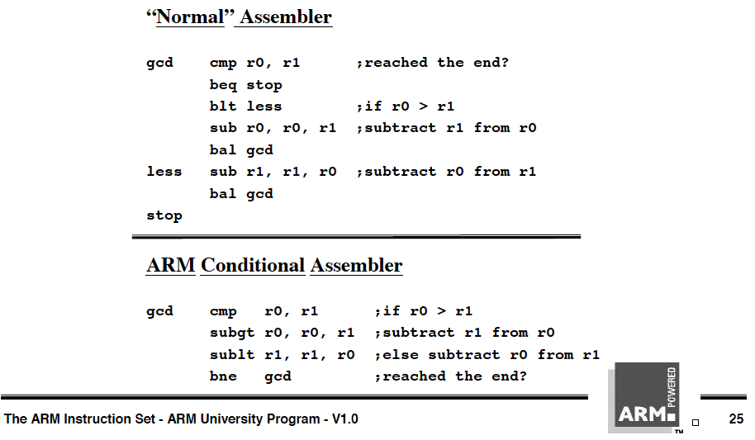
Conditional Execution in ARM ISA

Slide 43
Idealism
Wouldn’t it be nice
If the branch is eliminated (predicated) only when it would actually be mispredicted
If the branch were predicted when it would actually be correctly predicted
Wouldn’t it be nice
If predication did not require ISA support

Slide 44
Improving Predicated Execution
Three major limitations of predication
1. Adaptivity: non-adaptive to branch behavior
2. Complex CFG: inapplicable to loops/complex control flow graphs
3. ISA: Requires large ISA changes
Wish Branches [Kim+, MICRO 2005]
Solve 1 and partially 2 (for loops)
Dynamic Predicated Execution
Diverge-Merge Processor [Kim+, MICRO 2006]
Solves 1, 2 (partially), 3
A

Slide 45
Wish Branches
The compiler generates code (with wish branches) that can be executed either as predicated code or non-predicated code (normal branch code)
The hardware decides to execute predicated code or normal branch code at run-time based on the confidence of branch prediction
Easy to predict: normal branch code
Hard to predict: predicated code
Kim et al., “Wish Branches: Enabling Adaptive and Aggressive Predicated Execution,” MICRO 2006, IEEE Micro Top Picks, Jan/Feb 2006.

Slide 46
Wish Jump/Join
High Confidence
Low Confidence
A
wish jump
A
A
nop
T
N
B
B
Taken
wish join
Not-Taken
C
B
C
C
D
D
D
A
A
p1=(cond)
wish.jump p1 TARGET
A
p1 = (cond)
branch p1, TARGET
p1 = (cond)
(!p1) mov b,1
(p1) mov b,0
B
nop
(!p1) mov b,1
wish.join !p1 JOIN
B
B
(1) mov b,1
wish.join (1) JOIN
mov b, 1
jmp JOIN
C
C
TARGET:
(p1) mov b,0
C
TARGET:
(1) mov b,0
TARGET:
mov b,0
D
JOIN:
normal branch code
predicated code
wish jump/join code

Slide 47
Wish Branches vs. Predicated Execution
Advantages compared to predicated execution
Reduces the overhead of predication
Increases the benefits of predicated code by allowing the compiler to generate more aggressively-predicated code
Makes predicated code less dependent on machine configuration (e.g. branch predictor)
Disadvantages compared to predicated execution
Extra branch instructions use machine resources
Extra branch instructions increase the contention for branch predictor table entries
Constrains the compiler’s scope for code optimizations

Slide 48
How to Handle Control Dependences
Critical to keep the pipeline full with correct sequence of dynamic instructions.
Potential solutions if the instruction is a control-flow instruction:
Stall the pipeline until we know the next fetch address
Guess the next fetch address (branch prediction)
Employ delayed branching (branch delay slot)
Do something else (fine-grained multithreading)
Eliminate control-flow instructions (predicated execution)
Fetch from both possible paths (if you know the addresses of both possible paths) (multipath execution)

Slide 49
Multi-Path Execution
Idea: Execute both paths after a conditional branch
For all branches: Riseman and Foster, “The inhibition of potential parallelism by conditional jumps,” IEEE Transactions on Computers, 1972.
For a hard-to-predict branch: Use dynamic confidence estimation
Advantages:
+ Improves performance if misprediction cost > useless work
+ No ISA change needed
Disadvantages:
-- What happens when the machine encounters another hard-to-predict branch? Execute both paths again?
-- Paths followed quickly become exponential
-- Each followed path requires its own context (registers, PC, GHR)
-- Wasted work (and reduced performance) if paths merge

Slide 50
Dual-Path Execution versus Predication
Dual-path
Predicated Execution
A
Hard to predict
path 1
path 2
path 1
path 2
C
B
C
B
C
B
D
D
D
CFM
CFM
D
E
E
E
E
F
F
F
F

