Slide 1
18-447 Computer Architecture Lecture 15: Load/Store Handling and Data Flow
Prof. Onur Mutlu
Carnegie Mellon University
Spring 2014, 2/21/2014

Slide 2
Lab 4 Heads Up
Lab 4a out
Branch handling and branch predictors
Lab 4b will be out soon
Fine-grained multithreading
Due March 21st
You have 4 weeks!
Get started very early – Exam and S. Break are on the way
Finish Lab 4a first and check off
Finish Lab 4b next and check off
Do the extra credit

Slide 3
Lab 2 Extra Credit Recognition
1. Albert Cho (260/263)
2. Bailey Forrest (252/263)
3. Jeremie Kim (248/263)
4. Clement Loh (240/263)
5. Xiang Lin (184/263)

Slide 4
Readings Specifically for Today
Smith and Sohi, “The Microarchitecture of Superscalar Processors,” Proceedings of the IEEE, 1995
More advanced pipelining
Interrupt and exception handling
Out-of-order and superscalar execution concepts
Kessler, “The Alpha 21264 Microprocessor,” IEEE Micro 1999.

Slide 5
Readings for Next Lecture
SIMD Processing
Basic GPU Architecture
Other execution models: VLIW, Dataflow
Lindholm et al., "NVIDIA Tesla: A Unified Graphics and Computing Architecture," IEEE Micro 2008.
Fatahalian and Houston, “A Closer Look at GPUs,” CACM 2008.
Stay tuned for more readings…

Slide 6
Review: Out-of-Order Execution with Precise Exceptions
Hump 1: Reservation stations (scheduling window)
Hump 2: Reordering (reorder buffer, aka instruction window or active window)
TAG and VALUE Broadcast Bus
S
C
H
E
D
U
L
E
R
E
O
R
D
E
R
E
Integer add
Integer mul
F
D
E
E
E
E
W
FP mul
E
E
E
E
E
E
E
E
. . .
E
E
E
E
E
E
E
E
Load/store
in order
out of order
in order

Slide 7
Review: Summary of OOO Execution Concepts
Register renaming eliminates false dependencies, enables linking of producer to consumers
Buffering enables the pipeline to move for independent ops
Tag broadcast enables communication (of readiness of produced value) between instructions
Wakeup and select enables out-of-order dispatch

Slide 8
OOO Execution: Restricted Dataflow
An out-of-order engine dynamically builds the dataflow graph of a piece of the program
which piece?
The dataflow graph is limited to the instruction window
Instruction window: all decoded but not yet retired instructions
Can we do it for the whole program?
Why would we like to?
In other words, how can we have a large instruction window?
Can we do it efficiently with Tomasulo’s algorithm?

Slide 9
Dataflow Graph for Our Example
MUL R3 ← R1, R2
ADD R5 ← R3, R4
ADD R7 ← R2, R6
ADD R10 ← R8, R9
MUL R11 ← R7, R10
ADD R5 ← R5, R11

Slide 10
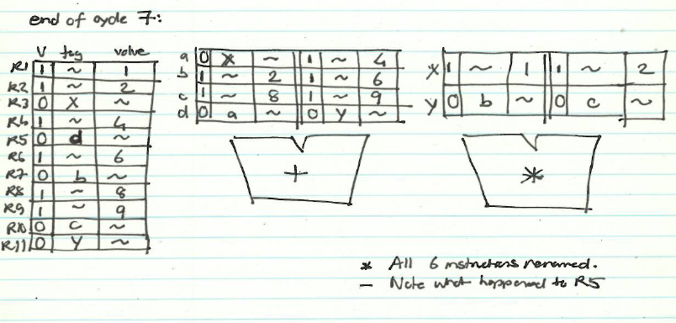
State of RAT and RS in Cycle 7

Slide 11
Dataflow Graph

Slide 12
Restricted Data Flow
An out-of-order machine is a “restricted data flow” machine
Dataflow-based execution is restricted to the microarchitecture level
ISA is still based on von Neumann model (sequential execution)
Remember the data flow model (at the ISA level):
Dataflow model: An instruction is fetched and executed in data flow order
i.e., when its operands are ready
i.e., there is no instruction pointer
Instruction ordering specified by data flow dependence
Each instruction specifies “who” should receive the result
An instruction can “fire” whenever all operands are received

Slide 13
Questions to Ponder
Why is OoO execution beneficial?
What if all operations take single cycle?
Latency tolerance: OoO execution tolerates the latency of multi-cycle operations by executing independent operations concurrently
What if an instruction takes 500 cycles?
How large of an instruction window do we need to continue decoding?
How many cycles of latency can OoO tolerate?
What limits the latency tolerance scalability of Tomasulo’s algorithm?
Active/instruction window size: determined by both scheduling window and reorder buffer size

Slide 14
Registers versus Memory, Revisited
So far, we considered register based value communication between instructions
What about memory?
What are the fundamental differences between registers and memory?
Register dependences known statically – memory dependences determined dynamically
Register state is small – memory state is large
Register state is not visible to other threads/processors – memory state is shared between threads/processors (in a shared memory multiprocessor)

Slide 15
Memory Dependence Handling (I)
Need to obey memory dependences in an out-of-order machine
and need to do so while providing high performance
Observation and Problem: Memory address is not known until a load/store executes
Corollary 1: Renaming memory addresses is difficult
Corollary 2: Determining dependence or independence of loads/stores need to be handled after their execution
Corollary 3: When a load/store has its address ready, there may be younger/older loads/stores with undetermined addresses in the machine

Slide 16
Memory Dependence Handling (II)
When do you schedule a load instruction in an OOO engine?
Problem: A younger load can have its address ready before an older store’s address is known
Known as the memory disambiguation problem or the unknown address problem
Approaches
Conservative: Stall the load until all previous stores have computed their addresses (or even retired from the machine)
Aggressive: Assume load is independent of unknown-address stores and schedule the load right away
Intelligent: Predict (with a more sophisticated predictor) if the load is dependent on the/any unknown address store

Slide 17
Handling of Store-Load Dependencies
A load’s dependence status is not known until all previous store addresses are available.
How does the OOO engine detect dependence of a load instruction on a previous store?
Option 1: Wait until all previous stores committed (no need to check)
Option 2: Keep a list of pending stores in a store buffer and check whether load address matches a previous store address
How does the OOO engine treat the scheduling of a load instruction wrt previous stores?
Option 1: Assume load dependent on all previous stores
Option 2: Assume load independent of all previous stores
Option 3: Predict the dependence of a load on an outstanding store

Slide 18
Memory Disambiguation (I)
Option 1: Assume load dependent on all previous stores
+ No need for recovery
-- Too conservative: delays independent loads unnecessarily
Option 2: Assume load independent of all previous stores
+ Simple and can be common case: no delay for independent loads
-- Requires recovery and re-execution of load and dependents on misprediction
Option 3: Predict the dependence of a load on an outstanding store
+ More accurate. Load store dependencies persist over time
-- Still requires recovery/re-execution on misprediction
Alpha 21264 : Initially assume load independent, delay loads found to be dependent
Moshovos et al., “Dynamic speculation and synchronization of data dependences,” ISCA 1997.
Chrysos and Emer, “Memory Dependence Prediction Using Store Sets,” ISCA 1998.

Slide 19
Memory Disambiguation (II)
Chrysos and Emer, “Memory Dependence Prediction Using Store Sets,” ISCA 1998.
Predicting store-load dependencies important for performance
Simple predictors (based on past history) can achieve most of the potential performance

Slide 20
Food for Thought for You
Many other design choices
Should reservation stations be centralized or distributed across functional units?
What are the tradeoffs?
Should reservation stations and ROB store data values or should there be a centralized physical register file where all data values are stored?
What are the tradeoffs?
Exactly when does an instruction broadcast its tag?
…

Slide 21
More Food for Thought for You
How can you implement branch prediction in an out-of-order execution machine?
Think about branch history register and PHT updates
Think about recovery from mispredictions
How to do this fast?
How can you combine superscalar execution with out-of-order execution?
These are different concepts
Concurrent renaming of instructions
Concurrent broadcast of tags
How can you combine superscalar + out-of-order + branch prediction?

Slide 22
Recommended Readings
Out-of-order execution processor designs
Kessler, “The Alpha 21264 Microprocessor,” IEEE Micro, March-April 1999.
Boggs et al., “The Microarchitecture of the Pentium 4 Processor,” Intel Technology Journal, 2001.
Yeager, “The MIPS R10000 Superscalar Microprocessor,” IEEE Micro, April 1996
Tendler et al., “POWER4 system microarchitecture,” IBM Journal of Research and Development, January 2002.

Slide 23
And More Readings…
Stark et al., “On Pipelining Dynamic Scheduling Logic,” MICRO 2000.
Brown et al., “Select-free Instruction Scheduling Logic,” MICRO 2001.
Palacharla et al., “Complexity-effective Superscalar Processors,” ISCA 1997.

Slide 24
Other Approaches to Concurrency (or Instruction Level Parallelism)

Slide 25
Approaches to (Instruction-Level) Concurrency
Pipelining
Out-of-order execution
Dataflow (at the ISA level)
SIMD Processing (Vector and array processors, GPUs)
VLIW
Decoupled Access Execute
Systolic Arrays

Slide 26
Data Flow: Exploiting Irregular Parallelism

Slide 27
Remember: State of RAT and RS in Cycle 7

Slide 28
Remember: Dataflow Graph

Slide 29
Review: More on Data Flow
In a data flow machine, a program consists of data flow nodes
A data flow node fires (fetched and executed) when all it inputs are ready
i.e. when all inputs have tokens
Data flow node and its ISA representation

Slide 30
Data Flow Nodes

Slide 31
Dataflow Nodes (II)
A small set of dataflow operators can be used to define a general programming language
Fork
Primitive Ops
Switch
Merge
+
T
T
T
F
T
F
⇒
+
T
T
T
F
T
F

Slide 32
Dataflow Graphs
{x = a + b;
y = b * 7
in
(x-y) * (x+y)}
b
a
1
+
2
*7
Values in dataflow graphs are represented as tokens
An operator executes when all its input tokens are present; copies of the result token are distributed to the destination operators
x
ip = 3
p = L
y
token
< ip , p , v >
3
-
4
+
instruction ptr
port
data
5
*
no separate control flow

Slide 33
Example Data Flow Program
OUT

Slide 34
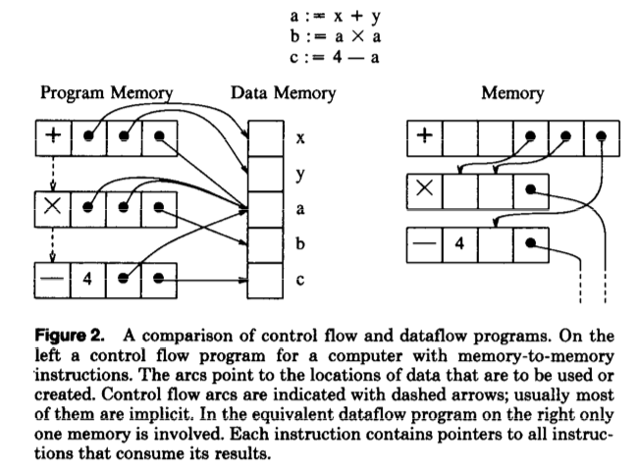
Control Flow vs. Data Flow

Slide 35
Data Flow Characteristics
Data-driven execution of instruction-level graphical code
Nodes are operators
Arcs are data (I/O)
As opposed to control-driven execution
Only real dependencies constrain processing
No sequential instruction stream
No program counter
Execution triggered by the presence/readiness of data
Operations execute asynchronously

Slide 36
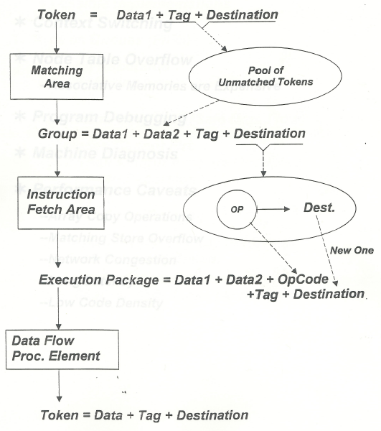
A Dataflow Processor

Slide 37
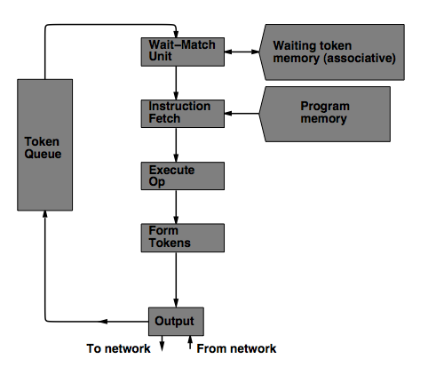
MIT Tagged Token Data Flow Architecture
Wait−Match Unit: try to match incoming token and context id and a waiting token with same instruction address
Success: Both tokens forwarded
Fail: Incoming token −−> Waiting Token Mem, bubble (no-op forwarded)

Slide 38
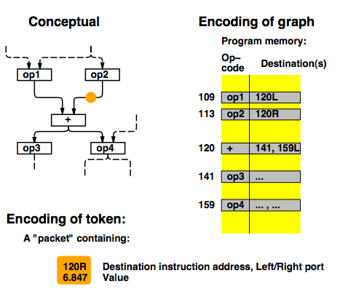
TTDA Data Flow Example

Slide 39
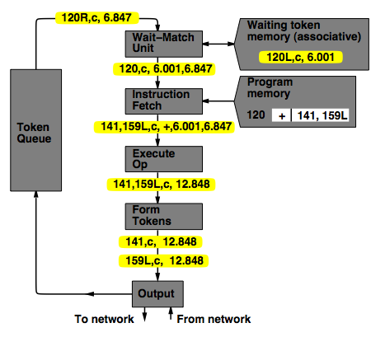
TTDA Data Flow Example

Slide 40
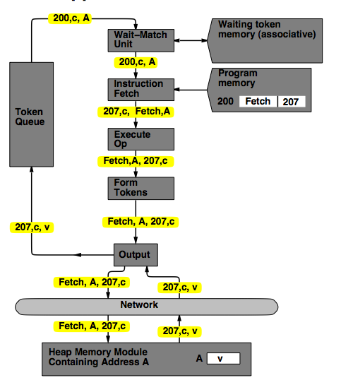
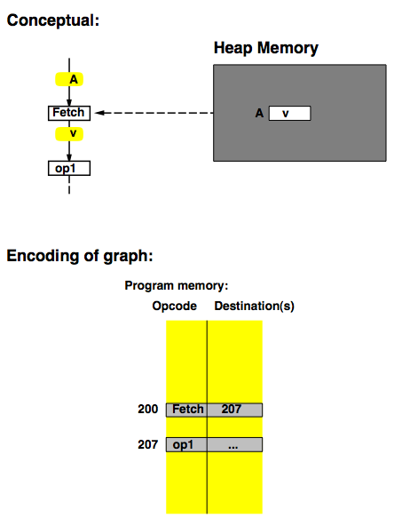
TTDA Data Flow Example

Slide 41
Manchester Data Flow Machine
Matching Store: Pairs together tokens destined for the same instruction
Large data set → overflow in overflow unit
Paired tokens fetch the appropriate instruction from the node store

Slide 42
Data Flow Advantages/Disadvantages
Advantages
Very good at exploiting irregular parallelism
Only real dependencies constrain processing
Disadvantages
No precise state
Debugging very difficult
Interrupt/exception handling is difficult
Bookkeeping overhead (tag matching)
Too much parallelism? (Parallelism control needed)
Overflow of tag matching tables
Implementing dynamic data structures difficult

Slide 43
Data Flow Summary
Availability of data determines order of execution
A data flow node fires when its sources are ready
Programs represented as data flow graphs (of nodes)
Data Flow at the ISA level has not been (as) successful
Data Flow implementations under the hood (while preserving sequential ISA semantics) have been very successful
Out of order execution
Hwu and Patt, “HPSm, a high performance restricted data flow architecture having minimal functionality,” ISCA 1986.

Slide 44
Further Reading on Data Flow
ISA level dataflow
Gurd et al., “The Manchester prototype dataflow computer,” CACM 1985.
Microarchitecture-level dataflow:
Hwu and Patt, “HPSm, a high performance restricted data flow architecture having minimal functionality,” ISCA 1986.

